Slide 1
STAGE MALTA
Ghigo e Gabriele

Slide 2
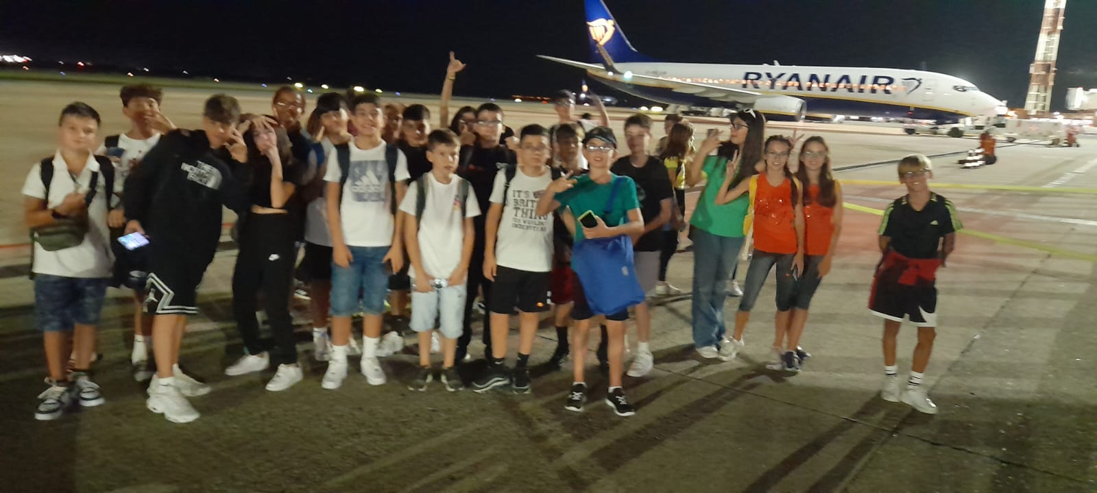
19 September:
Here we are at the airport while we were waiting to go on the plane.
We were very excited!

Slide 3
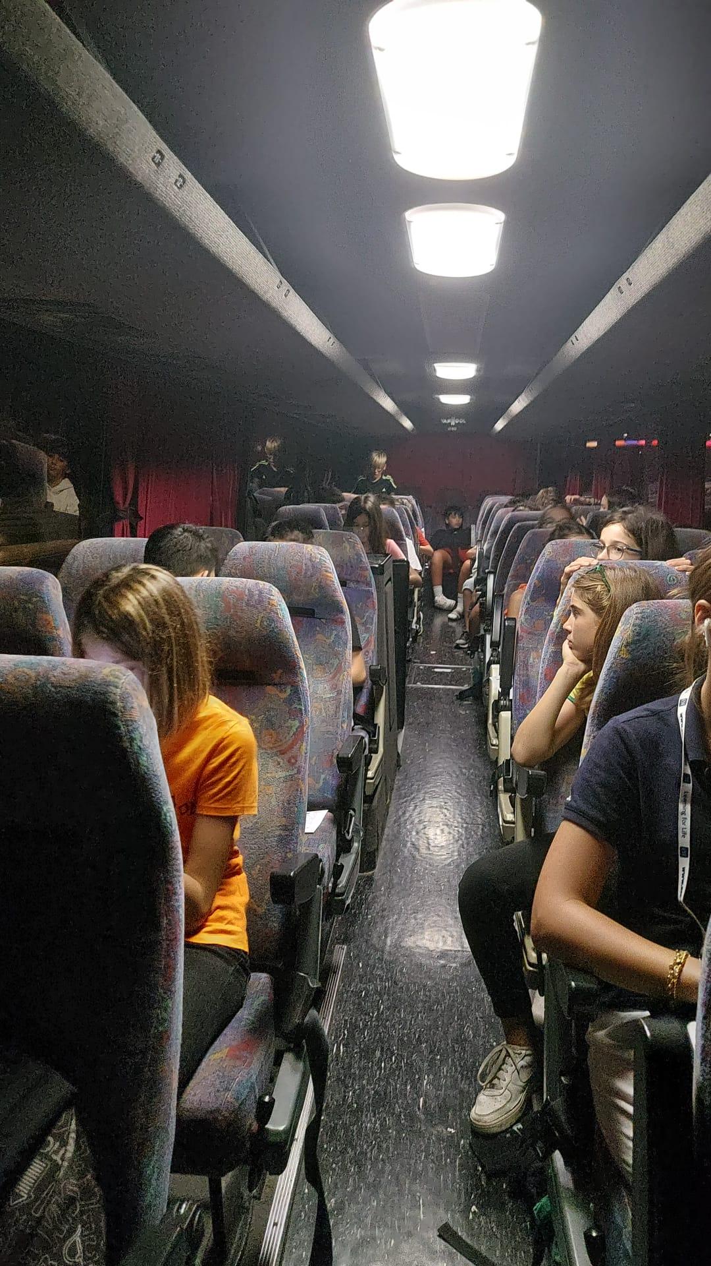
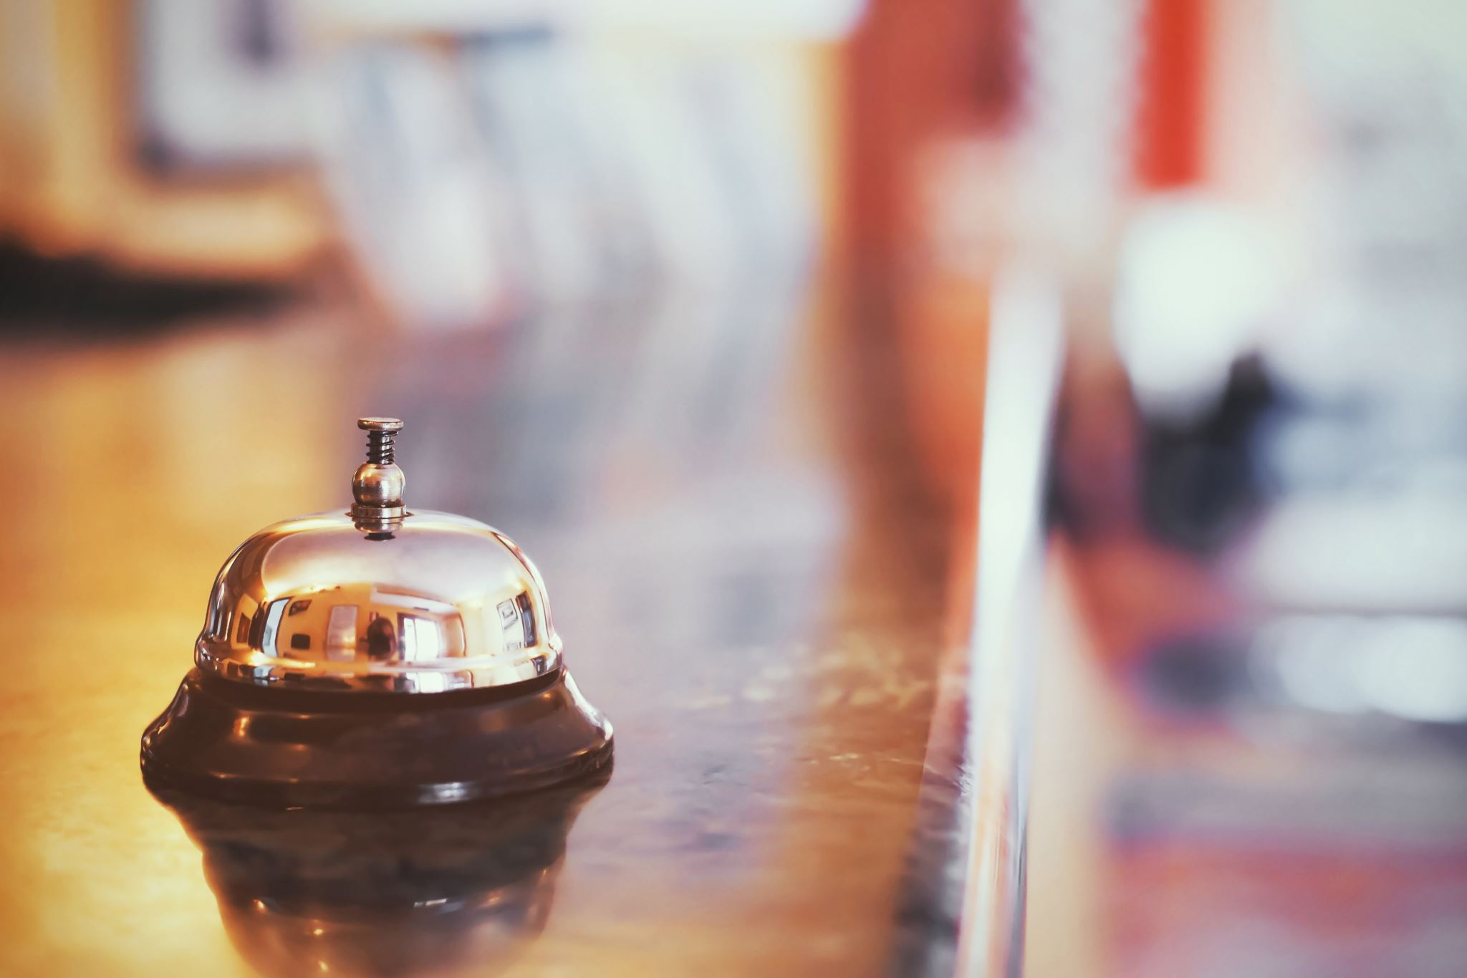
19 September:
We arrived in Malta really late by minibus,infact we were very tired when we went to the hotel.

Slide 4
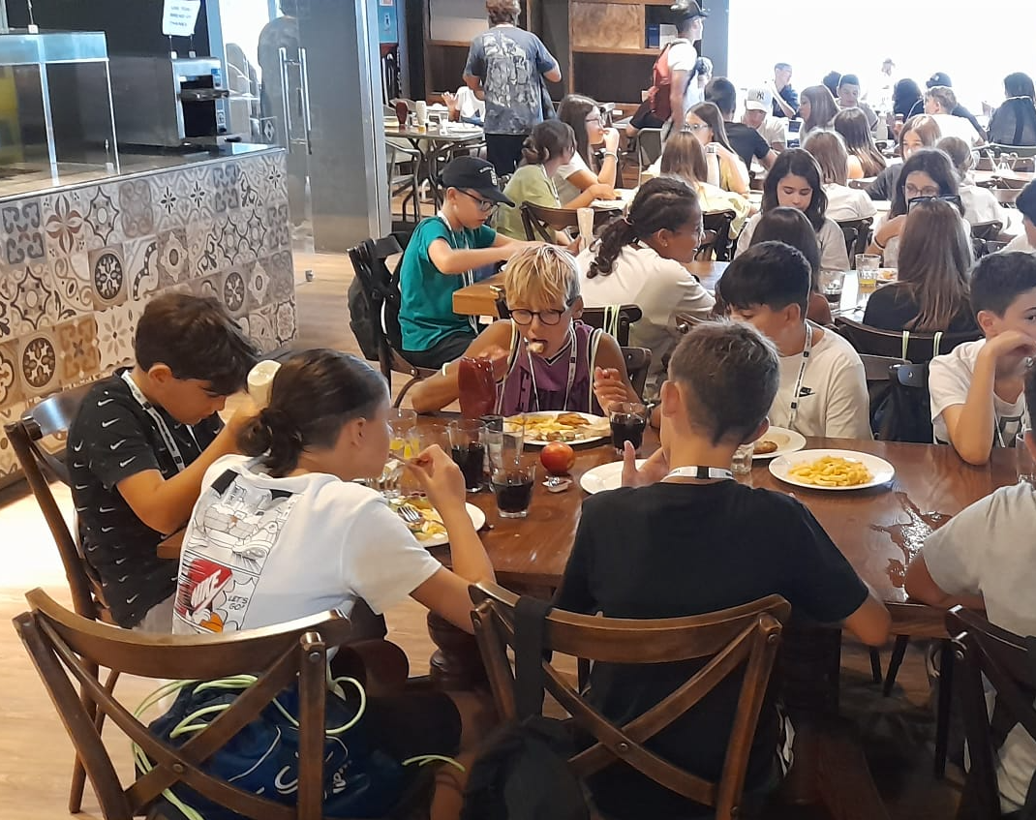
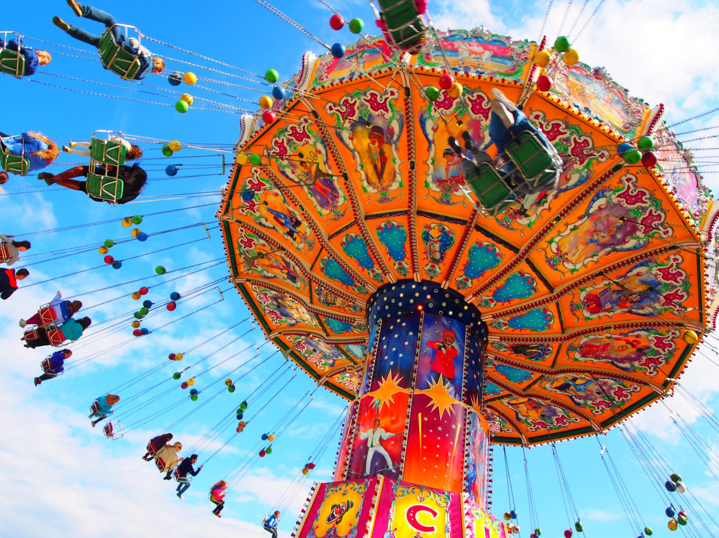
20 September:
In these day we stayed in the hotel all day, but we still had fun.

Slide 5
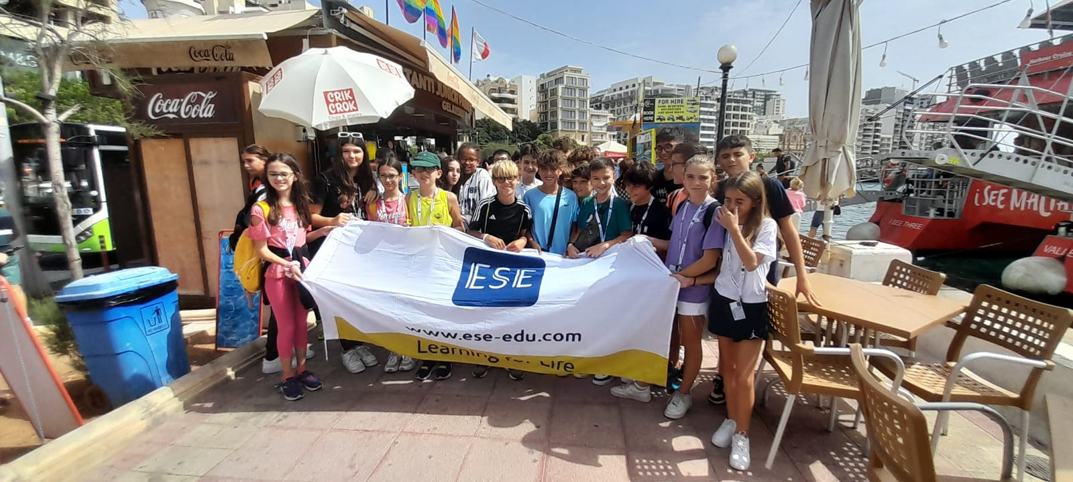
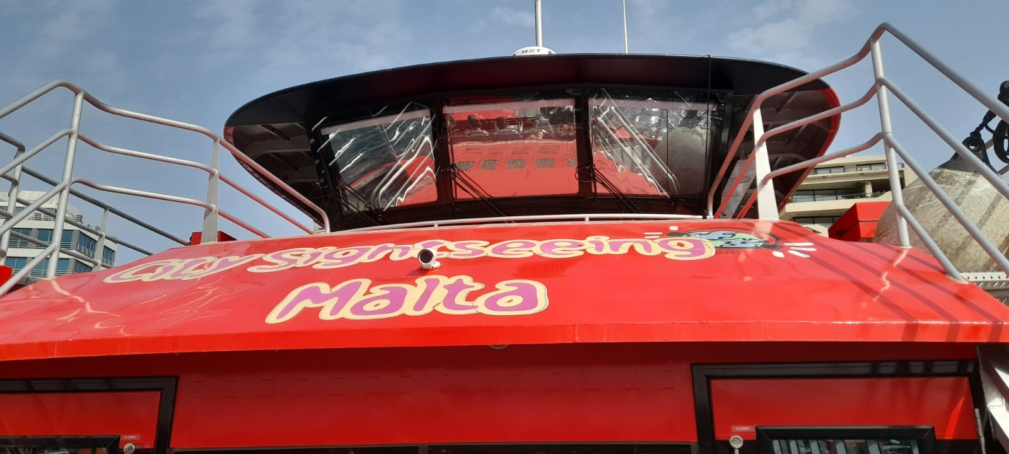
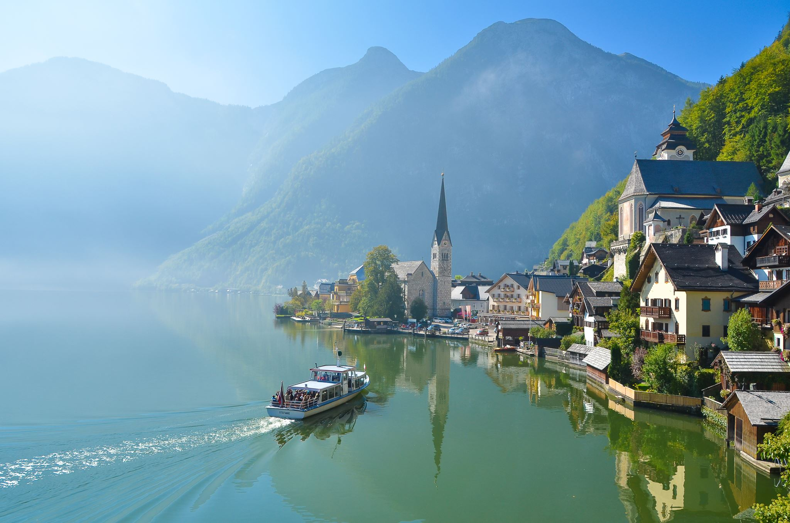
21 September:
On these day we went to visit Malta by ship, then we go to the shopping center. After we return to the hotel

Slide 6
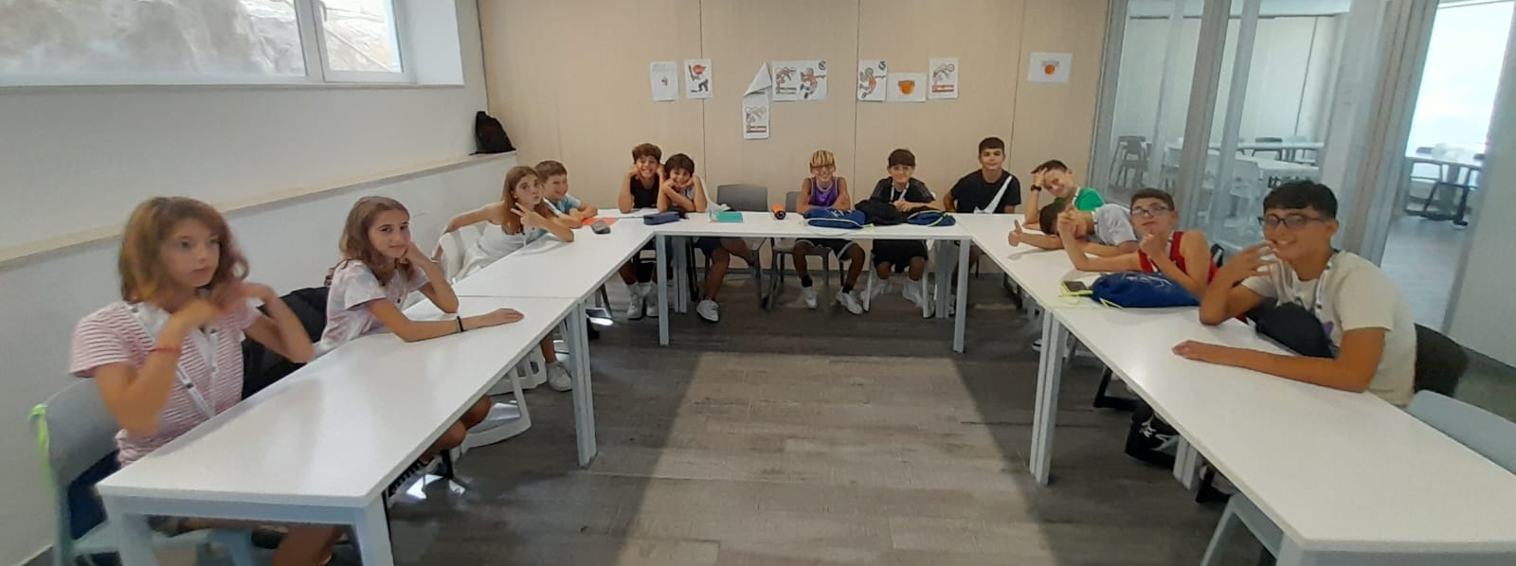
22 September:
On this day we went to visit Malta with a guided tour which took us to buy some souvenirs in a place.
when we got back to the hotel we has the english lesson downstairs at the hotel.
The evening the hotel has prepared karaoke for us.

Slide 7
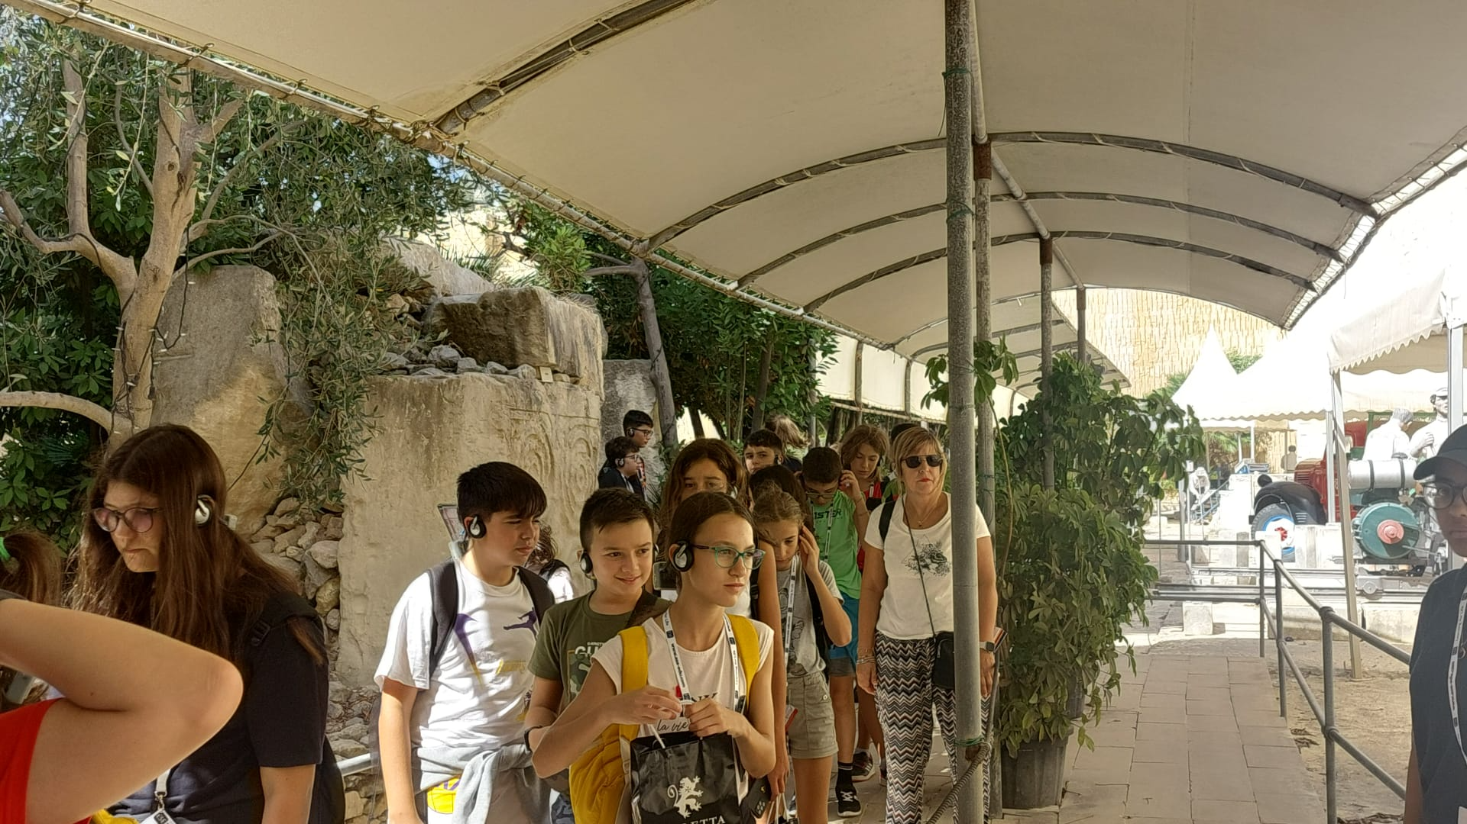
23 September:
On this day we went to see how they made glass, then we went to a jewelry shop.
after we went for a guided tour with strange headphones that explained how they worked the typical Maltese stone.

Slide 8
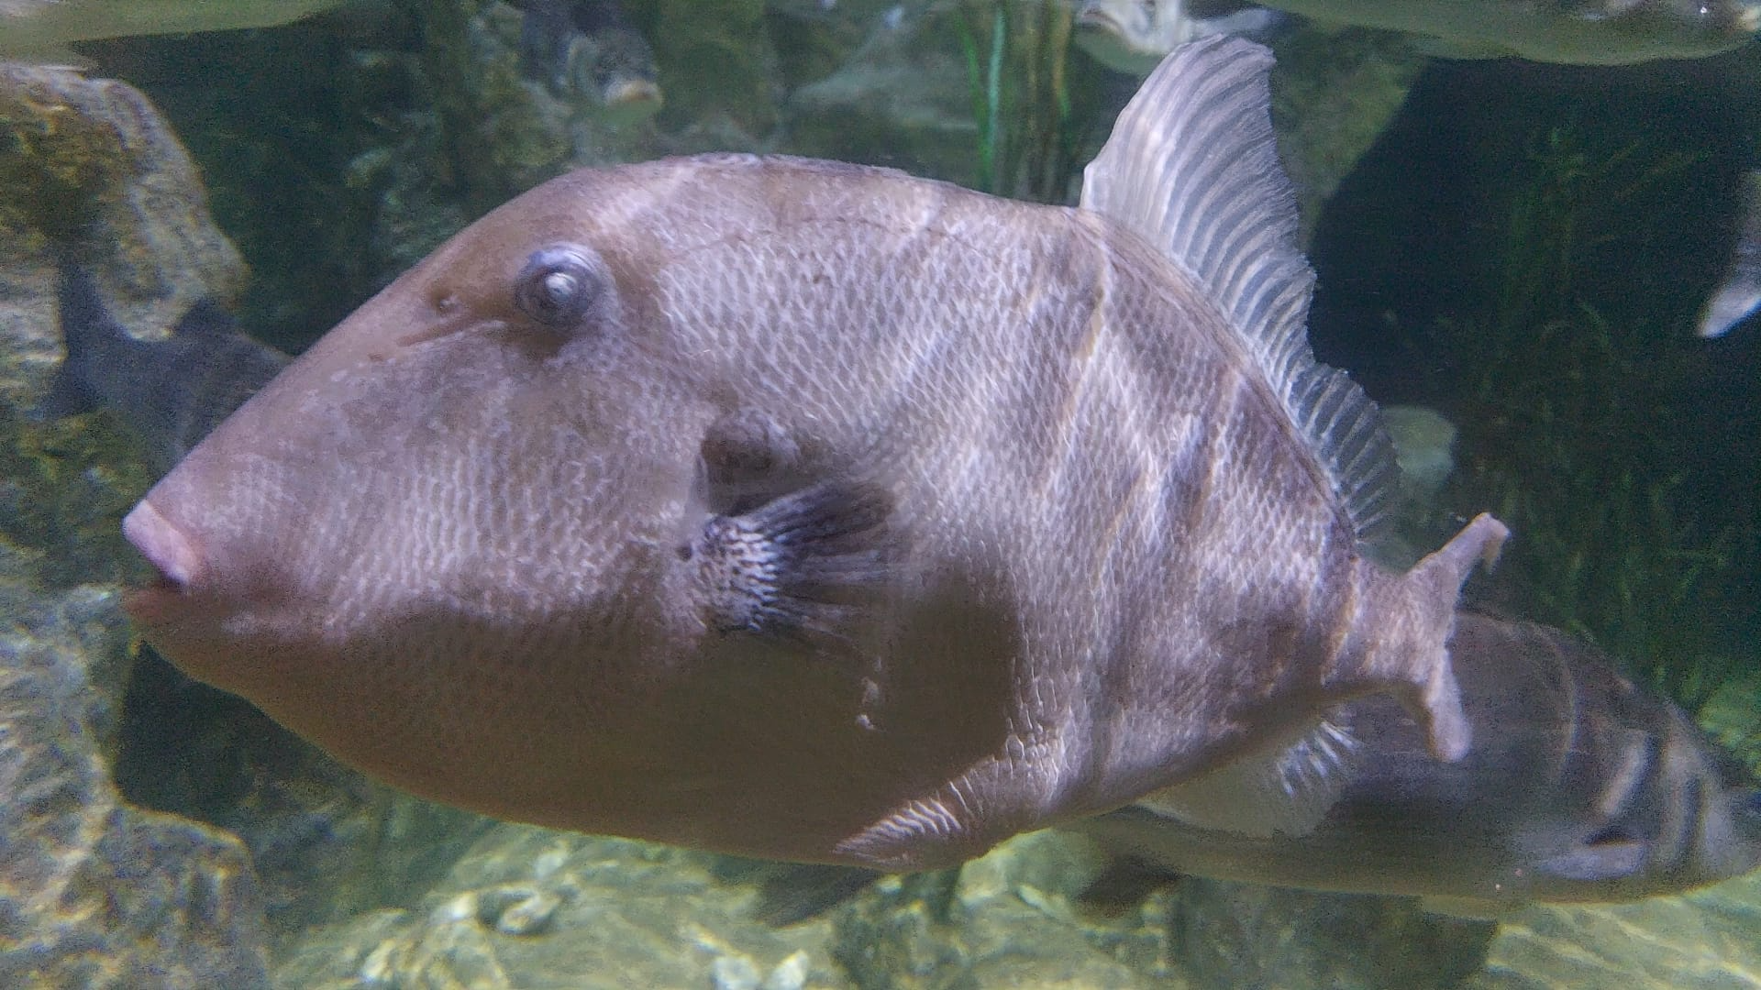
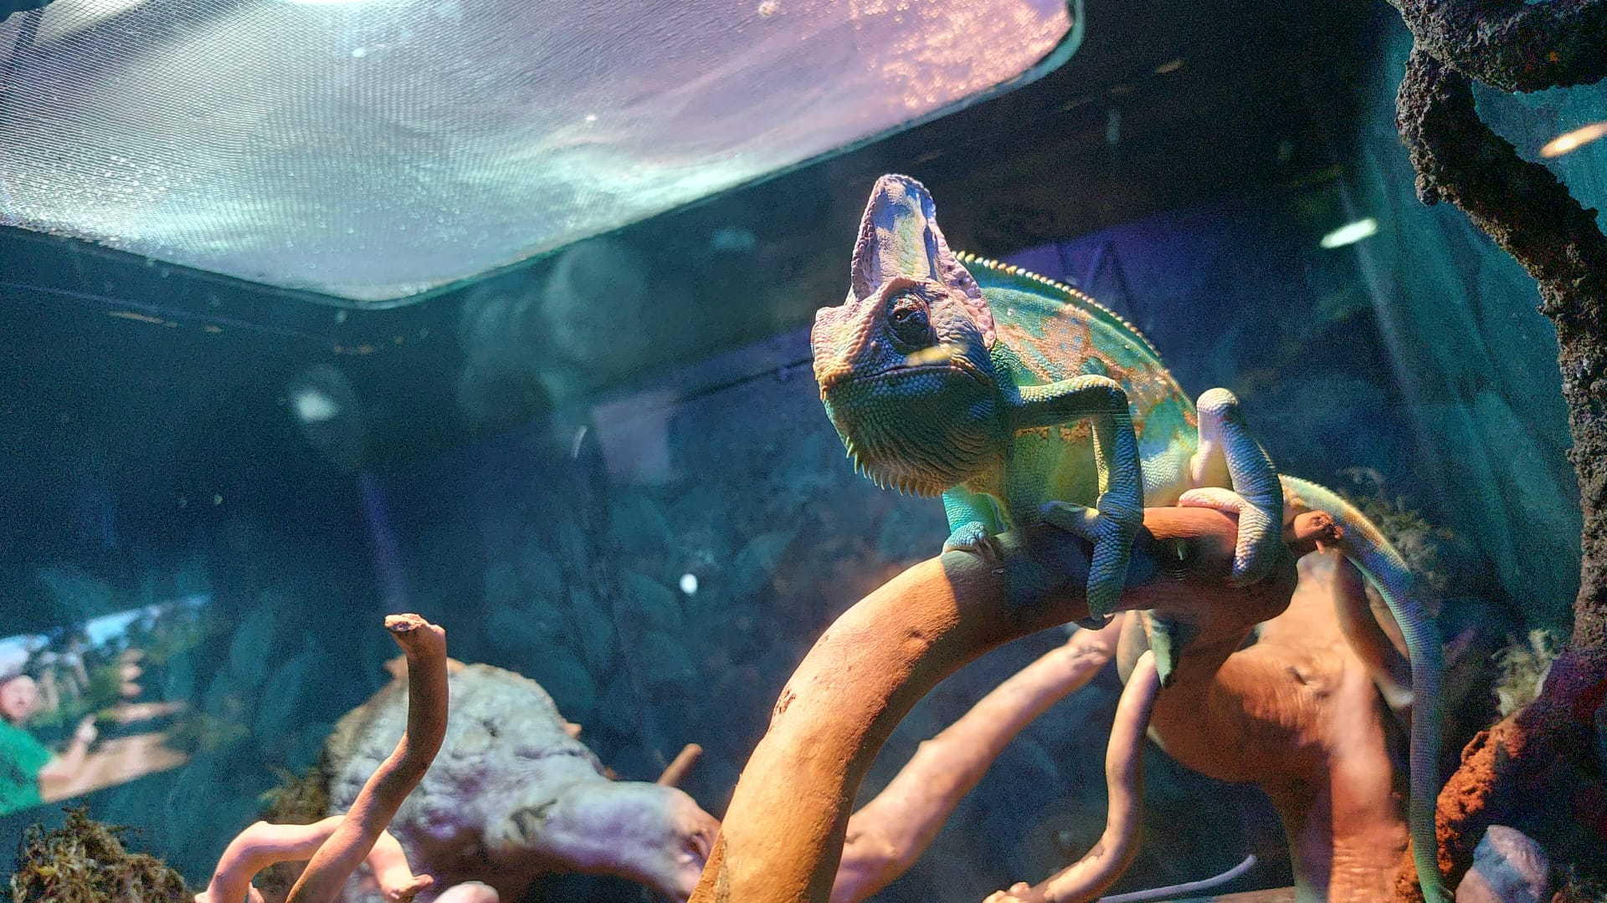
24 September:
On this day we went to visit a very large aquarium where they also showed non-aquatic animals and in the evening we went go at bowling.

Slide 9
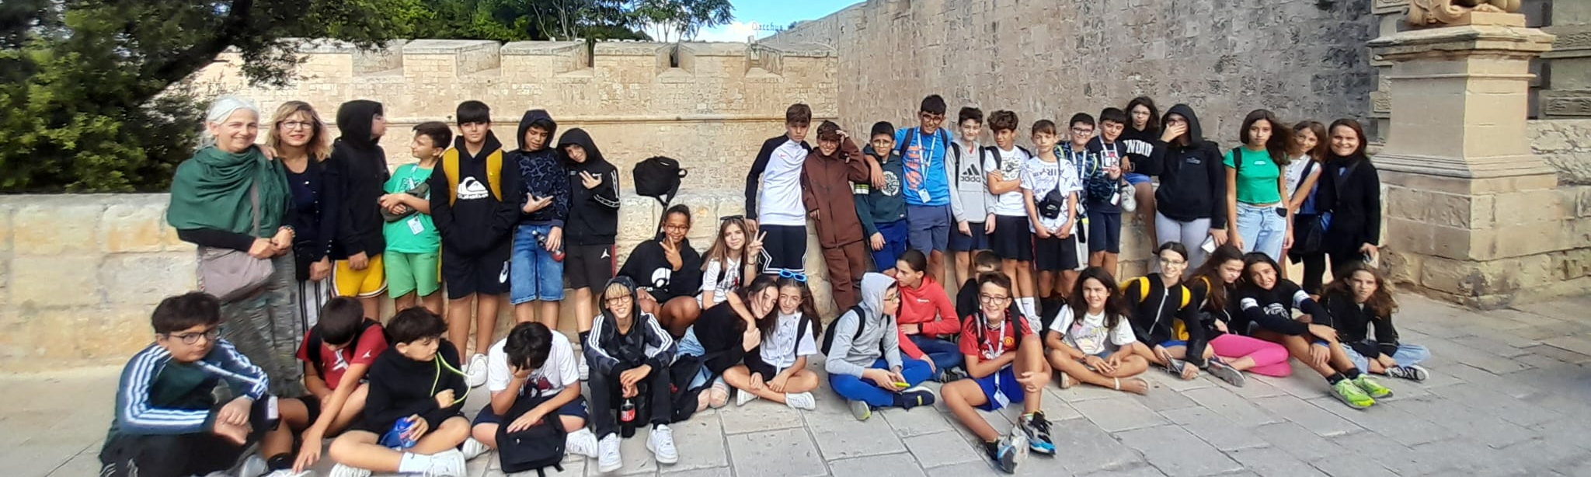
25 September:
On this day we visited the Medina which was really big

Slide 10
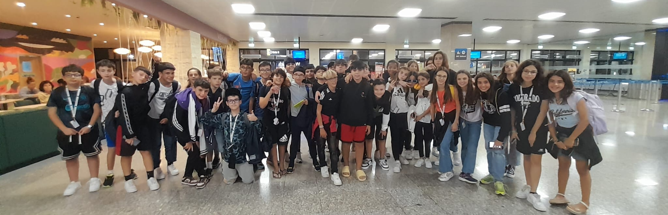
26 September:
On the last day we were all very sad. We returned home very late in fact we almost all fell asleep both on the plane and in the minibus. The trip to Malta was beautiful. And I'm sorry it's over.

