Slide 1
STAGE MALTA
On 19th September 2023 we started our trip to Malta, for the Stage of secondary school.

Slide 2
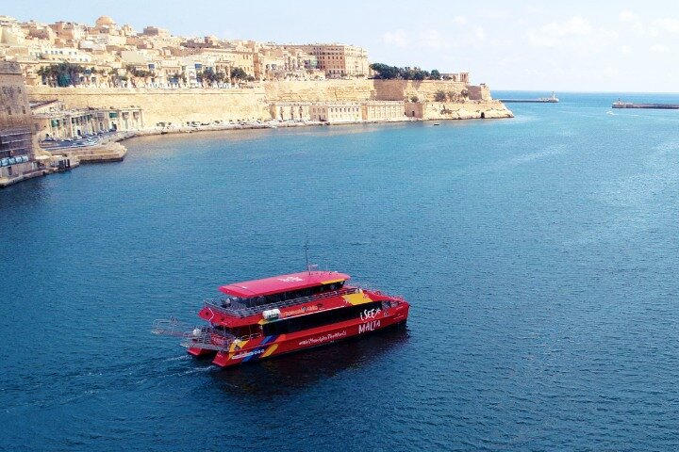
In the first day we went on the Harbour Cruise boat trip.
The boat tour takes us the coves of the cities around Valletta,
across the Harbour of Marsamxetto and the Grand Harbour.

Slide 3
The Harbour of
Marsamxetto was the home of the knights of St. John of Malta and was used to defend against enemy sieges

Slide 4
On 22nd September we toured Valletta, the capital city of Malta.
In Valletta there are 320 monuments, we visited Independence Place and Place with the President’s Office.

Slide 5
In front of the Grand Harbour there is the Saluting Battery .
That is an ancient ceremonial platform, from which cannon shots are fired.

Slide 6
Near the Indipendence Place there is the Triton’s Fountain, symbol of Malta.
The fountain is illuminated at the night.

Slide 7
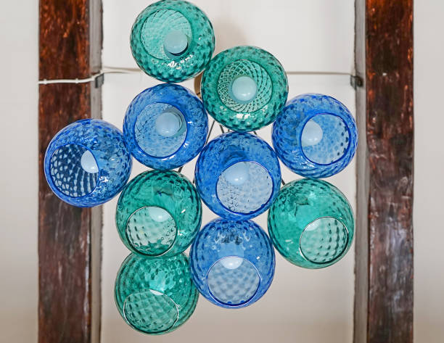
On 23rd September we visited the Crafts Village and saw how glass is made and worked.
Glassmakers shape molten glass too make many objects.

Slide 8
On 23rd September we visited the Museum of the typical maltese stone.

Slide 10
Our resort had a big pool, with a table tennis and a games room.

Slide 11
From 14 to 18:15 we had english lessons in different classrooms, with two breaks of 15 minutes.

Slide 12
Here we have seen how to work glass.

Slide 13
On 24th September we were at the National Acquarium of Malta.
It is the home of more than 175 species between fish, molluscs and reptiles.

Slide 14
IIn the acquarium there was a room dedicated to the pollution of the seas with the number of fish dead.

Slide 15
On 25th September we visited
Mdina, the capital of Malta
until 1530.
Mdina is know as a silent
city, with narrow street.

Slide 16
Rabat is the city near Mdina, with one the moust famous shrines dedicated to Saint Paul

