Slide 1
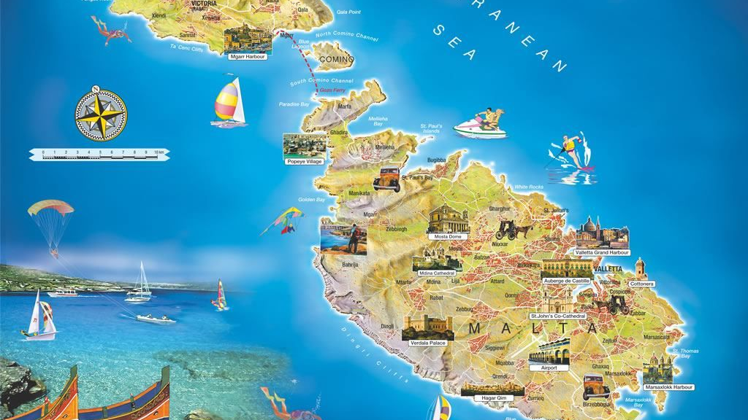
OUR HOLIDAY IN MALTA
BY EDOARDO PIU AND LORENZO POMPILI

Slide 2
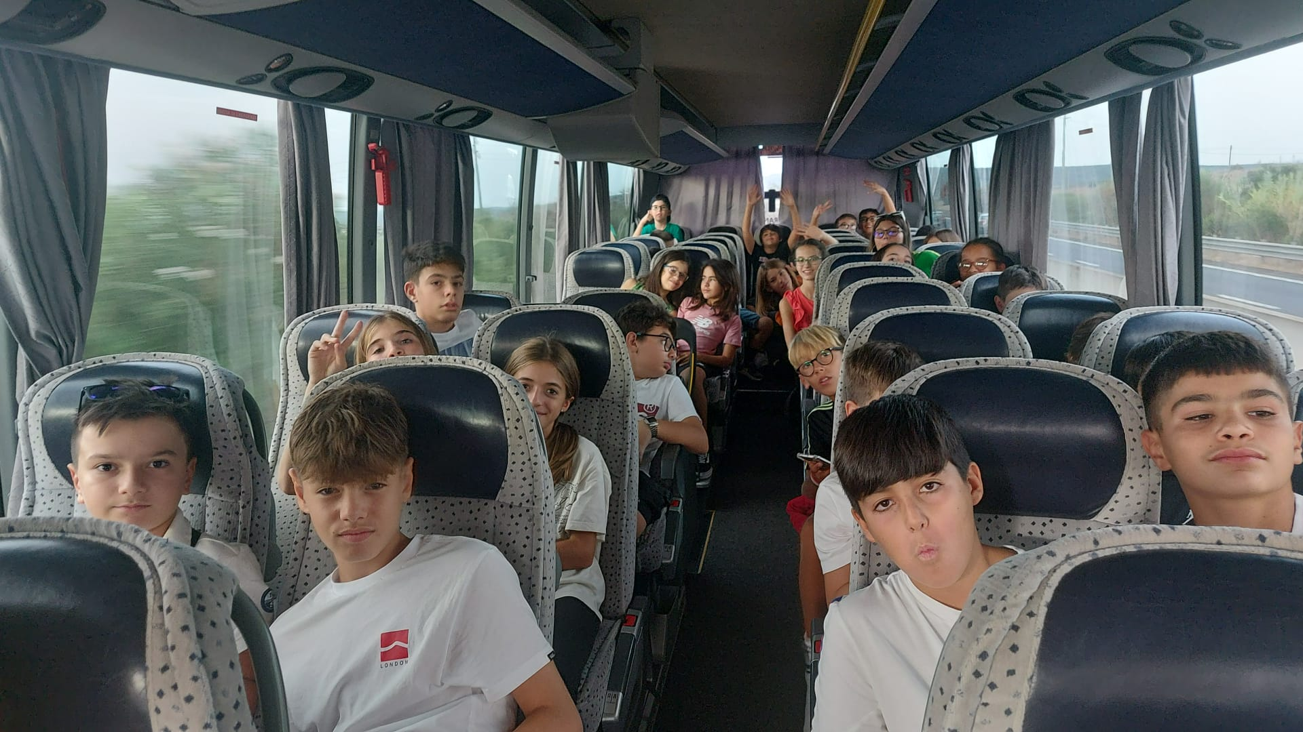
It seemed that the long awaited September 19 would never arrive…
MALTAWE ARRIVE!!!!

Slide 3
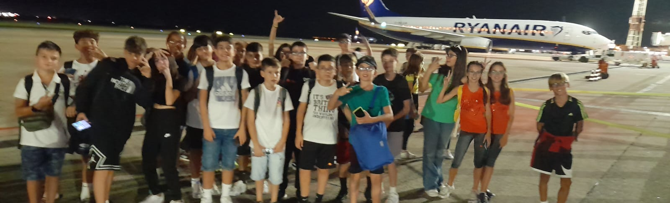
We are 34 middle school kids of the Brigata Sassari comprehensive institute.
We are taking part in a proget promoted by the school and coordinated by the teacher Moretti which took us to Malta for a study trip.

Slide 4
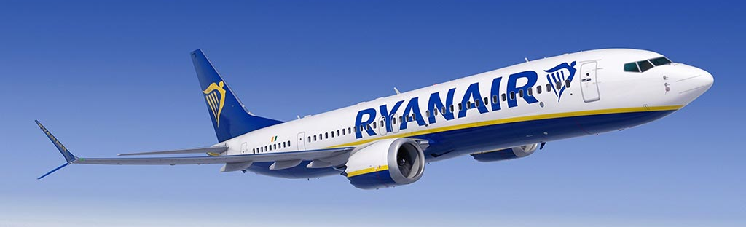
THE JOURNEY
It all began in piazzale Segni near our school.
At 5:00 we said goodbye to our family members and got on the bus with the bit of nostalgia mixed with curiosity.
Our fligth left Cagliari at around 10:00 and we arrived there from the 3 hour journey, but still with energy from the excitement.
Once we got on the plane and we said goodbye to our land which we would see again on september 26.

Slide 5
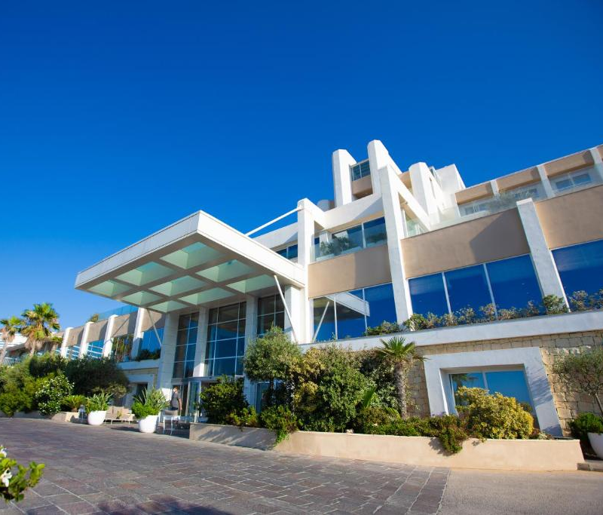
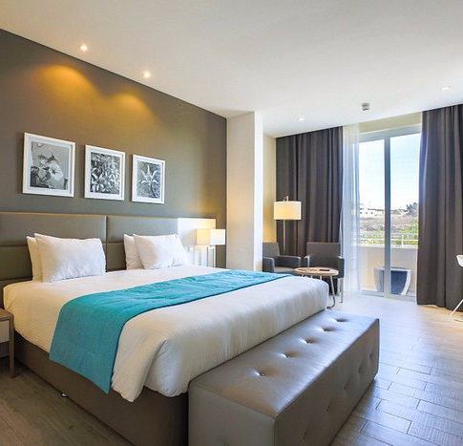
Hotel Salini
When we arrived, we were very tired from the trip, but we immediately noticed the beauty of the hotel: it was very large and had a large swimming pool and a breathtaking view of the maltese see.
The rooms were also very welcoming and comfortable.

Slide 6
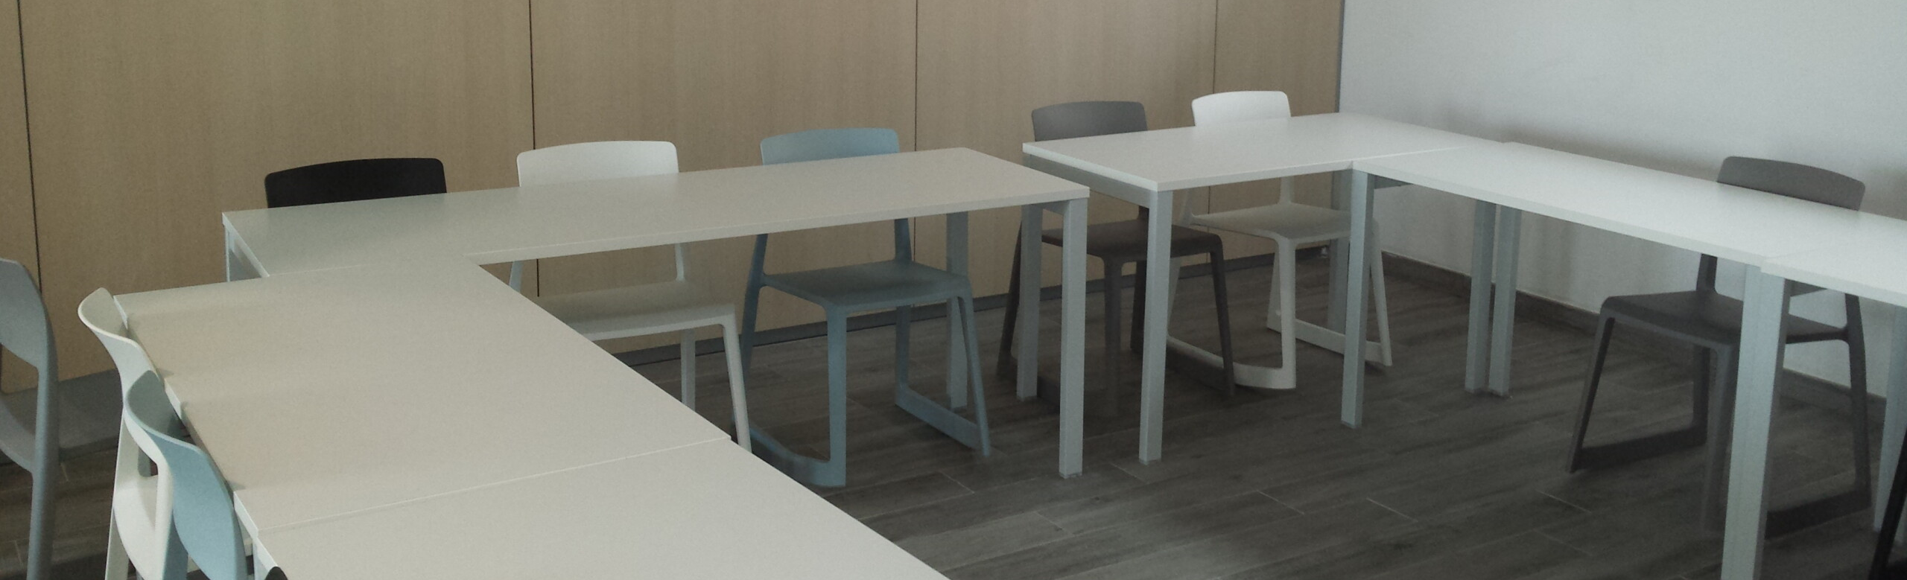
A tipycal day
Every day we woke up early to go have breakfast; after eating we returned to our rooms to prepare for that day’s trip.
When we returned from the trip we had lunch and then went to class: the lessons lasted about 4 hours including three quarter-our breaks.
There were various classes were games and activities were played to learn english.
Once the lessons were over we had a moment of leisure before dinner.
We weren’t the only ones studying in the resort: there were also other kids of othr nationalities

Slide 7
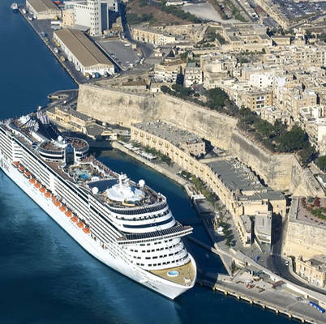
The most important destinations
On the second day we visited Valletta, the capital of Malta,taking a ferry and visiting the port going to places accessible only by sea.
During the tour we saw fortresses built around the 13° century.
There were many luxury boats and cruises landing there.

Slide 8
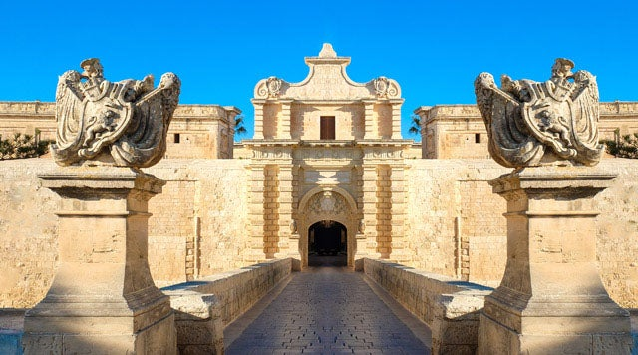
Mdina e Rabat
Mdina is a very small medieval city and attached to Rabat.
Mdina was founded by the Phoenicians in 70b.C..
Due to its strategic position, it was the capital of Malta until 1530.
Rabat means suburb, as it was once a fraction of Mdina.
Although very small, it is a city rich in history: Saint Paul is said to have lived for a time and created Malta’s first Christian community.

Slide 9
The glass of Valletta
One of our outings was to go and see glass making in Valletta.
There was a craftman working next to the oven and next to us; he showed us how he made the figurines..

Slide 10
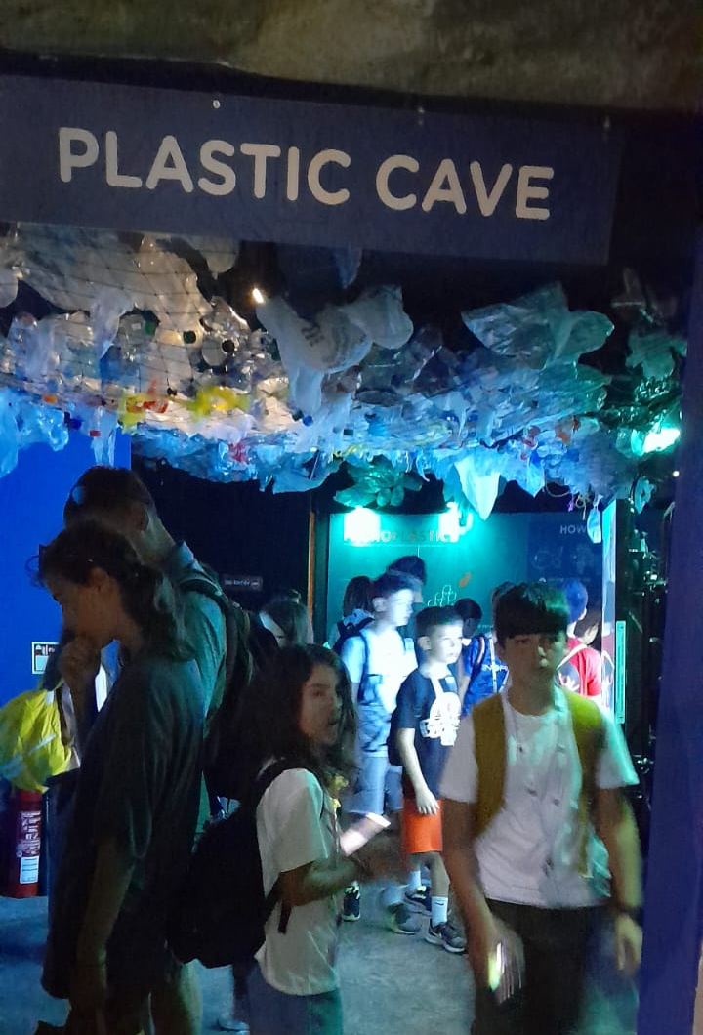
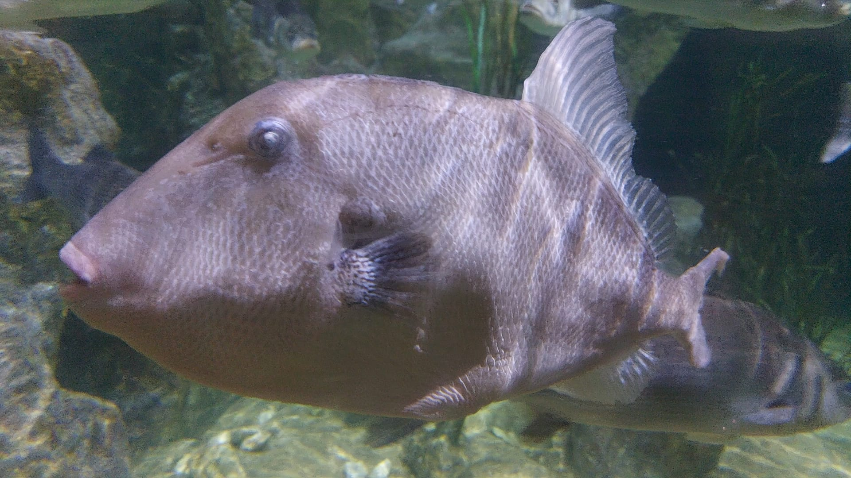
THE AQUARIUM
On sunday we visited the Malta Aquarium.
We had fun observing and taking photos of the various animals.

Slide 11
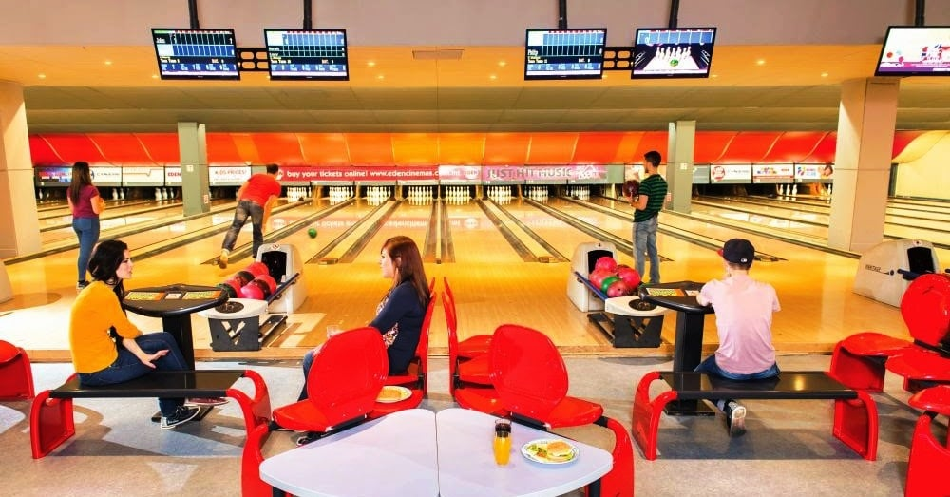
Bowling
The same day we visited The aquarium, we went bowling.
We competed with each other while having fun and a great evening.

Slide 12
THE RETURN HOME
On day 25 we packed our bags to prepare for the return.
Having handed over our suitcases and room key, we had some time to have fun in the pool before lunch.
Once the lessons were over we got on the bus that took us to the airport, where we waited and had dinner before boarding the plane.
Once we arrived in cagliari we had a three hour journey ahead of us to get to Sassari where our parents were waiting for us.

Slide 13
OUR PERSONAL OPINIONS
We think that this trip was important because we learned English better, but above all because we had fun and made new friends.

Slide 14
We thank the professors because they made us live a unique and splendid experience, we also thank them for putting up with us.
We also thank our classmates for being together and having fun.
Thank you

