Slide 1
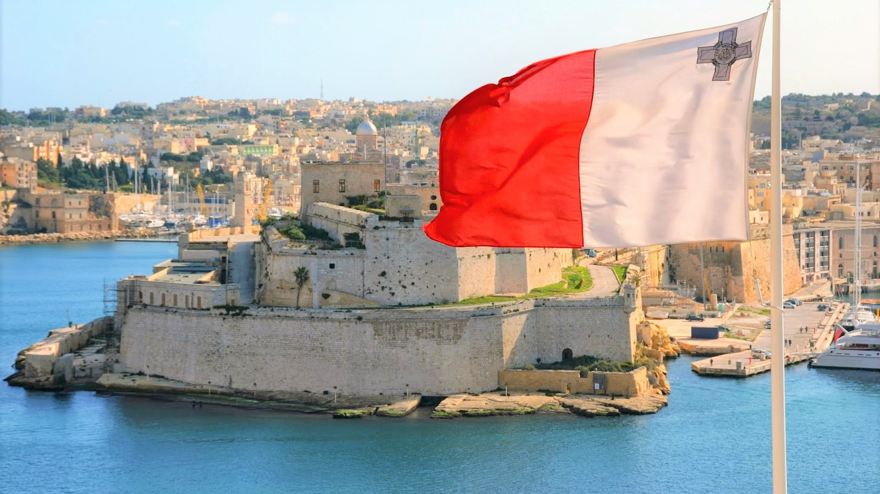
MALTA EXPERIENCE
BY GABRIELE, ARIANNA AND GIULIA

Slide 2
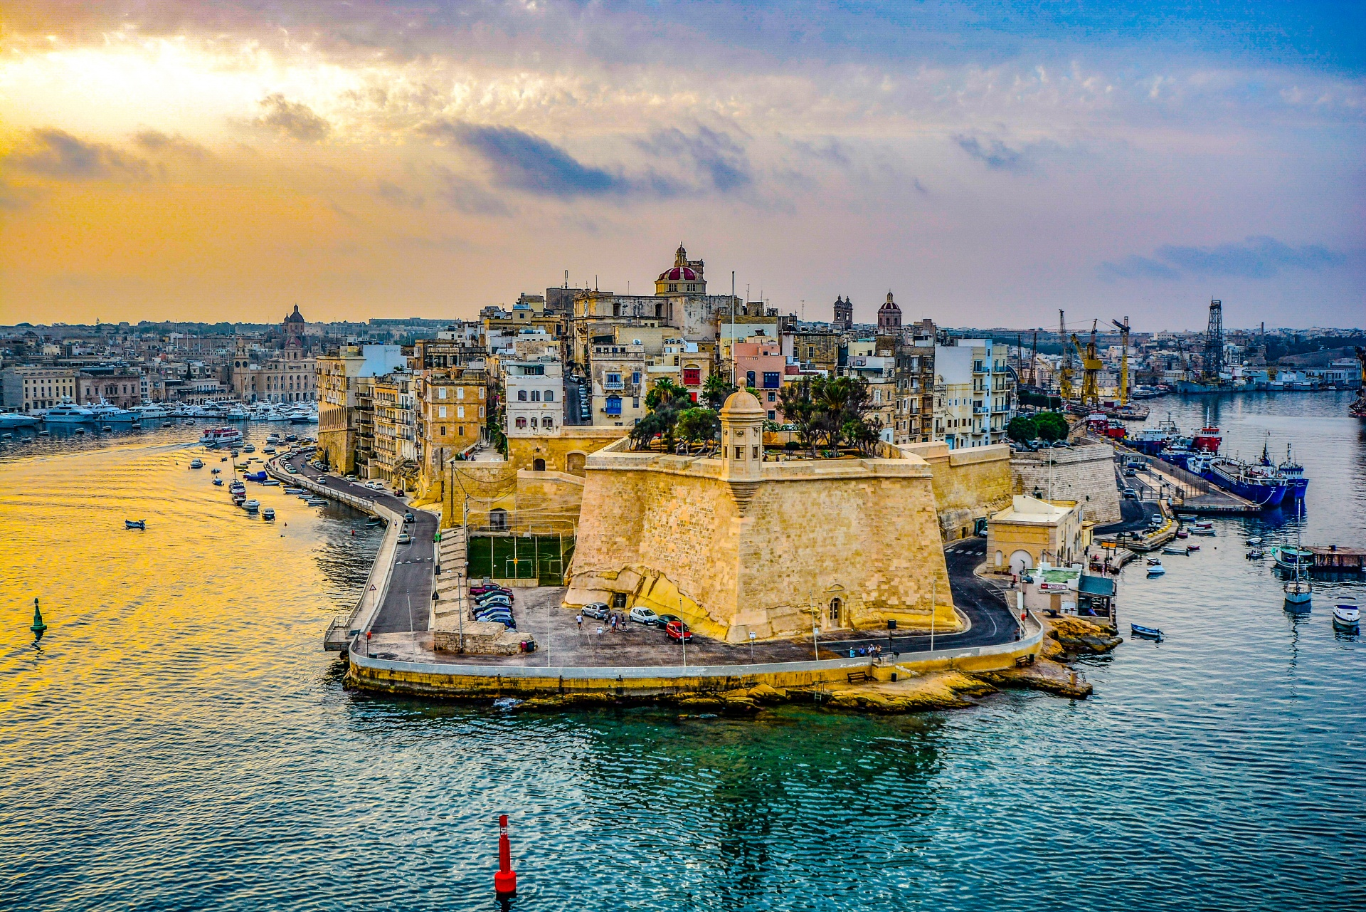
WHAT IS MALTA
Malta is an archipelago in the center of the Mediterranean Sea, located between Sicily and the coast of North Africa. It is a nation famous for historical sites connected to the various rulers of the island. Numerous fortresses and megalithic temples are found here.

Slide 3
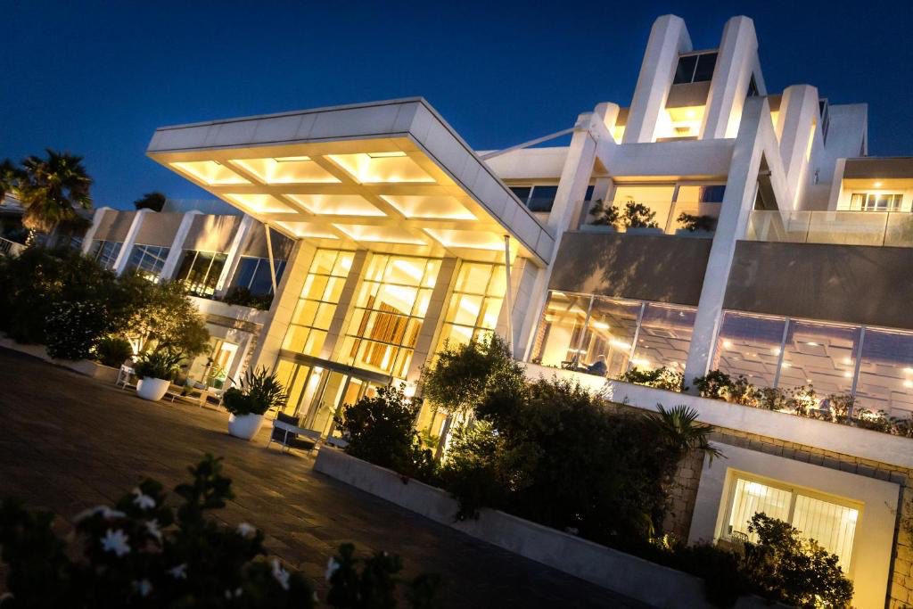
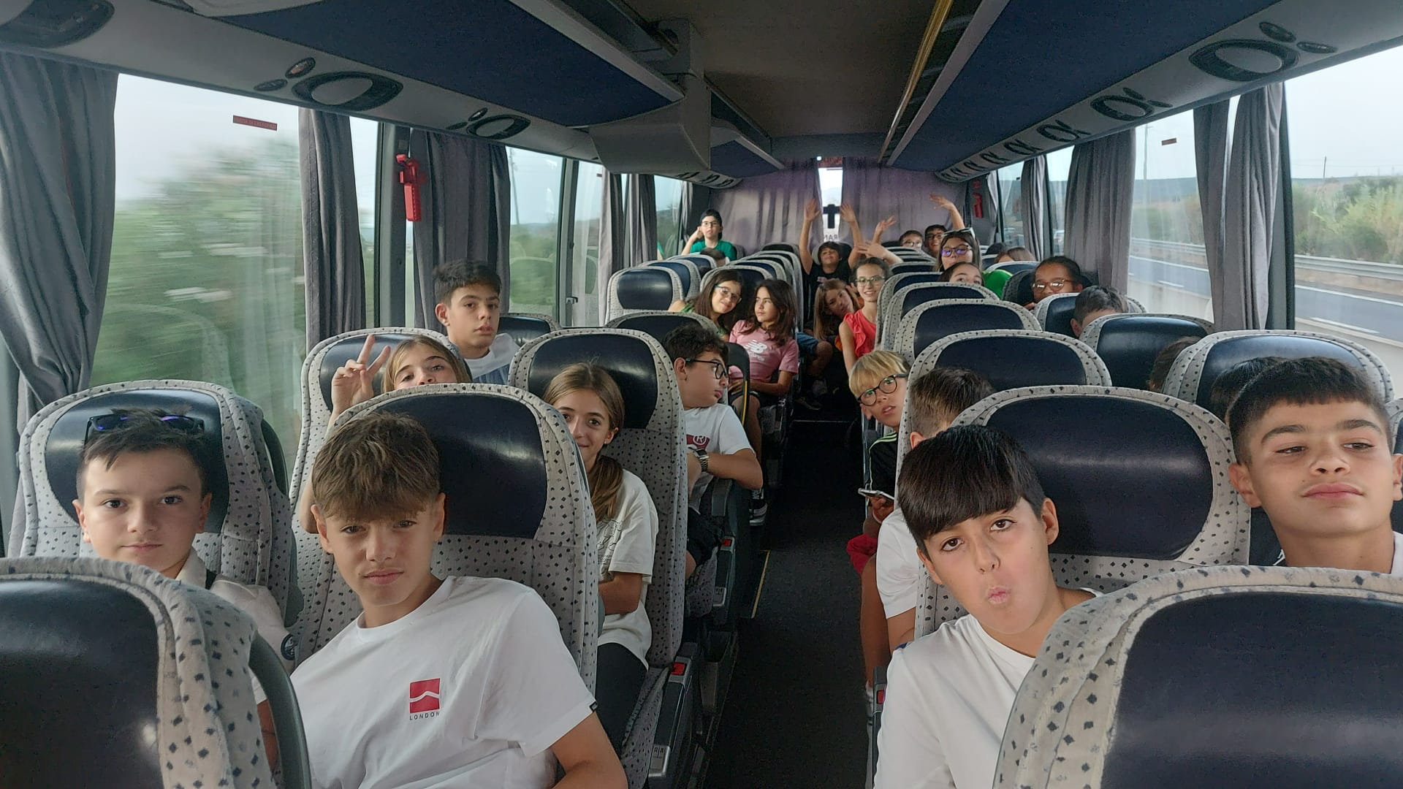
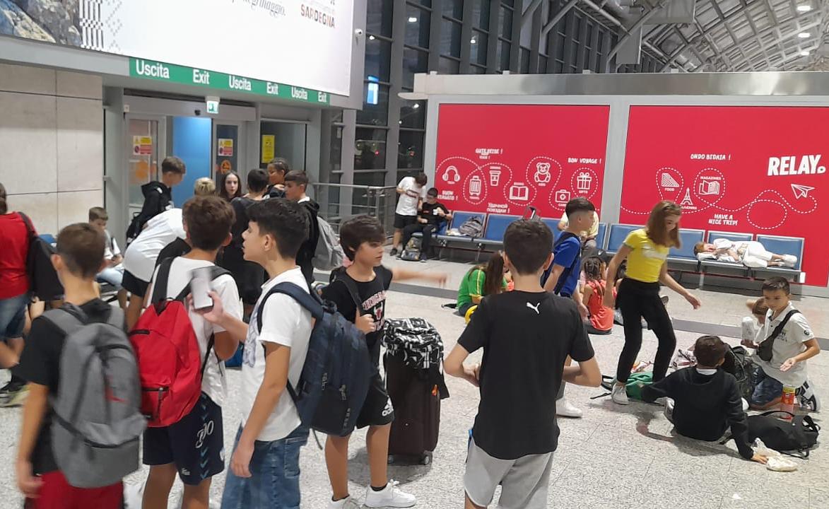
DEPARTURE AND FLIGHT
We left at 5.30pm from Piazzale Segni with destination Cagliari airport. once we got on the bus our excitement was through the roof. after about three hours on the bus, we had finally reached our destination and we were a little tired but the excitement was certainly not over. while we were doing the checks, one of our companions had to abandon us because he didn't have the necessary documents. after having dinner, it was time to get on the plane and we couldn't believe it. During takeoff I don't think the passengers were very calm given our screams.
Once we landed we noticed a peculiarity: to surf online you had to activate roaming, i.e. the data you use abroad. Then we took another bus and after about half an hour we arrived at the hotel, precisely at the Salini Resort, around 2 in the morning. Once we checked in, we got the keys to our rooms and went to sleep.

Slide 4
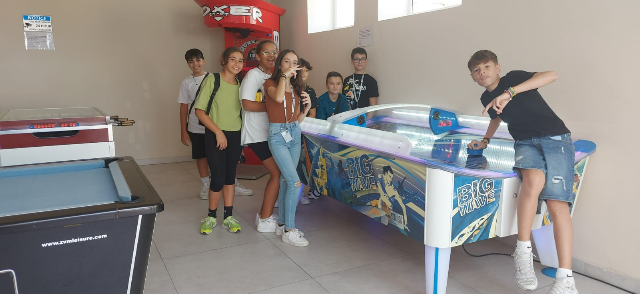
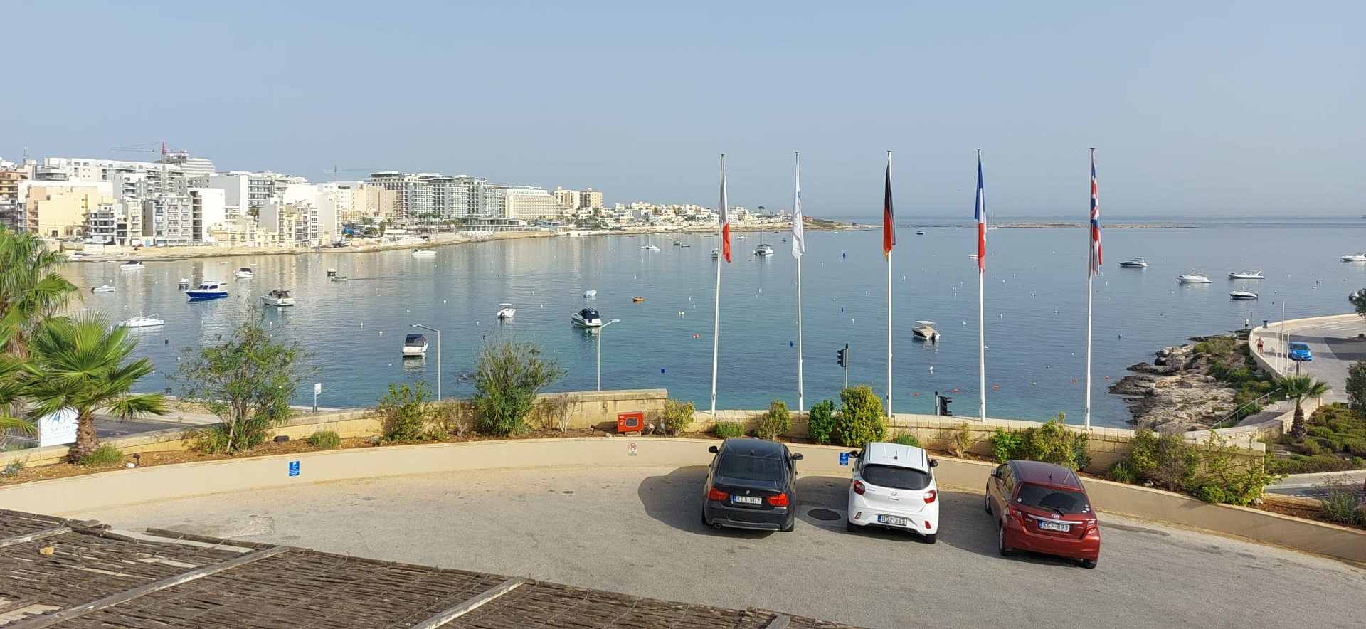
THE HOTEL
The Salini resort is a structure equipped with a swimming pool, gym, spa and many other services. Our rooms were very spacious, with a large suitcase rack and a large wardrobe. The bathroom was comfortable in which there is a shower; the only flaw is that there was no bidet. We also had a small terrace with two chairs and a table where we could relax. Breakfast wasn't bad: we could choose between sweet and savory and lunch and dinner were also reliable. In the hotel there is an English school where we held our lessons, modern classrooms equipped with a large screen and air conditioning. Fun was guaranteed!

Slide 5
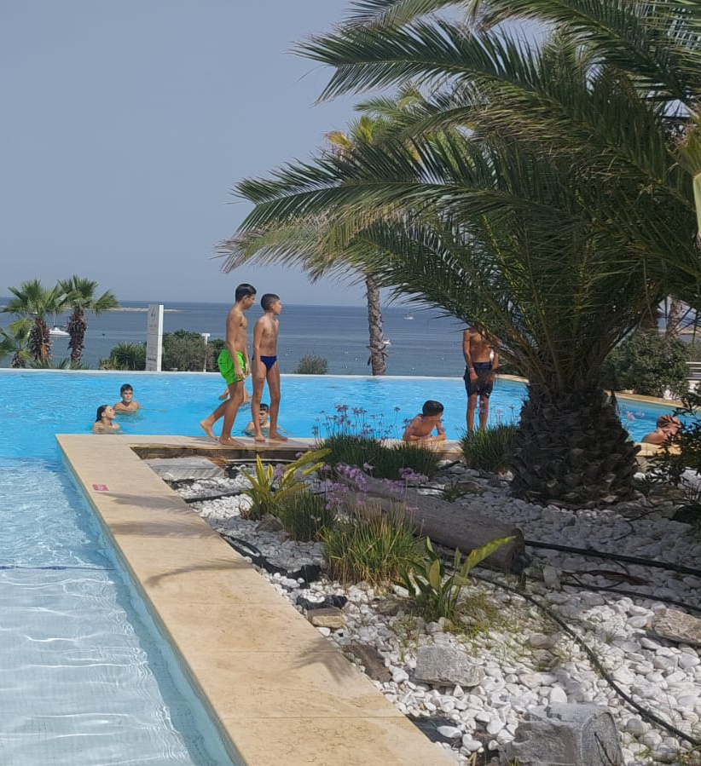
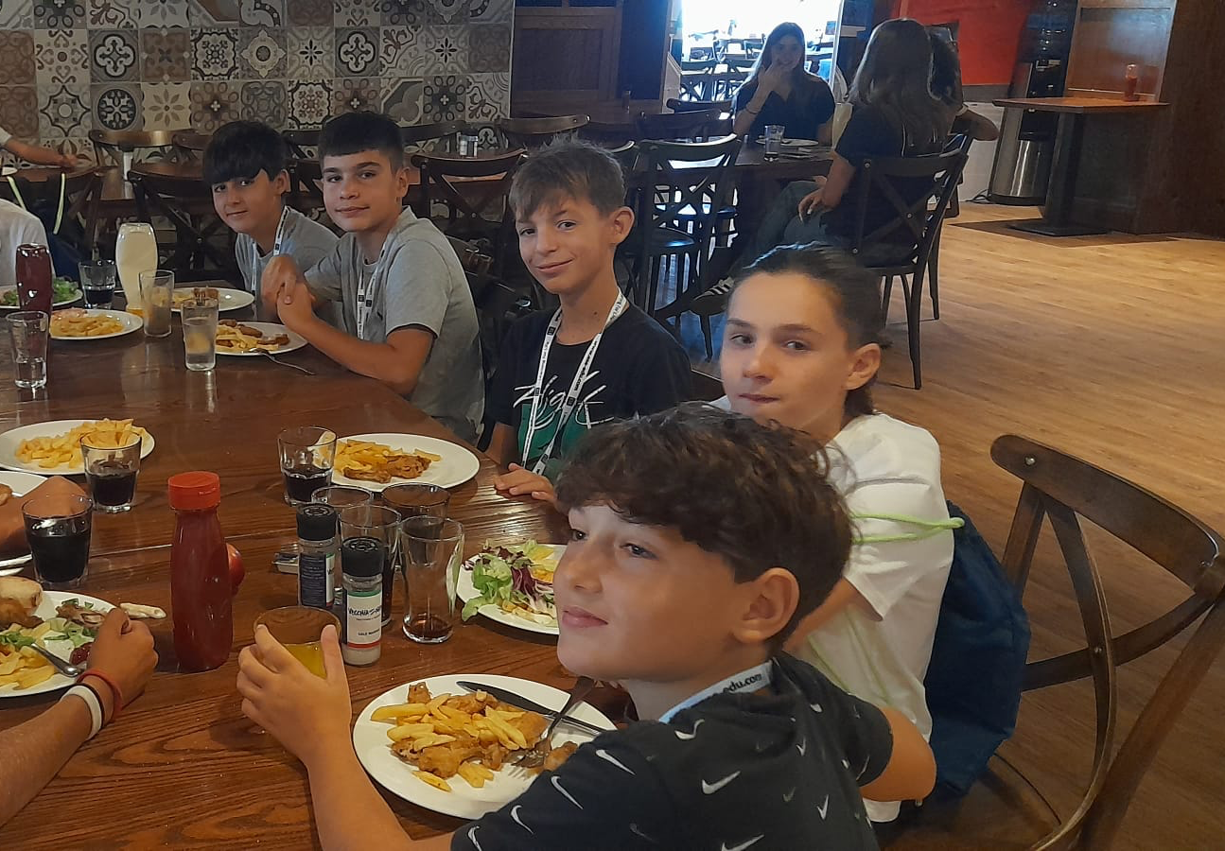
OUR TIPYCAL DAY
Our typical day began with an alarm clock based on the following activities. We got ready and went to breakfast. After the meal we either spent our time freely or went to visit a city. The visits could last all afternoon, in which case the facility would give us a packed lunch, or just for the morning and in that case we would return to the hotel for lunch. Immediately after lunch at the facility we went to English lessons; they started at 2pm and ended at 6.15pm with two 15 minute breaks. After class we could relax and play until 7.15pm, time for dinner. Afterwards we could stay out of the rooms freely until 10pm, or they made us do activities such as bowling and karaoke.

Slide 6
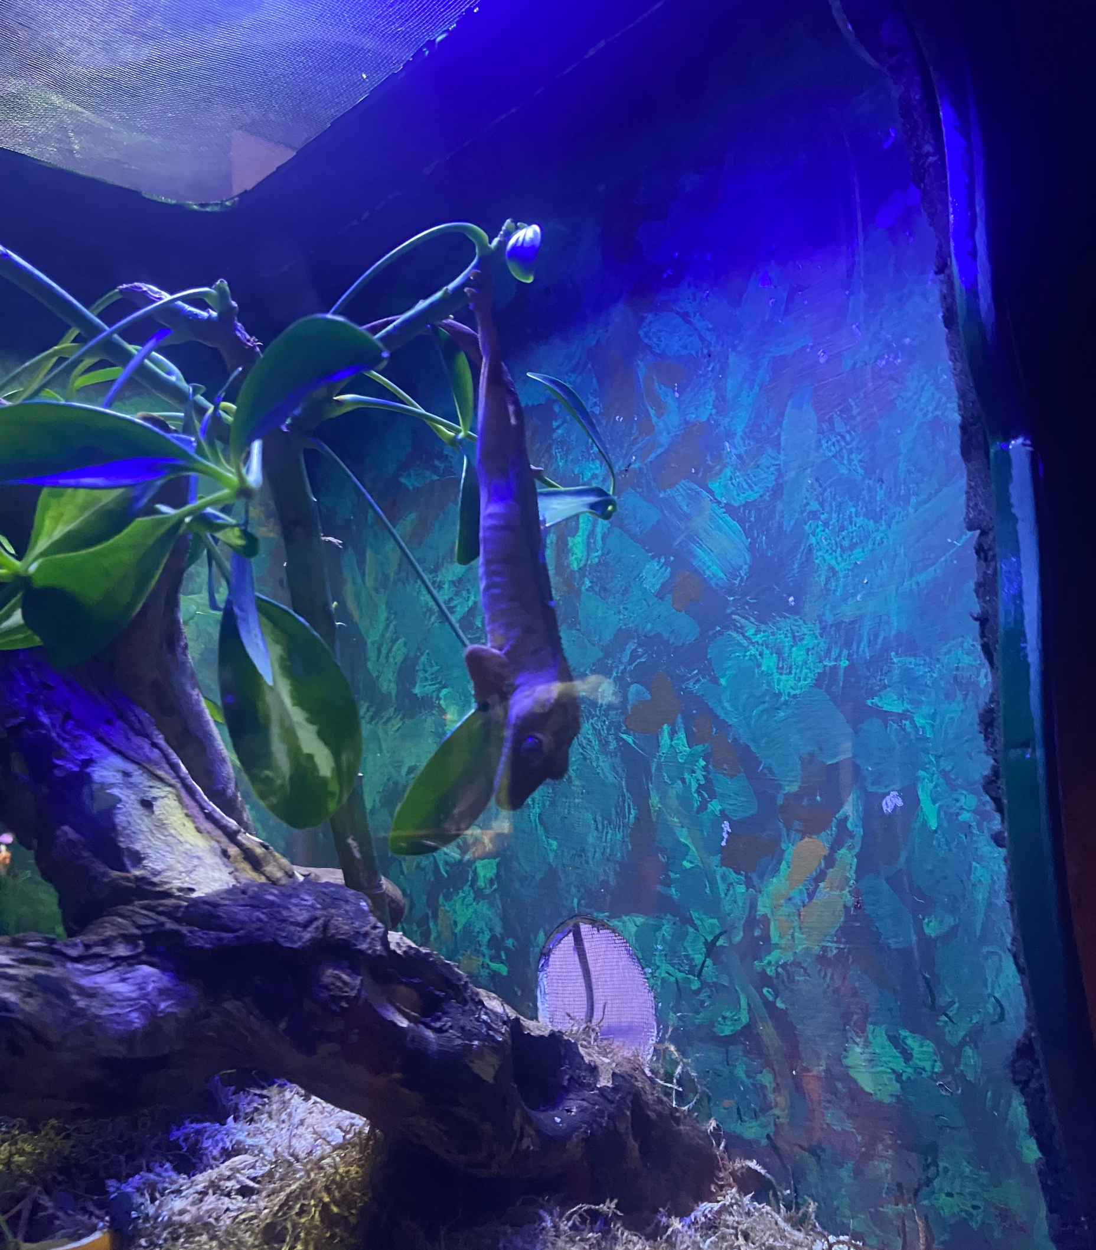
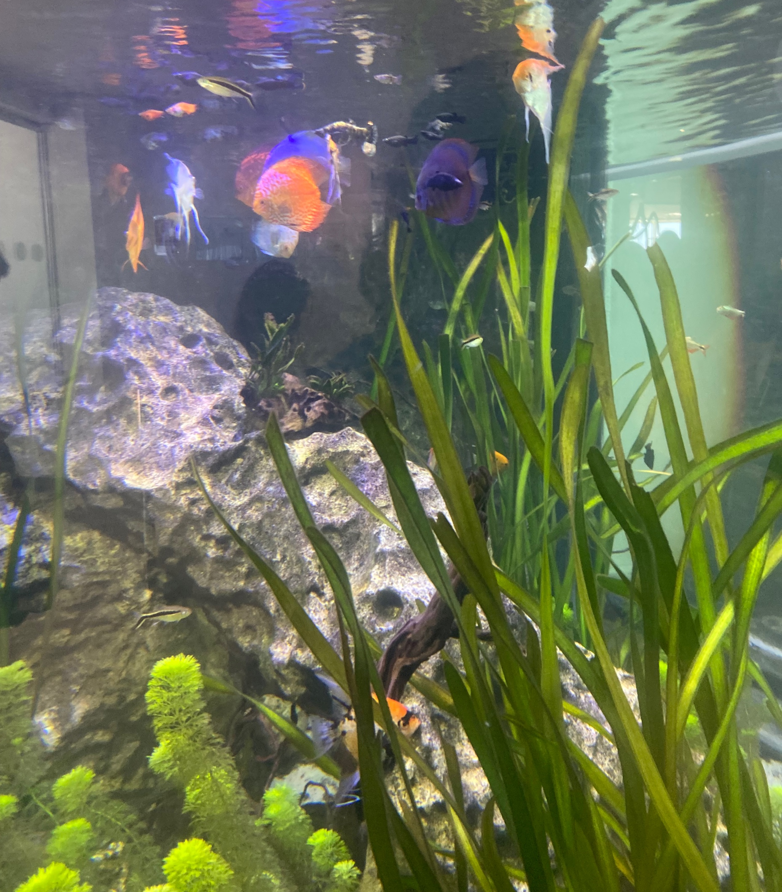
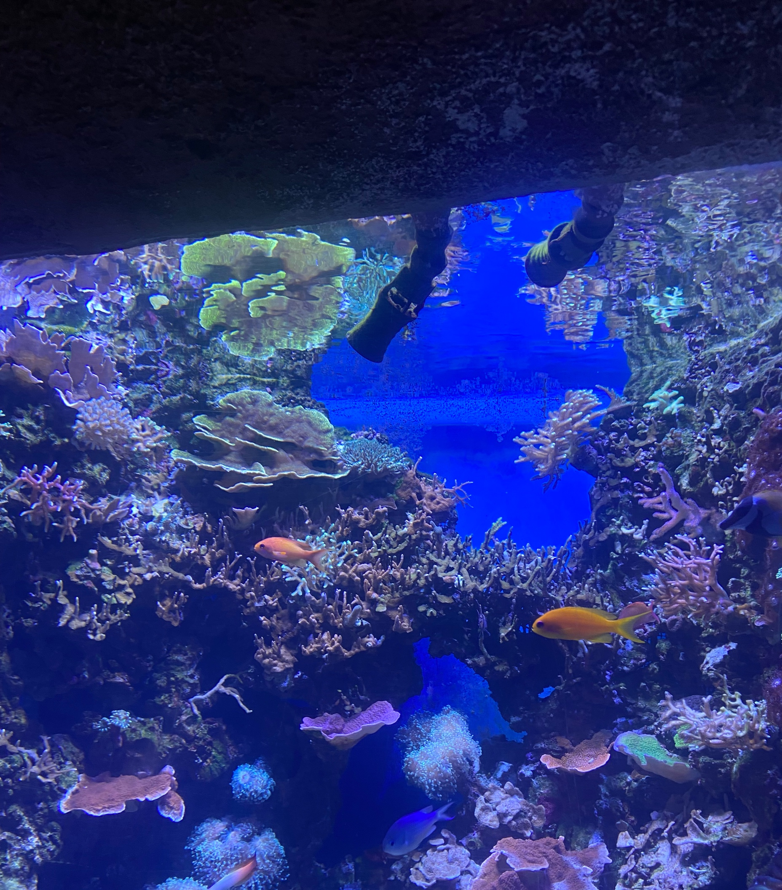
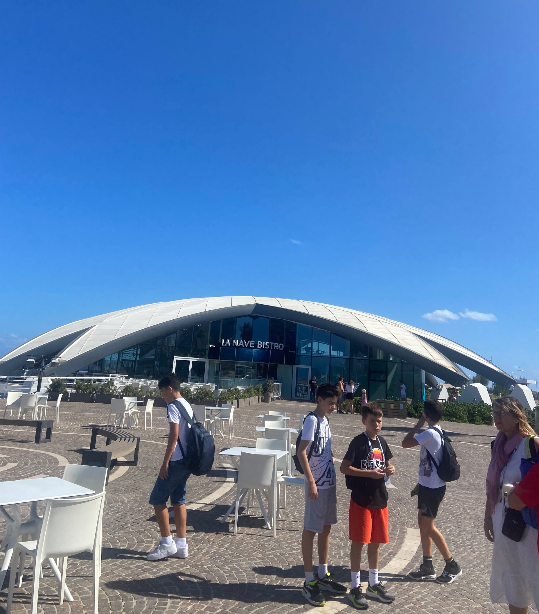
THE AQUARIUM
One of the activities we did was a visit to the Malta Aquarium. It was very big from the outside, when we entered it was amazing! There was a small shop to buy the little plush fish that represented the animals seen in the aquarium. We saw numerous fish such as seals, sharks, seahorses and turtles. 🐠 We also saw reptiles such as small frogs, Komodo dragons, chameleons and lizards.🦎 Furthermore, water spiders were also present! The Aquarium was one of the best activities!

Slide 7
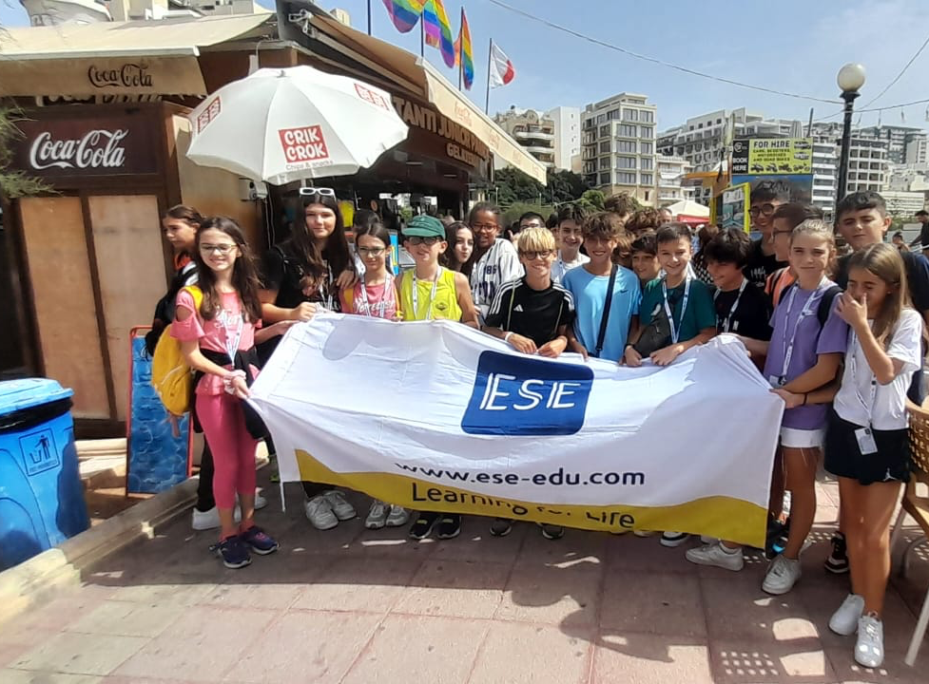
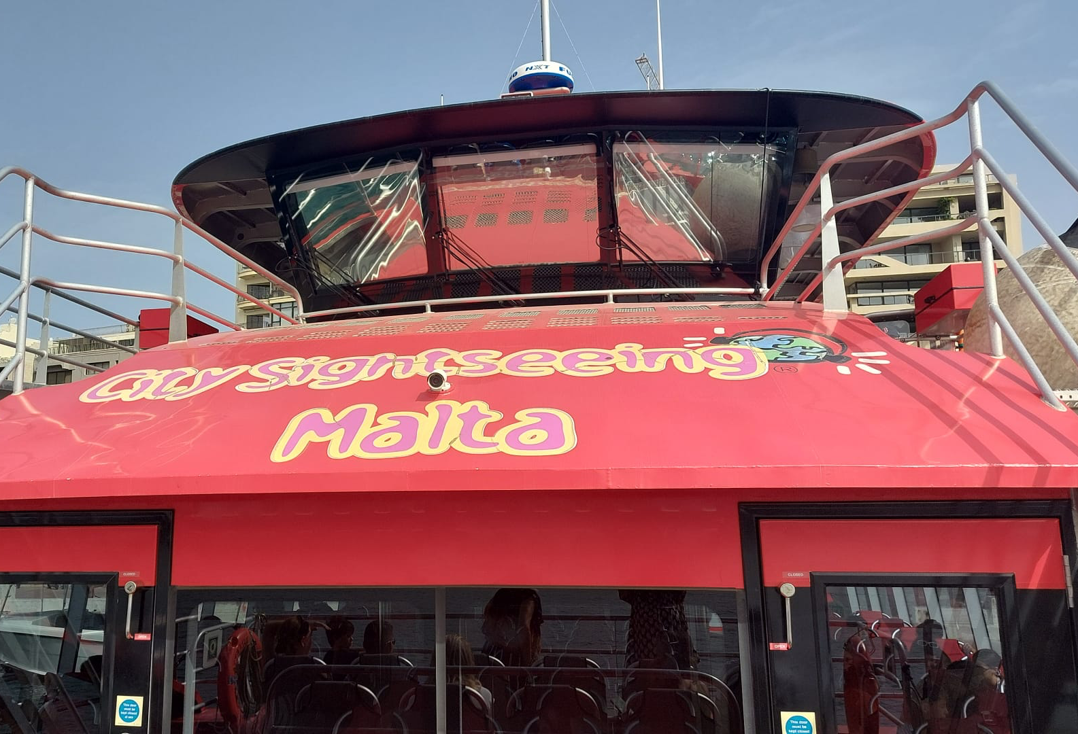
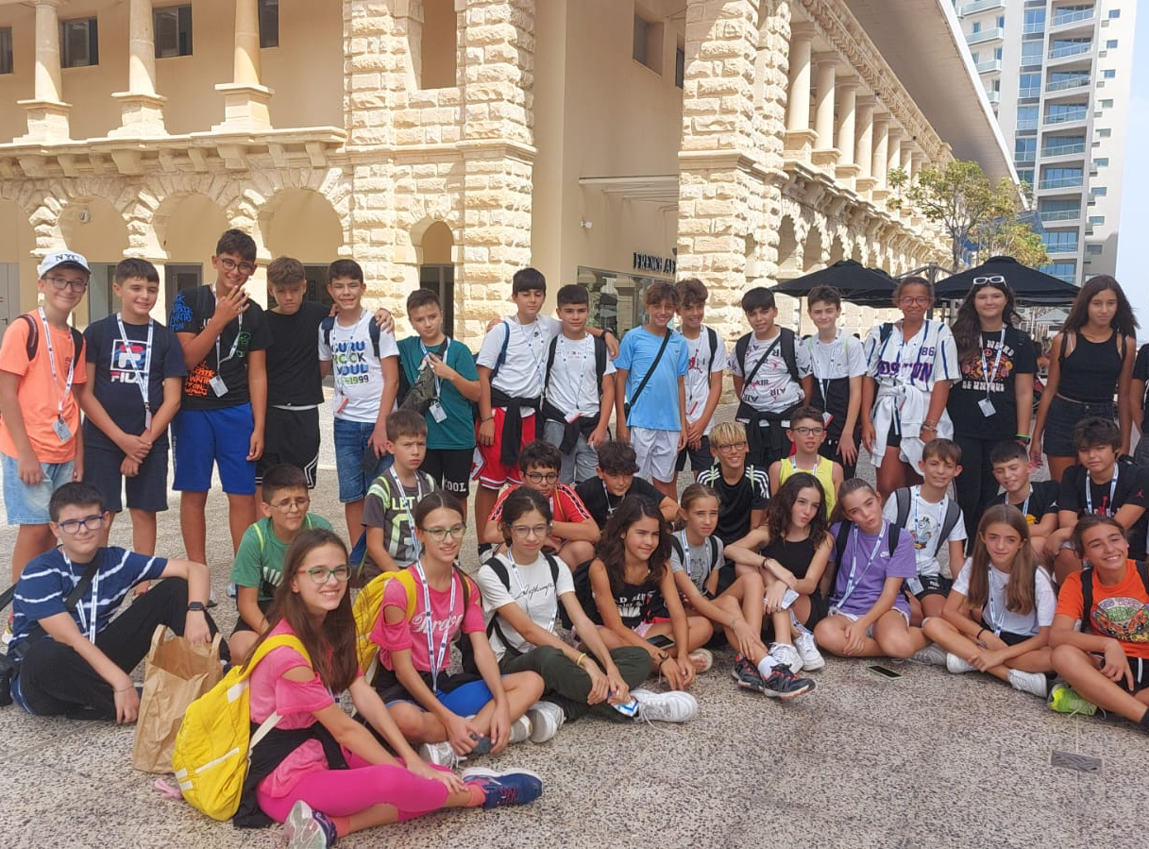
VISIT TO THE COAST
Another activity we carried out was to visit the coasts of Malta where we could observe the popular, inhabited and historical parts by taking a ferry. Once we got off we met our travel companion who hadn't been able to leave. Once welcomed we went to a shopping center where we could relax, have lunch and do some shopping and then return to the hotel in the evening.

Slide 8
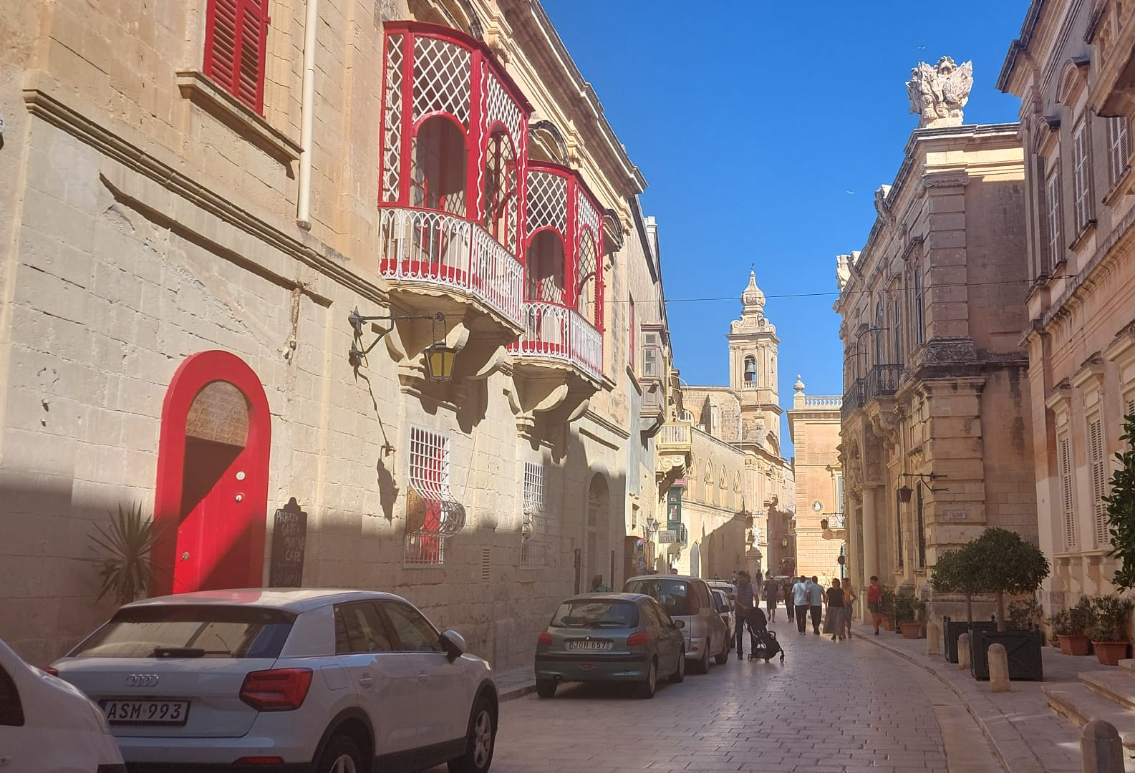
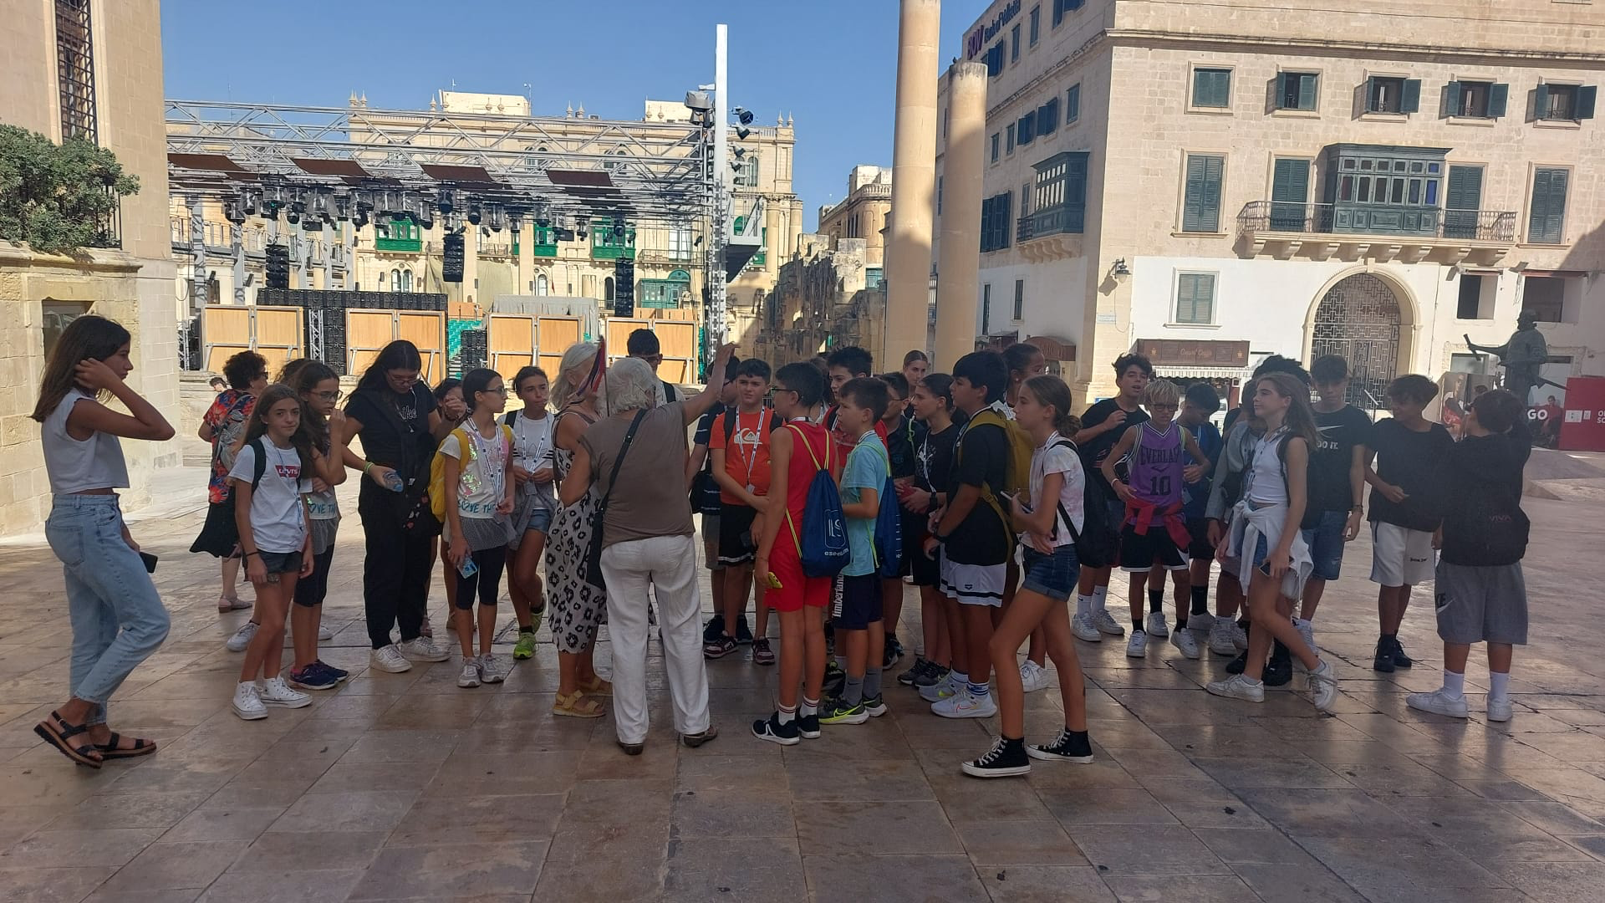
VISIT OF MEDINA AND RABAT
Another activity we did was visiting Medina, the old capital of Malta and Rabat. We visited the historic center, in particular the alleys, a beautiful mosaic made with flowers and also the church where Pope Francis goes when he visits Malta.

Slide 9
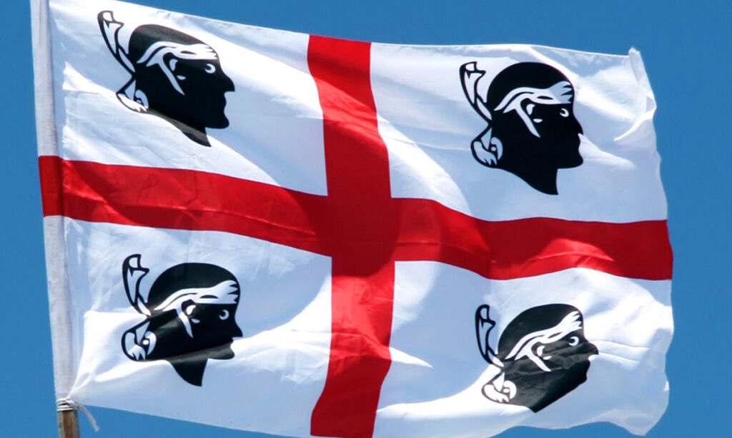
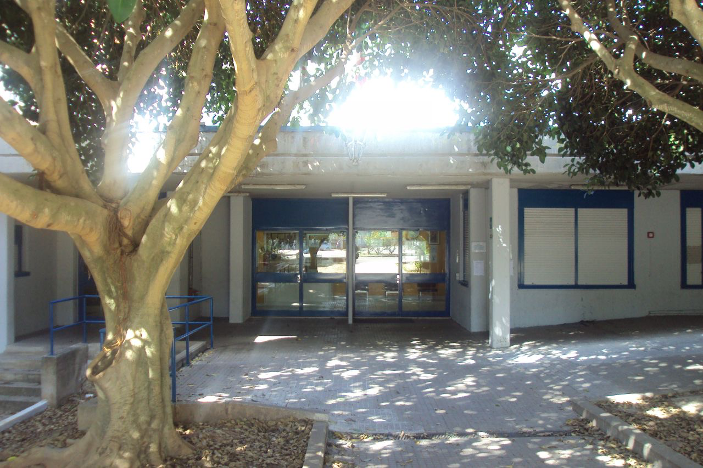
THE RETURN IN SARDINIA
When the day came to return to Sardinia we were very sad given the beautiful experience and the much fun that we would not be able to enjoy again in Sardinia. Once we arrived at the airport with a bus it was around 8pm and we were scared of the storm outside, in fact the flight arrived a hair late. After having dinner and chatting we did the checks and left for Cagliari. All the excitement we had on the way out was certainly not there on the way back and what's more we were very tired since we landed at around 10pm. Then we took a bus, in which the driver was phenomenal who brought us back to our city around 2 in the morning. When we saw our parents again we were very happy but not enough to console ourselves. It is certainly an experience worth repeating both from a linguistic and cultural point of view but above all from a social point of view: we made so many friends! Now our destiny had returned to normal: we had to wake up early and go to school

