Slide 1
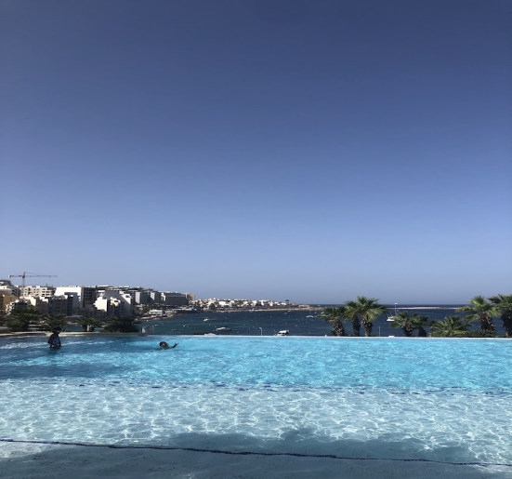
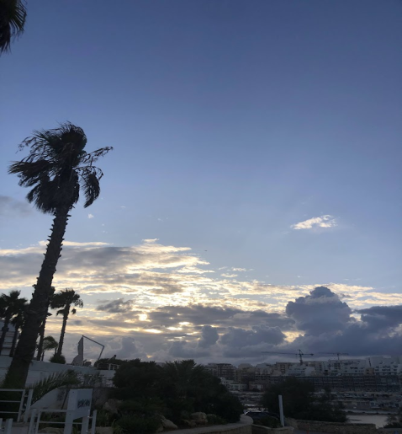
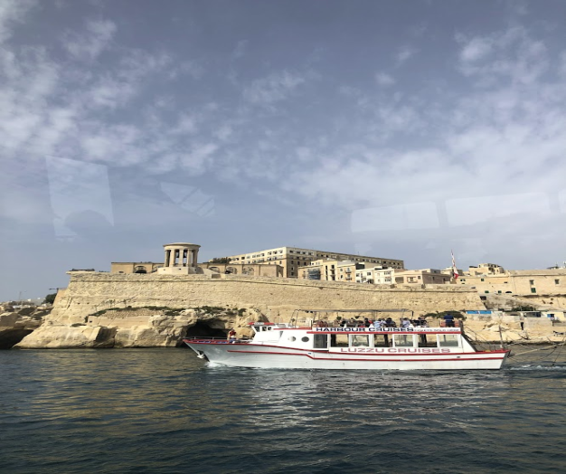
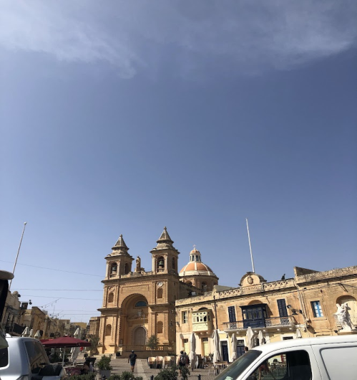
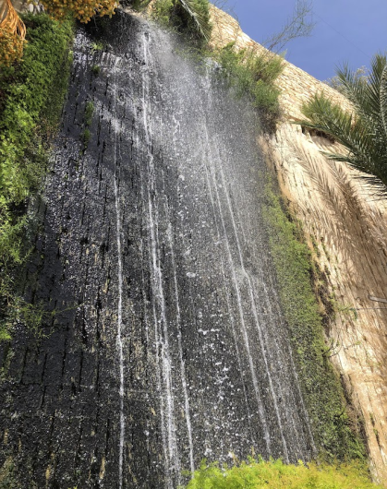
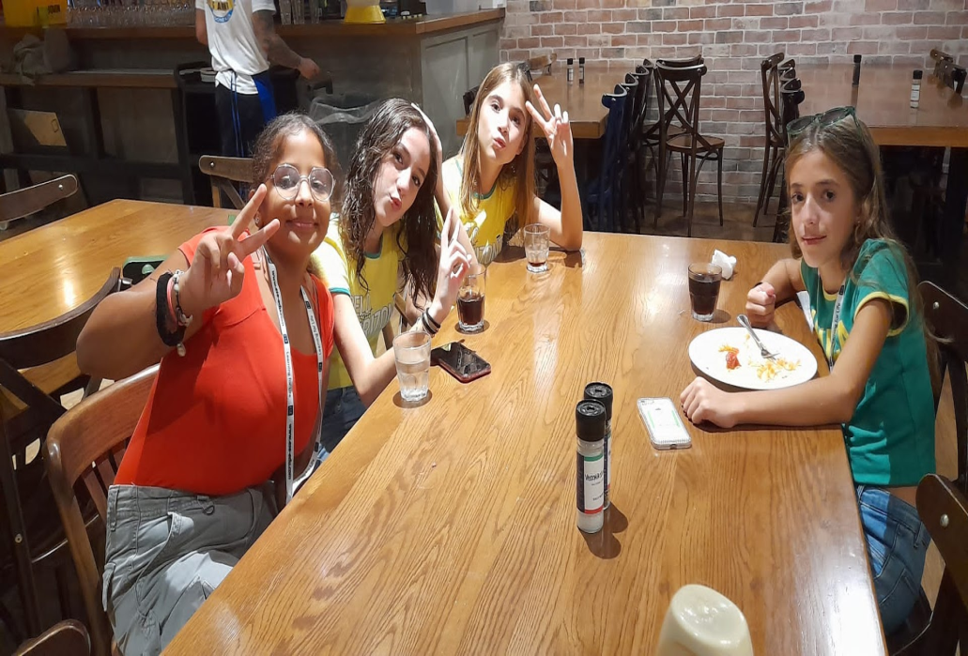
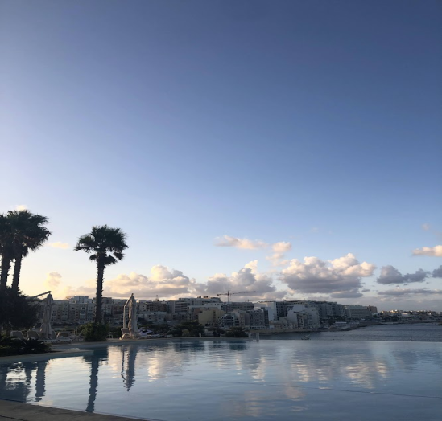
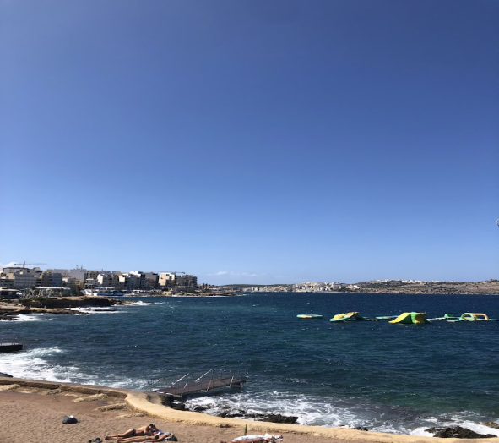
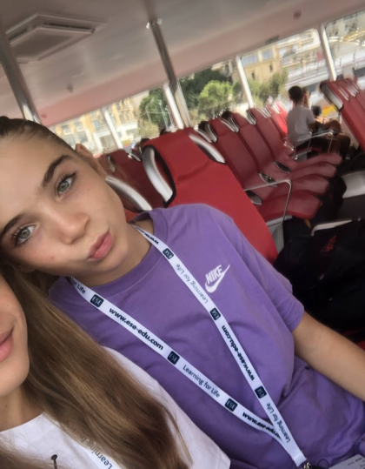
EXEPERIENCE TO MALTA
(Elettra and Matilde)

Slide 2
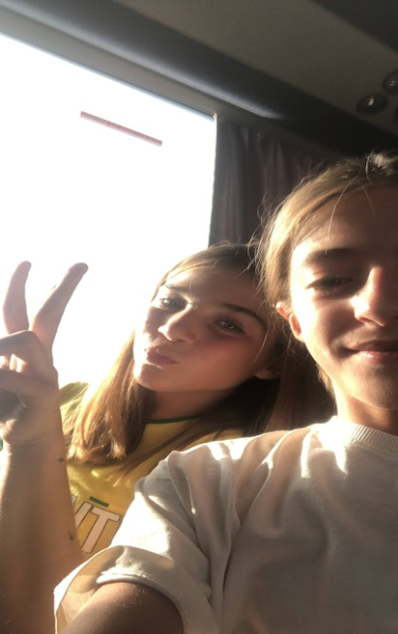
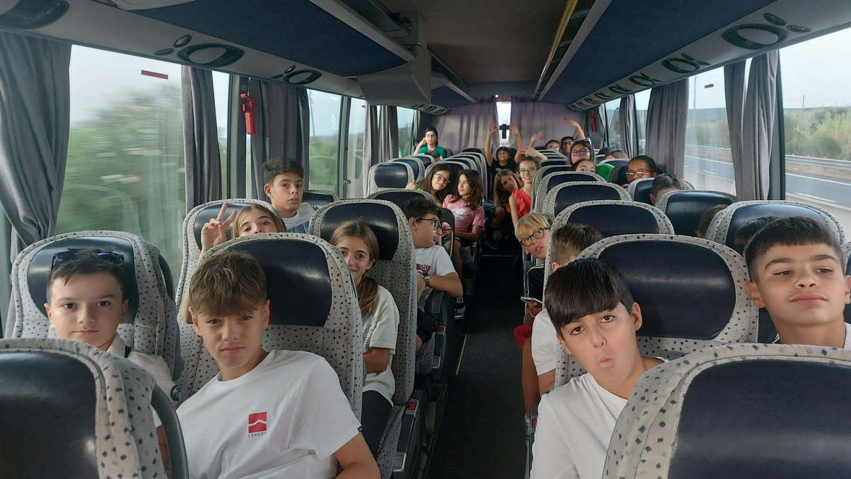
We went on a bus from Sassari to Cagliari airport

Slide 3
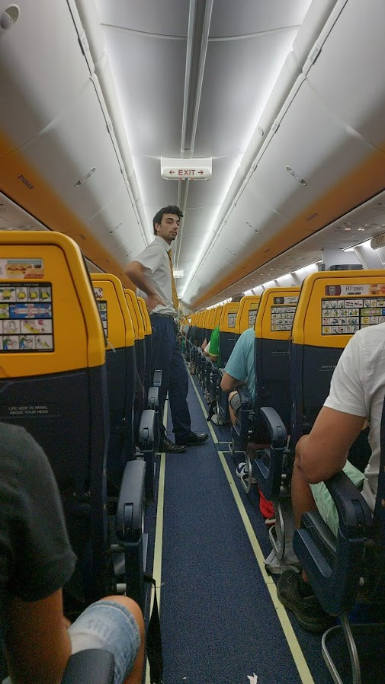
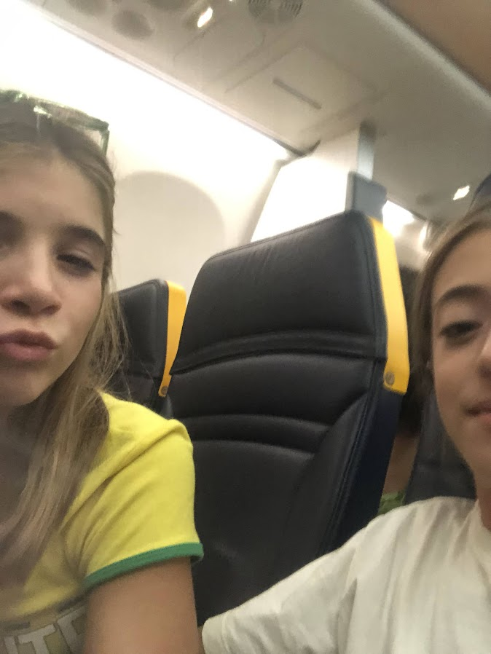
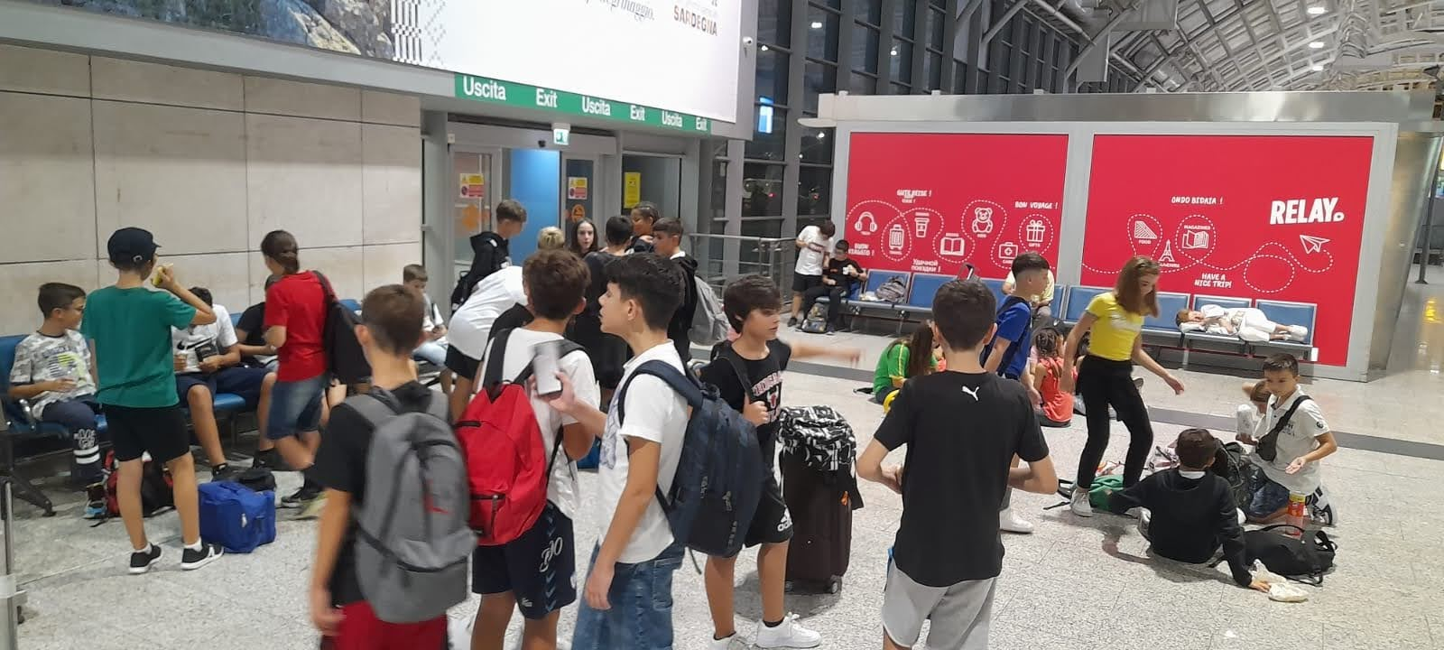
When we arrived at the airport we took the plane to Malta

Slide 4
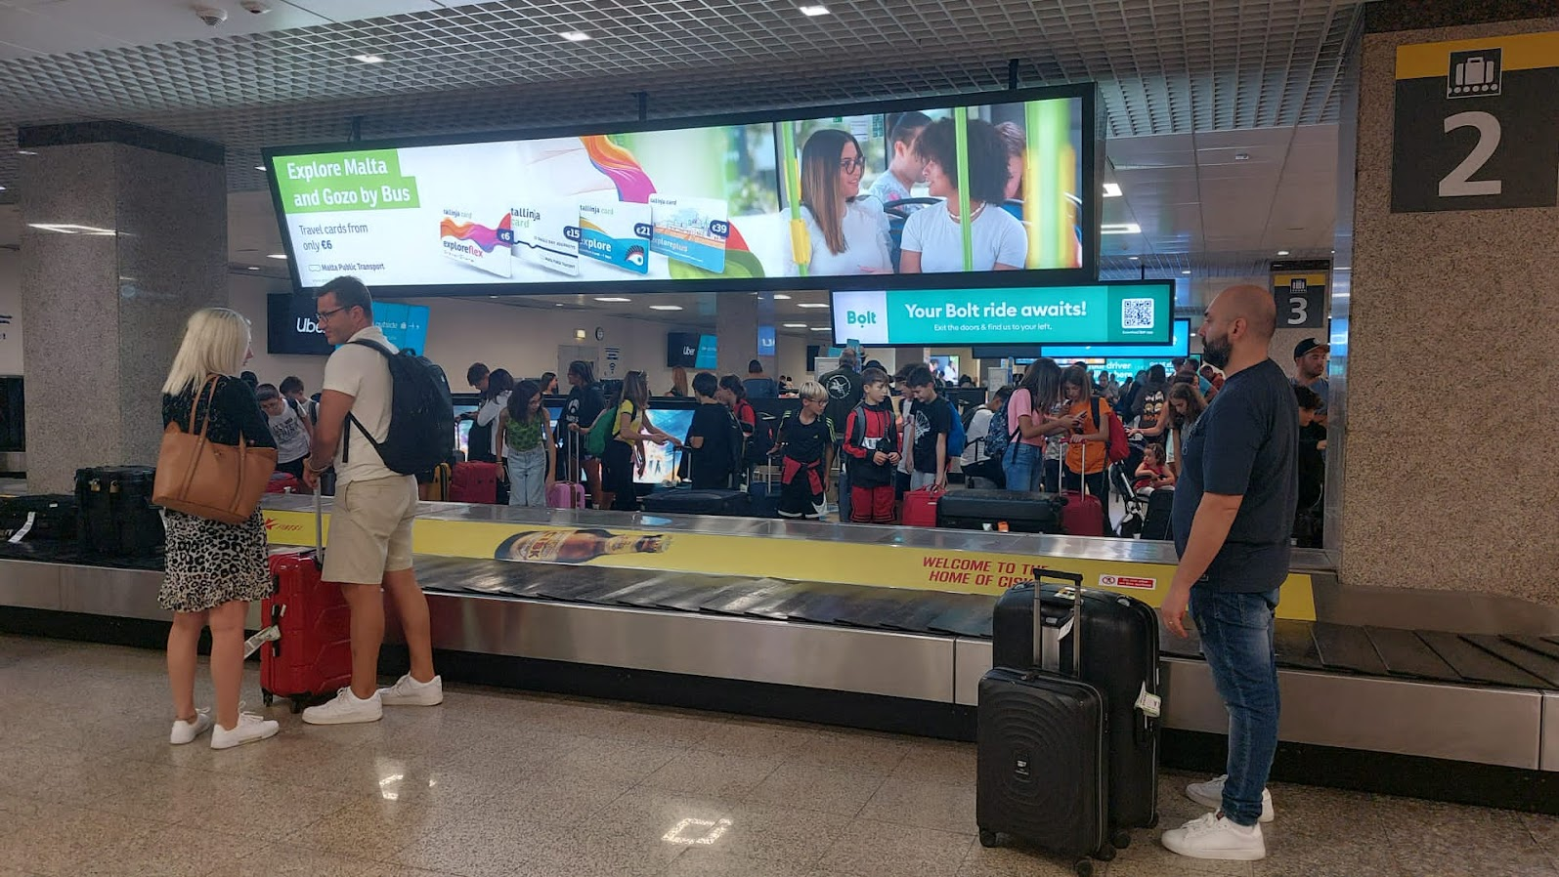
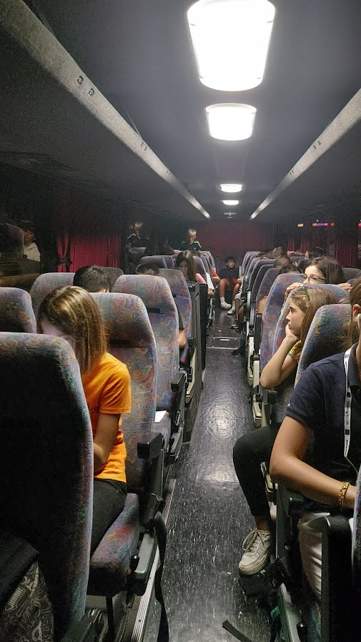
When we arrived in Malta it was 2 in the morning so we went to sleep and the next day we started touring the city

Slide 5
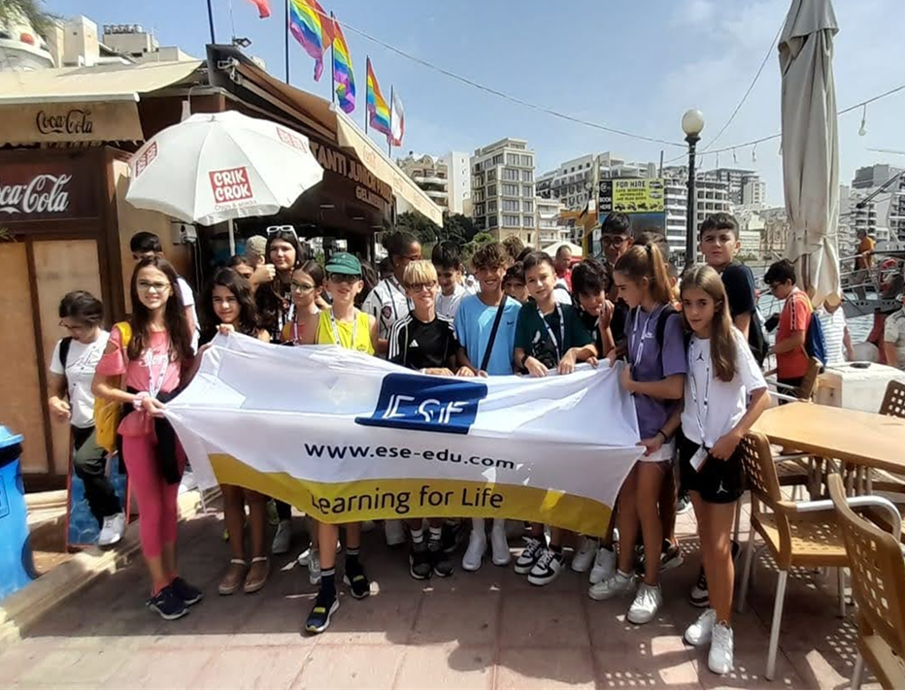
This is the whole group

Slide 6
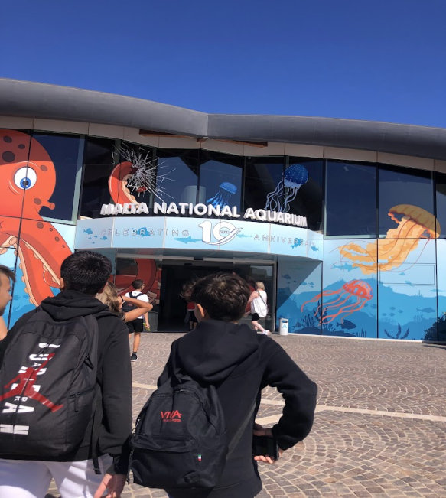
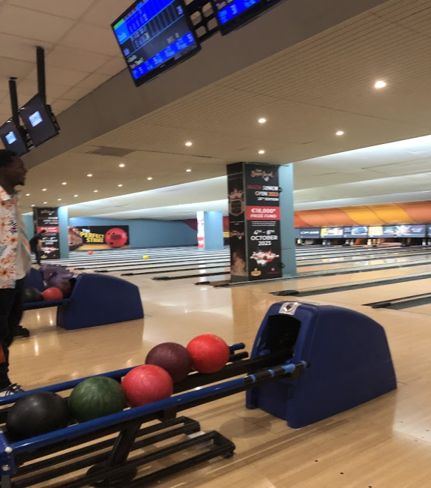
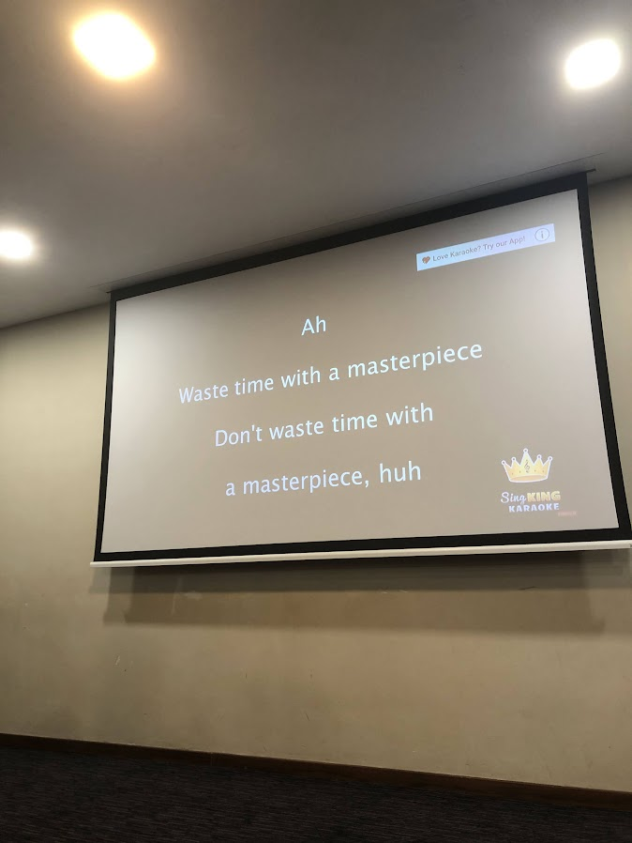
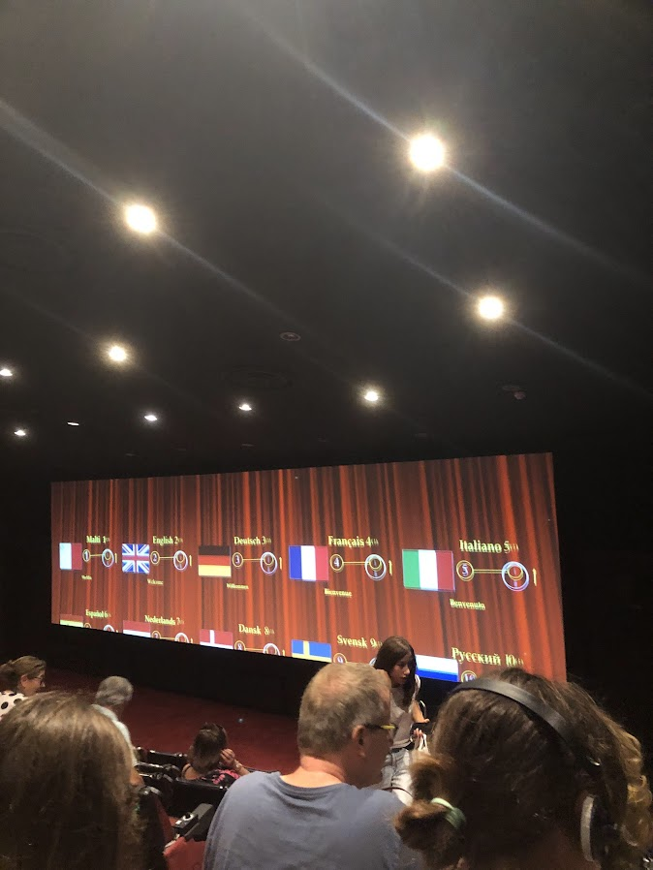
We saw the aquarium, the minerals of Malta, la Valletta and Mdina. We took a boat tour, we saw the glass blowing shop and the bowling. We did karaoke in the hotel, we had English lessons, we swam in the pool, we watched a movie, played in the gaming room, we went shopping…

Slide 7
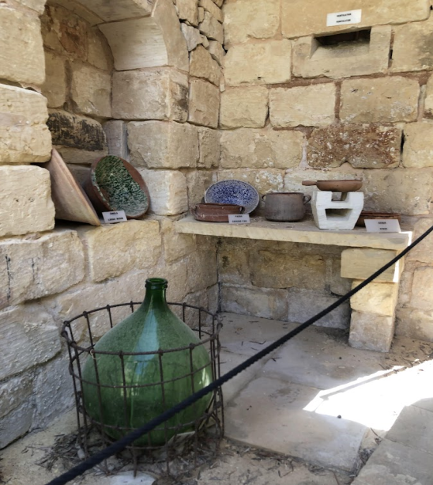
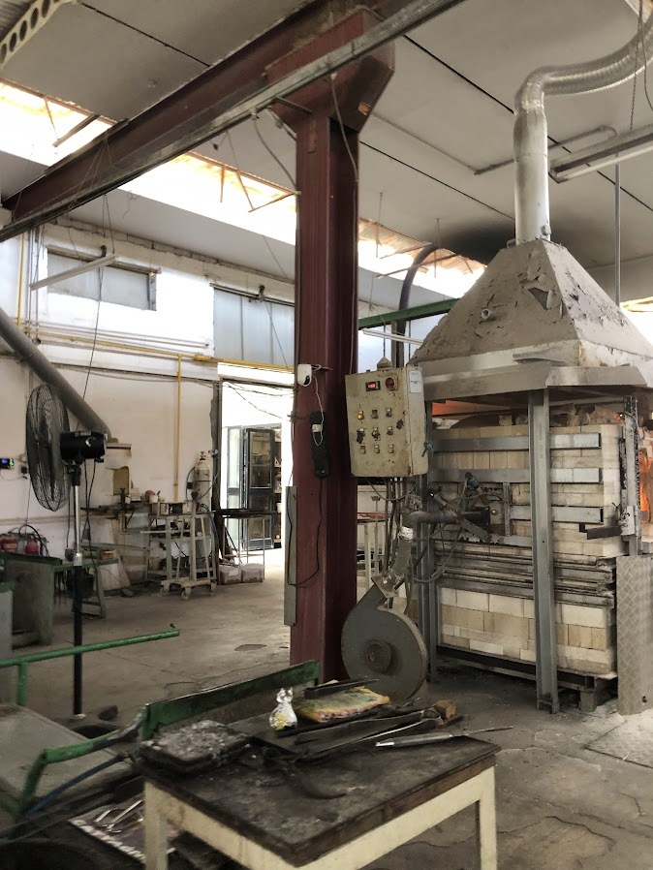
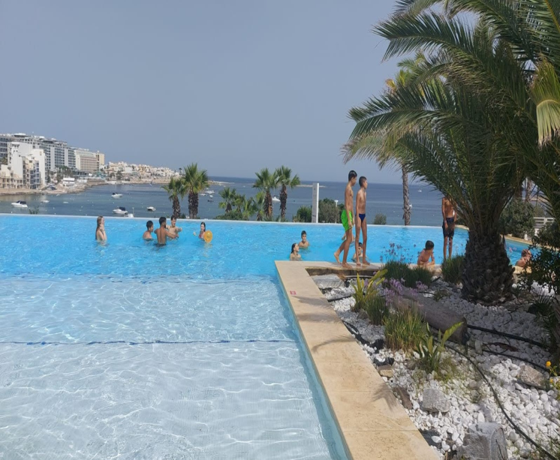
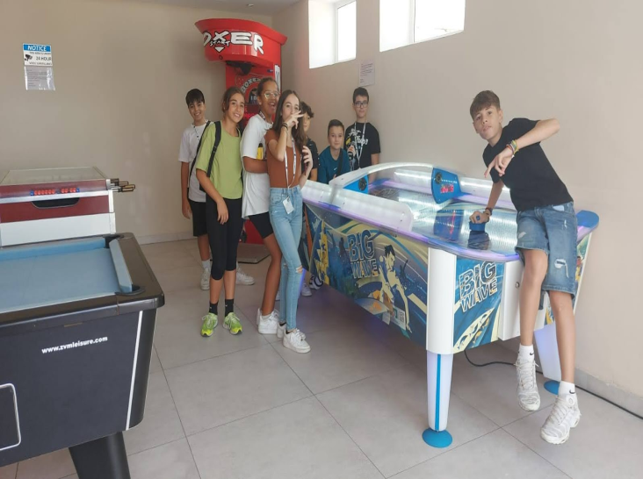
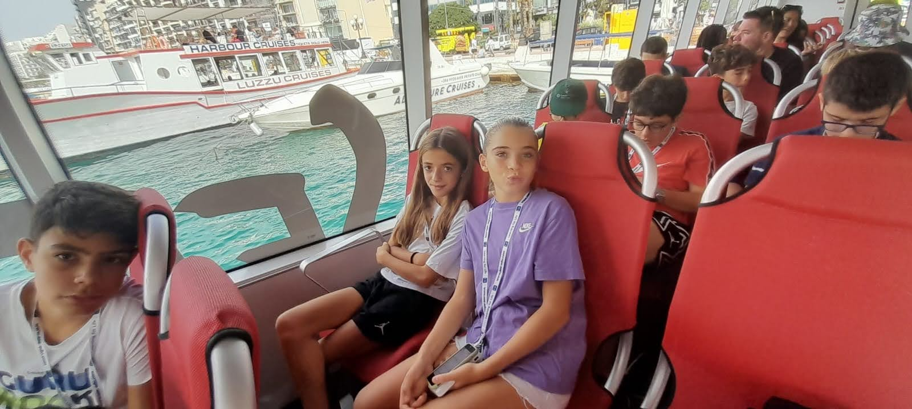
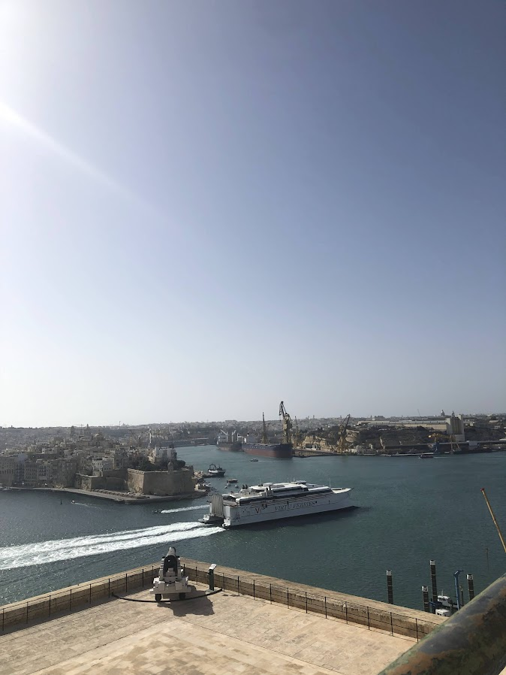

Slide 8
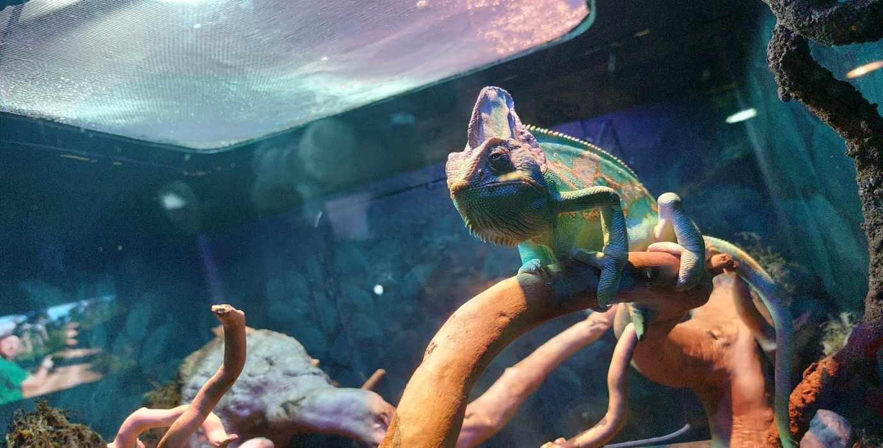
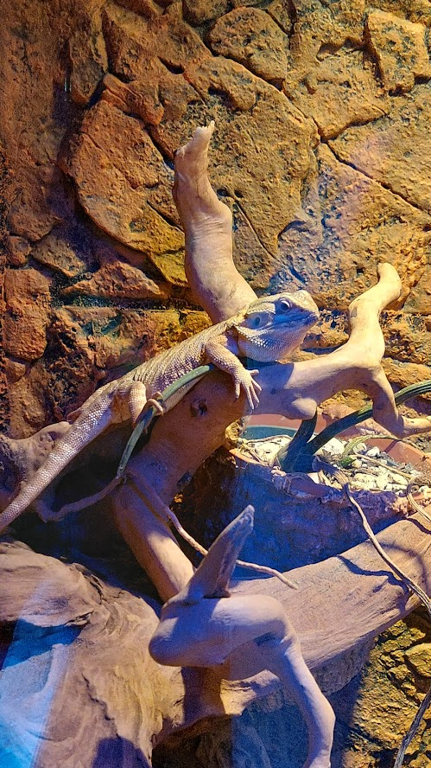
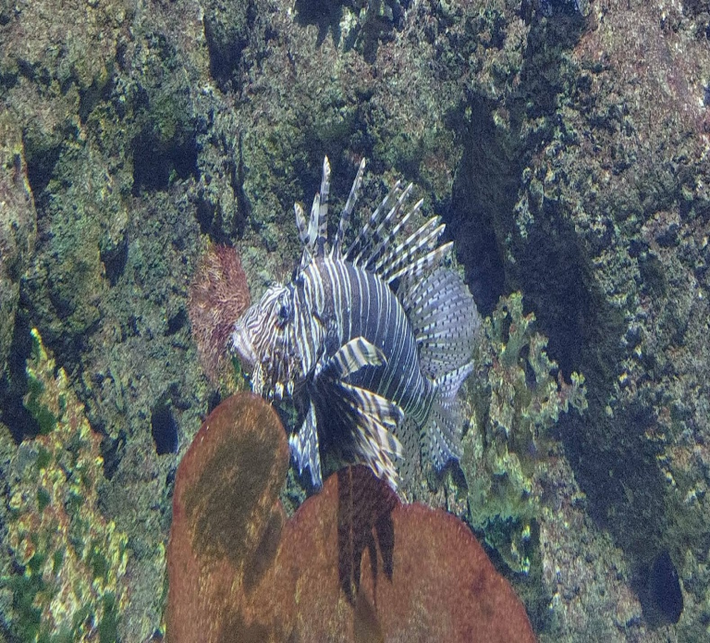
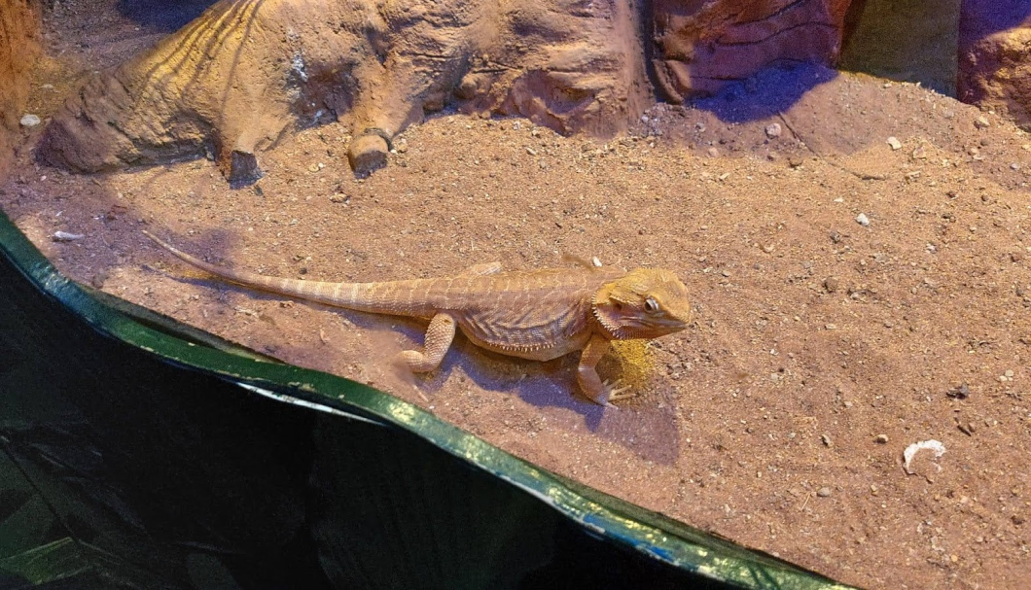
Aquarius
Here you can come accross groupes of: amberjaks, octopus, squi, flying fish, rays perch, boghe, mullet and parrot fish to name the most common species.

Slide 9
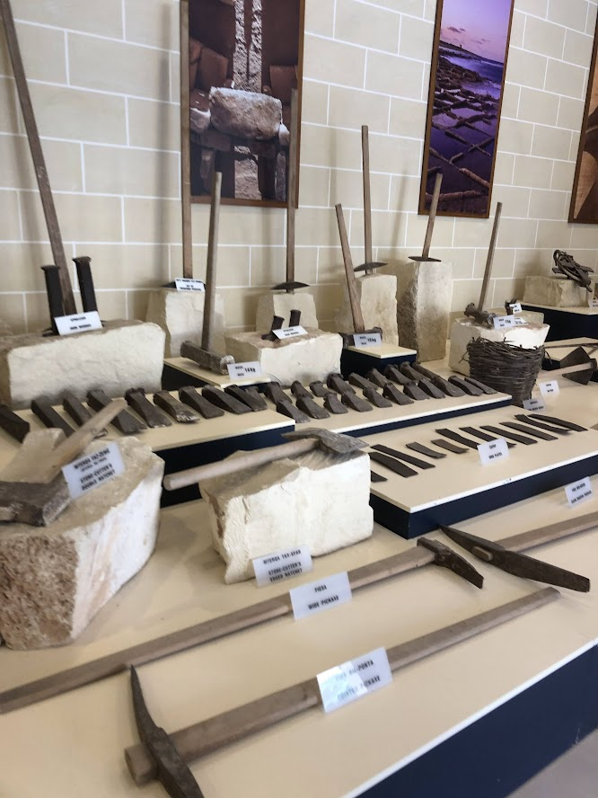
Minerals of Malta
All the industrial minerals on Malta are seedimentary in origin. They comprise limestone, clays, sandstones and phosphate. It is widely known that the quality of these minerals varies a lot.

Slide 10
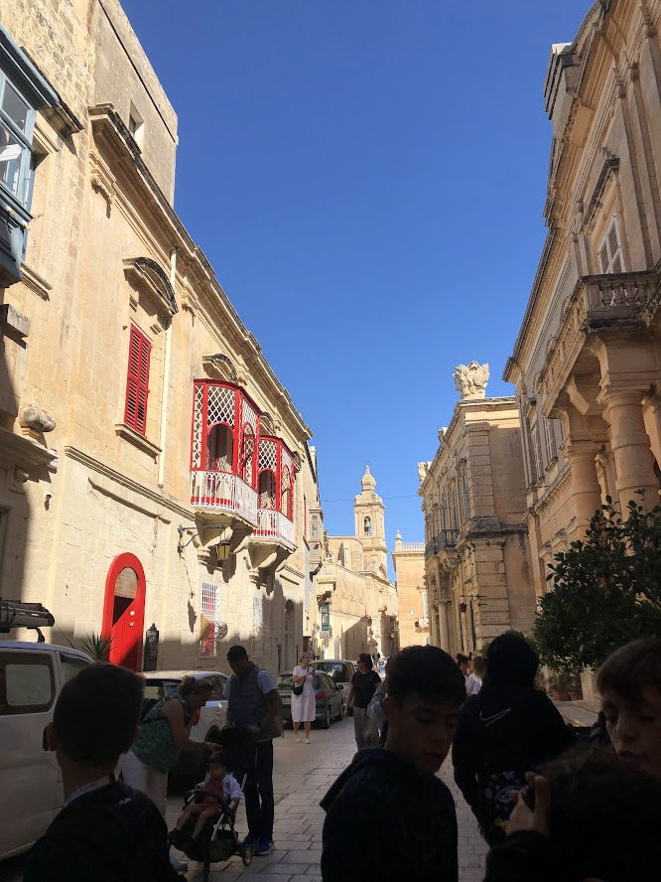
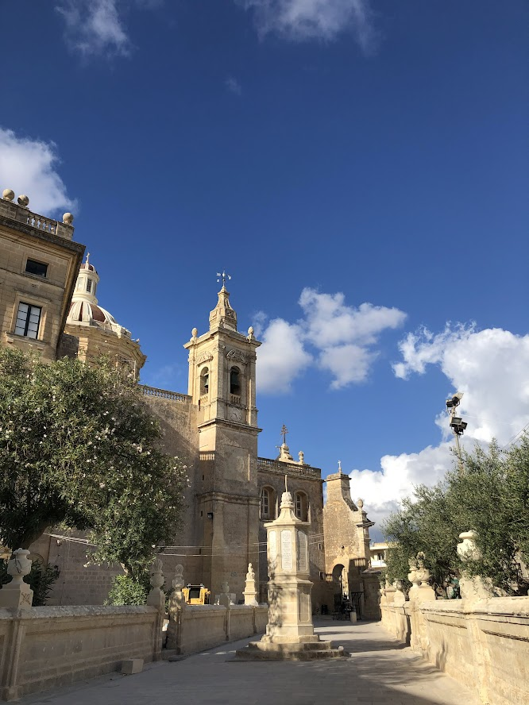
La Valletta
La Valletta is the small capital of the island state of Malta. The walled city was founded in the 16th ceuntry on a peninsula by the Knights of St. John, a Catholic religious order. It is known for its museums, palaces and impressive churches. Among the baroque buildings, the Co- Cathedral of Saint John stands out, whose sumptuous interior houses «The Beheading of Saint John the Baptist », a masterpiece by Caravaggio.

Slide 11
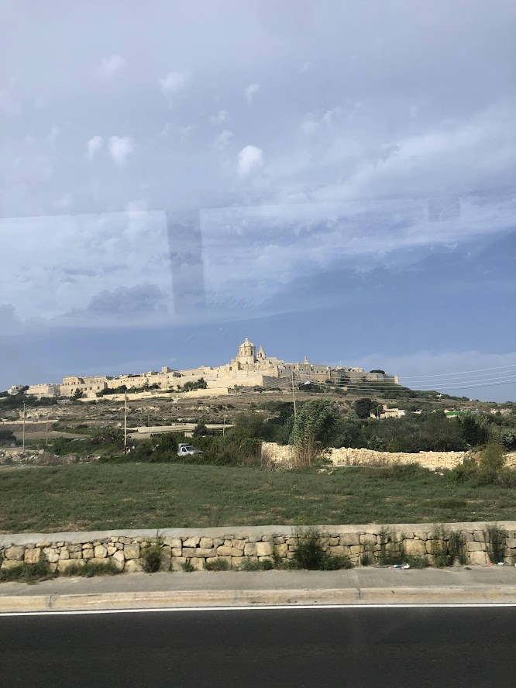
Castle of Mdina
The fortifications of Mdina are a series of defensive walls which surround the former capital city of Mdina, Malta. The city was founded as Maleth by the Phoenicians in around the 8th centrury BC, and it later became part of the Roman Empire under the name Malite.

Slide 12
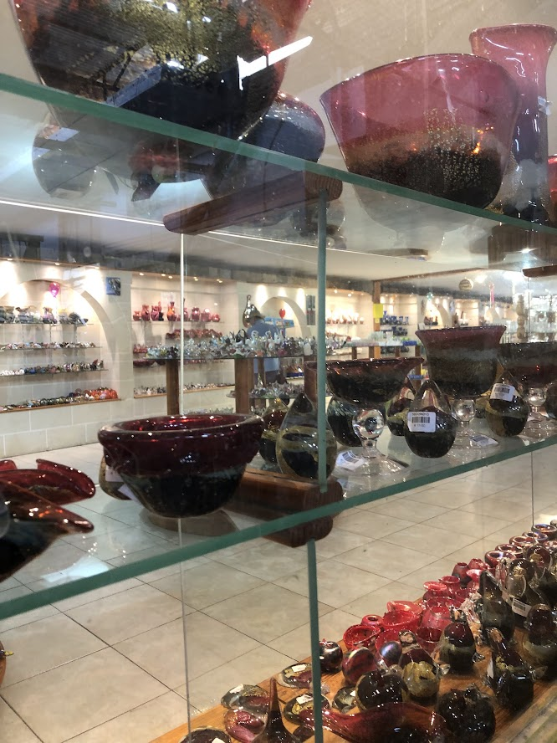
Blown glass
Glass processing in Malta is a very important artisanal richness, the pride of the island and much much admired by tourists. Maltese art glass creations come to life using only the oldest glass blowing techniques, which have been refined over the centuries.

Slide 13
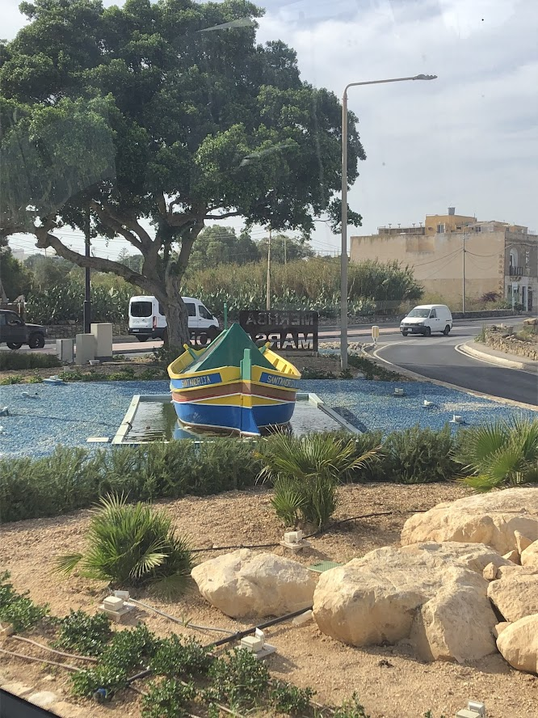
Boats of Malta
These colourful boats are known as the Maltese luzzu, and they date back to the time of the ancient Phoenicians. The luzzu has now even become, one of the symbols associated with the Maltese islands.

Slide 14
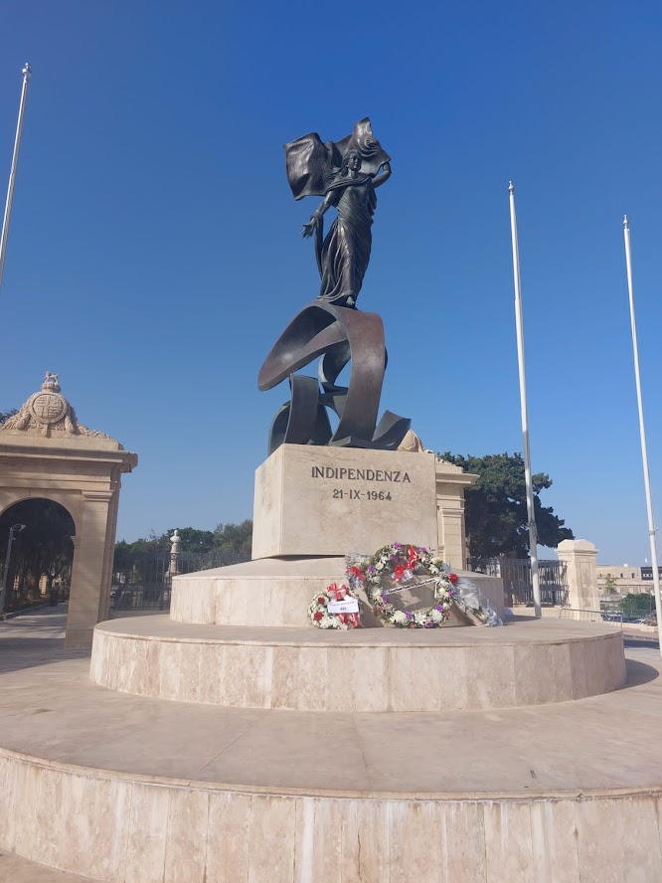
Indipendece day
Indipendence day is one of the five national holidays in Malta. It celebrates the day the country gained indipendence from the United Kingdom on 21 September 1964.

Slide 15
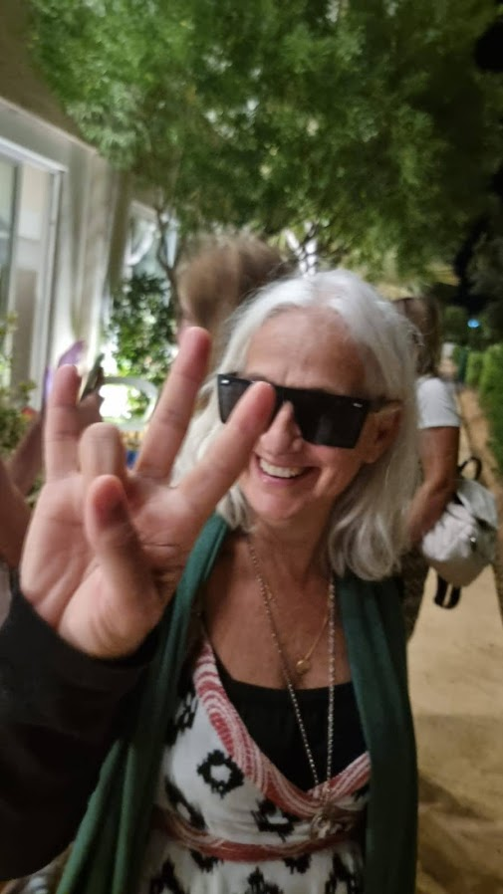
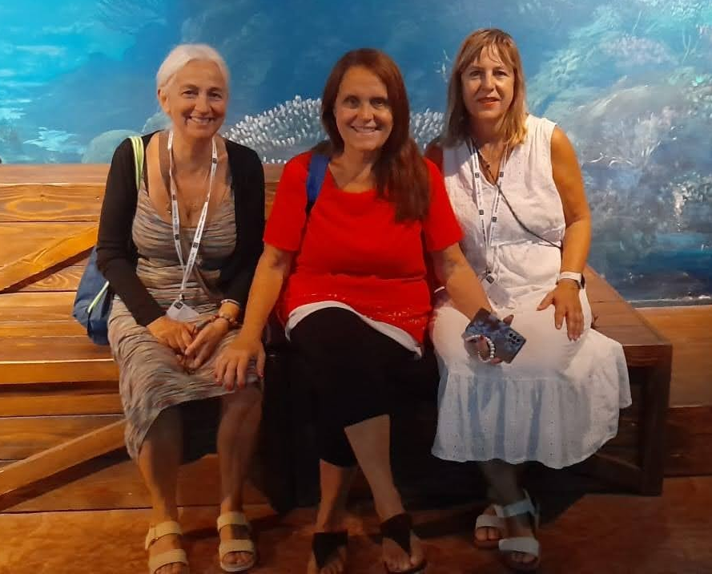
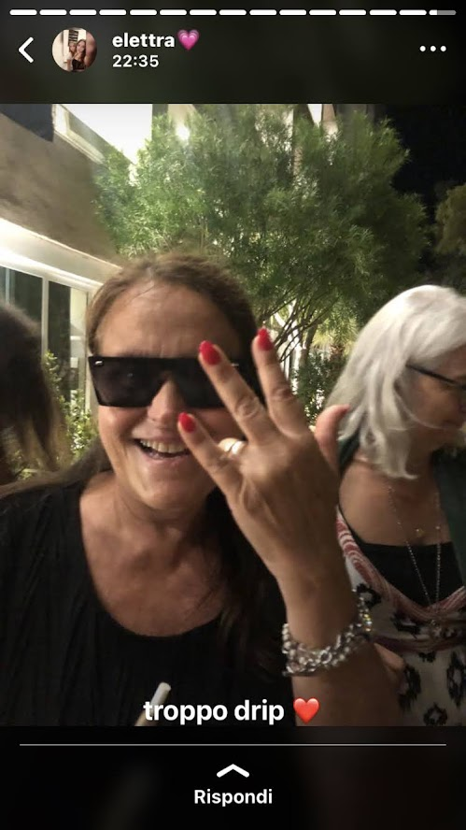
We thank the teachers for this wonderful experience, we had a lot of fun and we hope to have another similar exeperience in the future. We made new friends, visited new places, we spoke English but above all we gossiped with the teachers…

