Slide 1
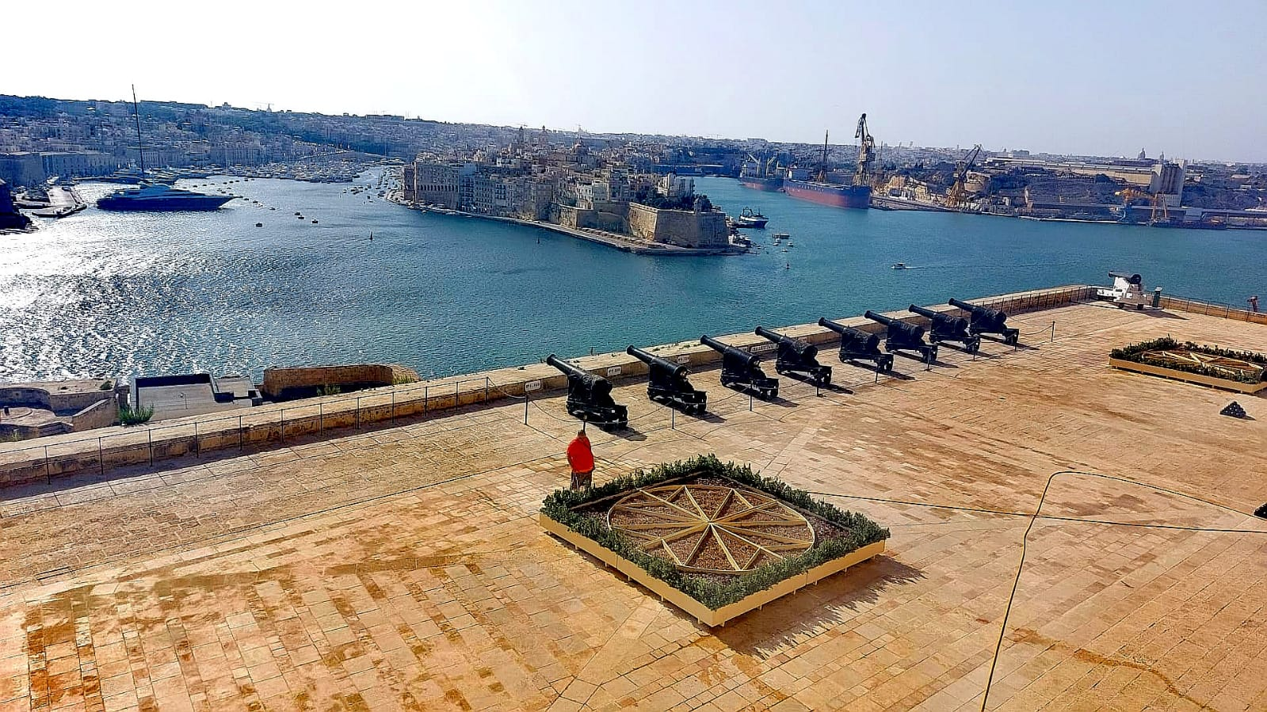
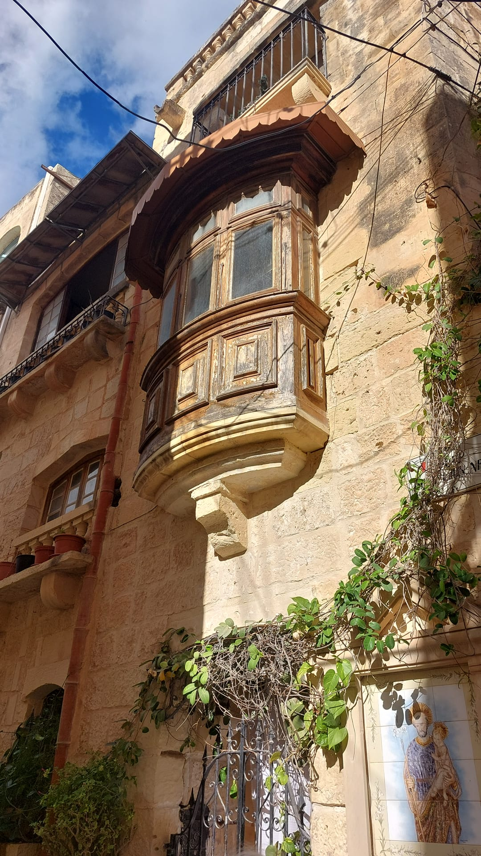
malta

Slide 2
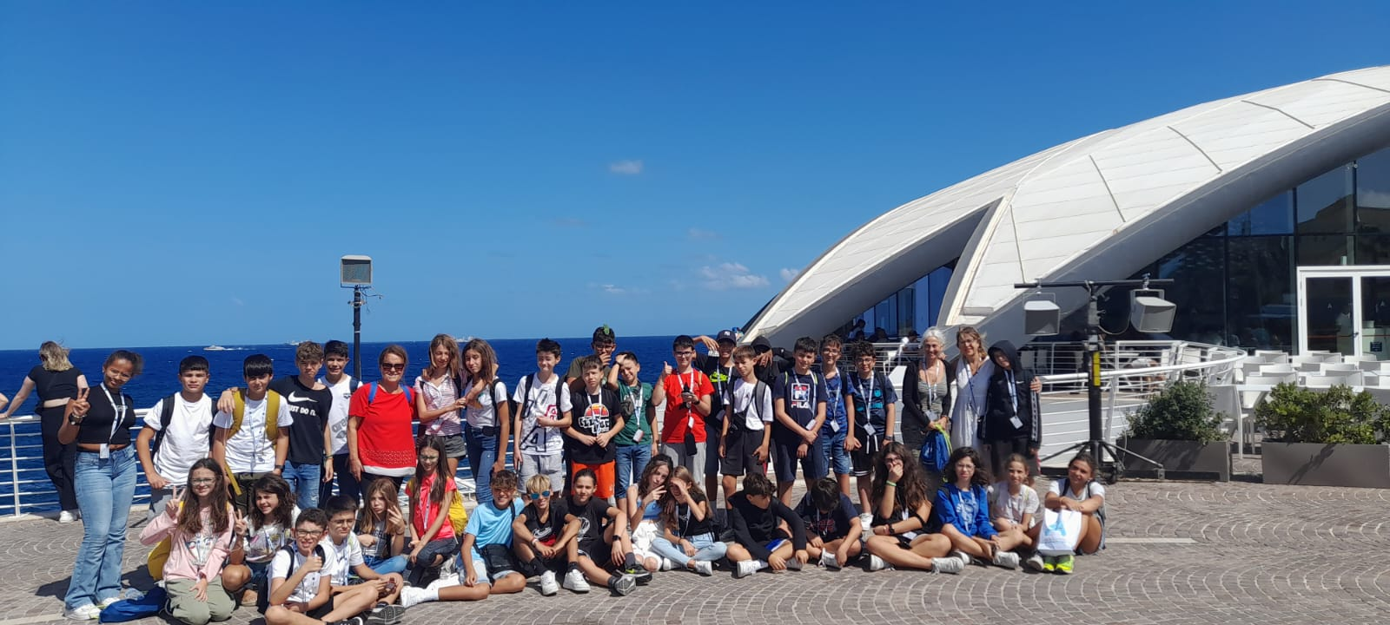
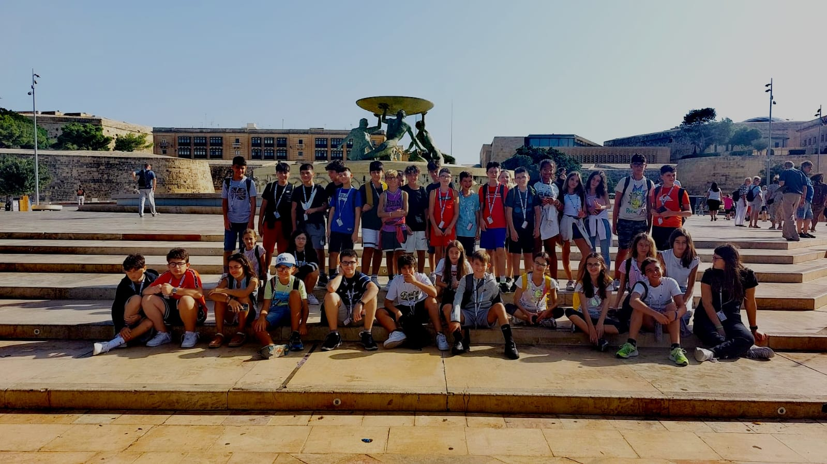
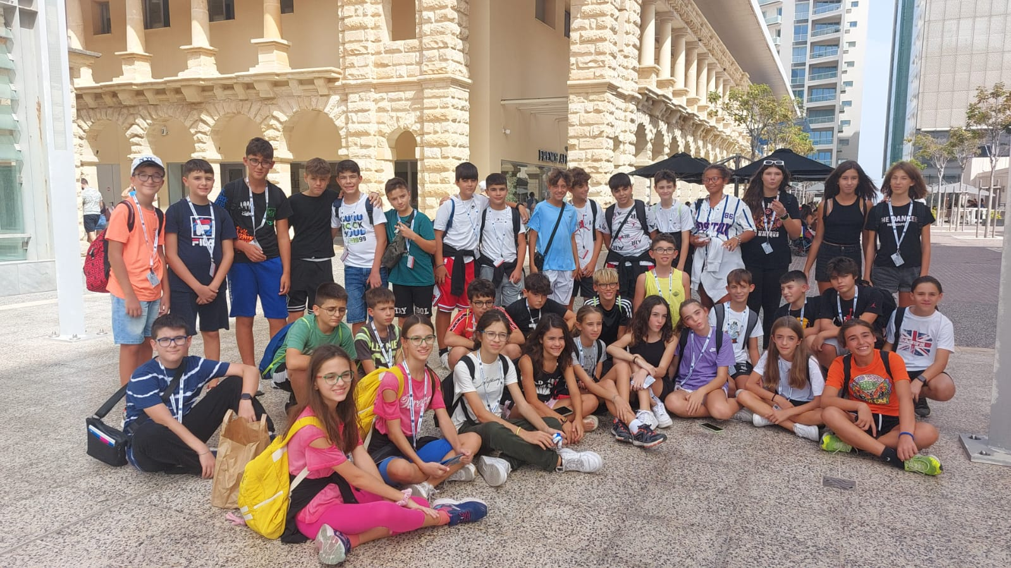
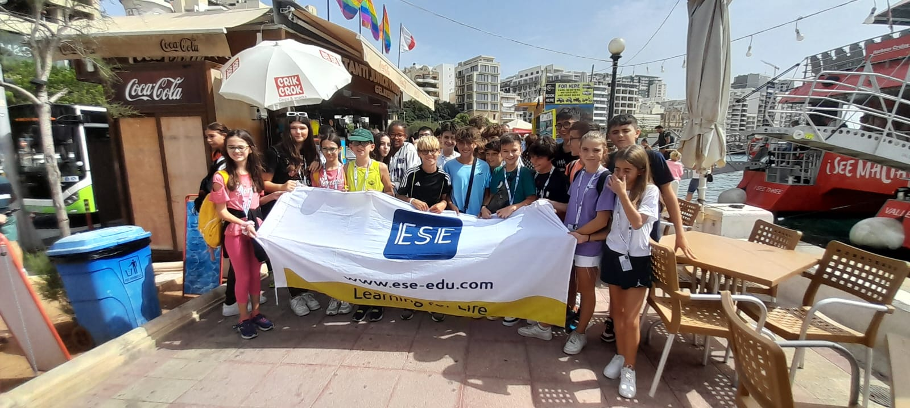
A journey of emotions

Slide 3
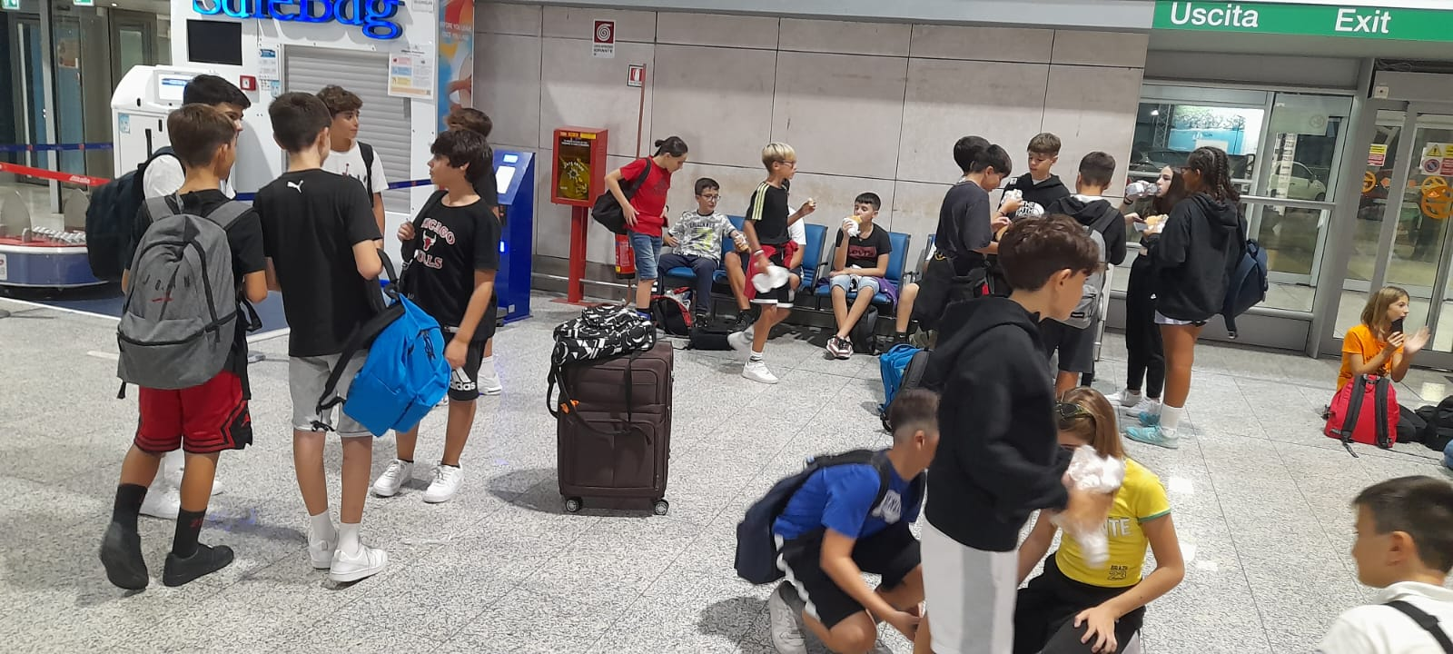
The unexpected
Unfortunately, as soon as we arrived at the airport (Cagliari) we had a big unforeseen event, because during the boarding of the luggage in the hold one of our travel companions realized that he had forgotten his identity document. It was a disappointment for the whole group as our teammate (Andrea) would not have been able to start. He would leave two days later, with his father accompanying him and then return to Sardinia.

Slide 4
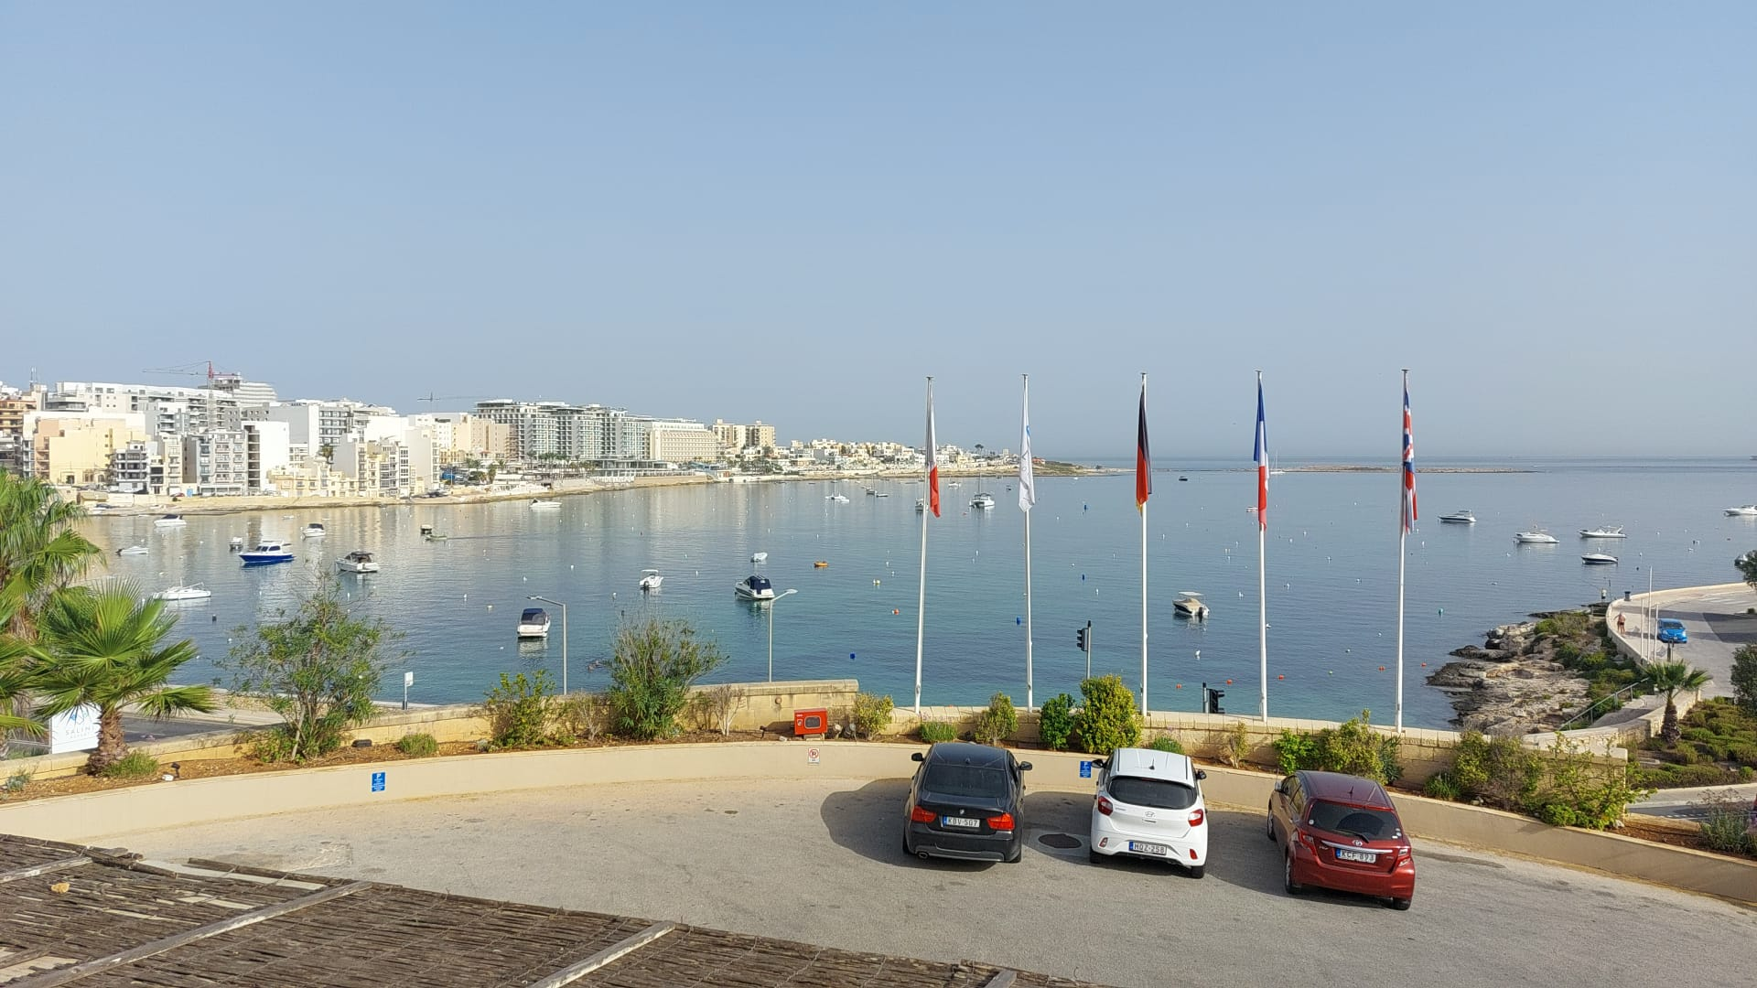
The Arrival
The arrival took place late in the evening. We entered the hotel, filled out some paperwork and with the key to the room we went up to the rooms to go to sleep ready and loaded for the next morning.

Slide 5
A normal day

Slide 6
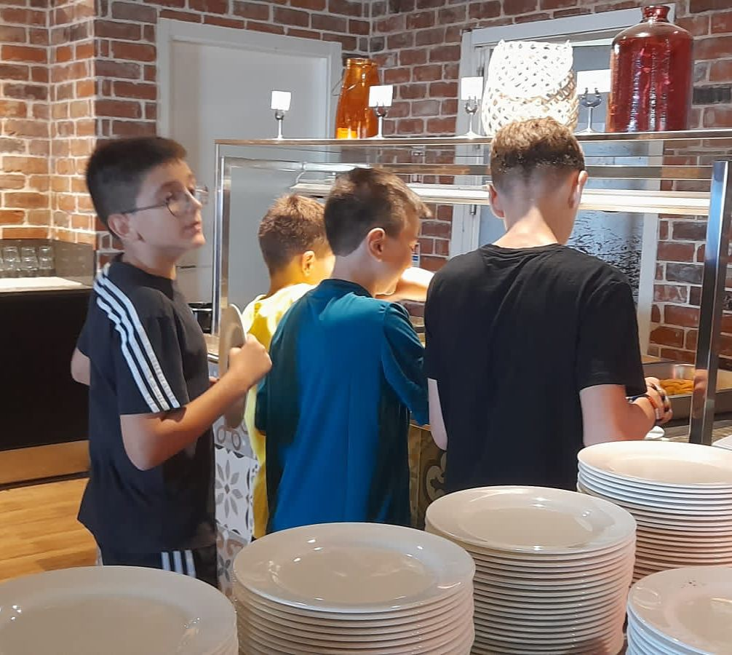
The morning
Every morning the alarm clock was at 7:30 am, since breakfast, based on toast, nutella, mini croissants, frankfurters, eggs etc. started at 8:00 am and was very similar to what the English do. As soon as breakfast was over, we could:
1. Stay all morning at the hotel until lunch. 2. Go for a little hike and come back before lunch. 3. Or take a full day excursion (only the days without lessons), in this case the hotel provided us with a packed lunch.

Slide 7
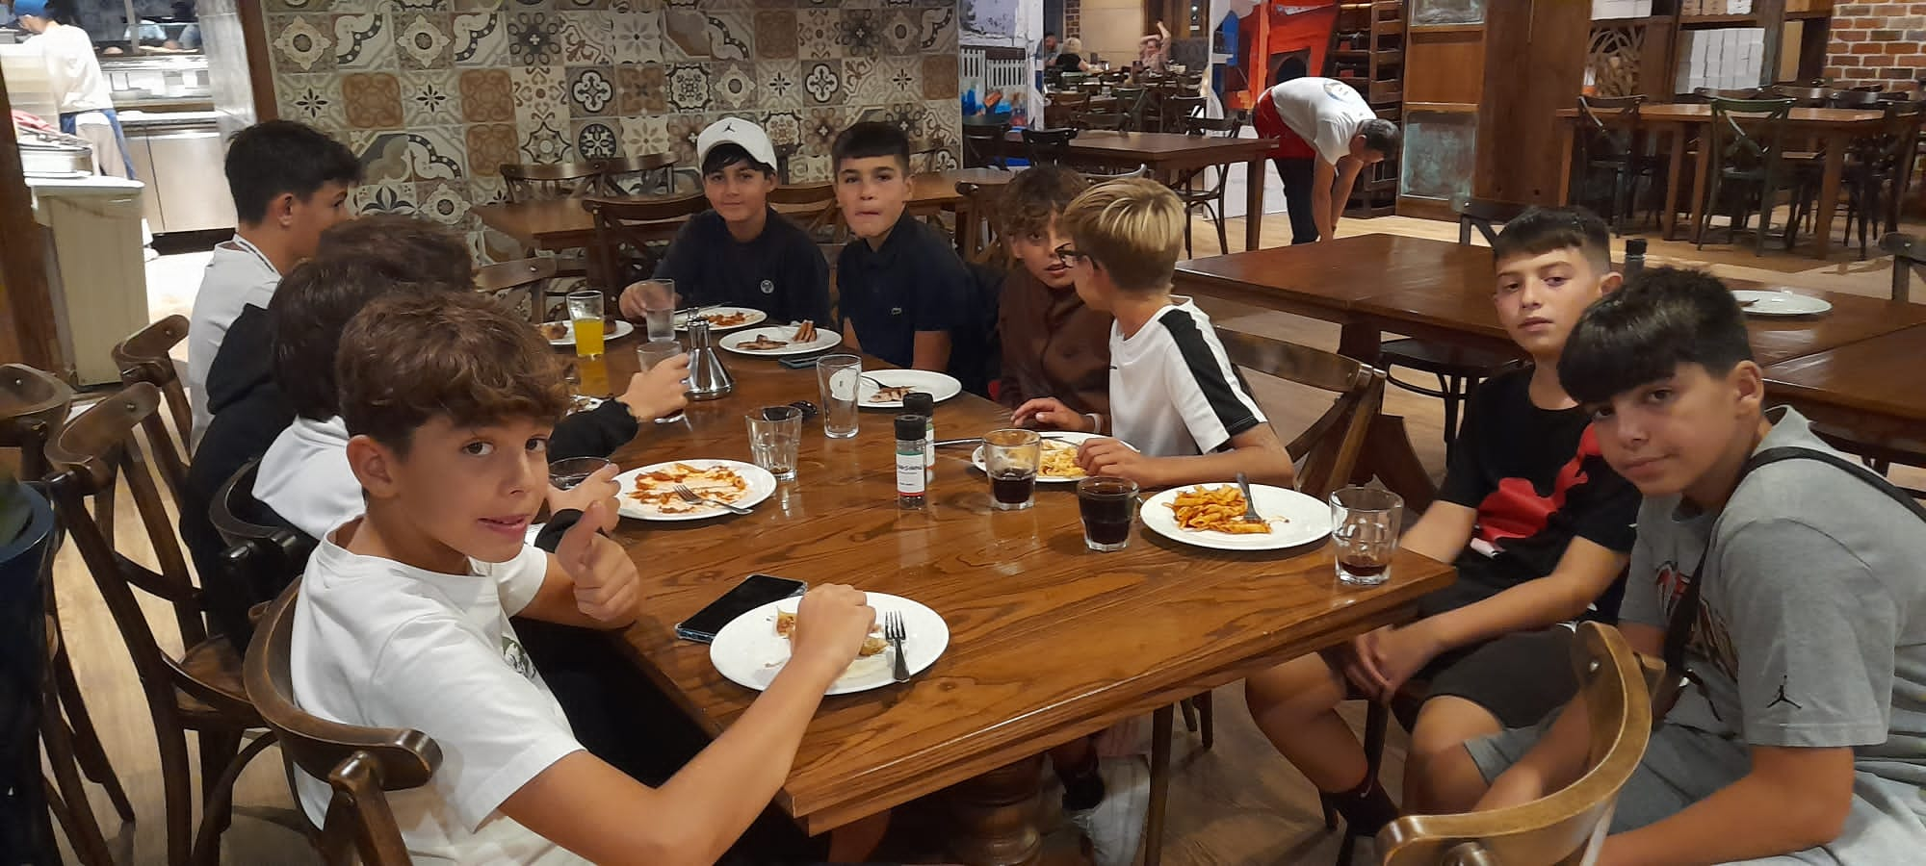
The afternoon
The afternoon was the best part of the day for me. After lunch which started at 13:00 you could choose to do different activities such as: 1. Inside the hotel: play table tennis, stay in the pool or in the games room... 2. Continue the tour started in the morning 3. Go to school from 14:00 until 18:15 with two 15-minute breaks, with also permission to be able to leave the classroom (during breaks). This was what we actually did most often as the other choices were only on days when there was no class

Slide 8
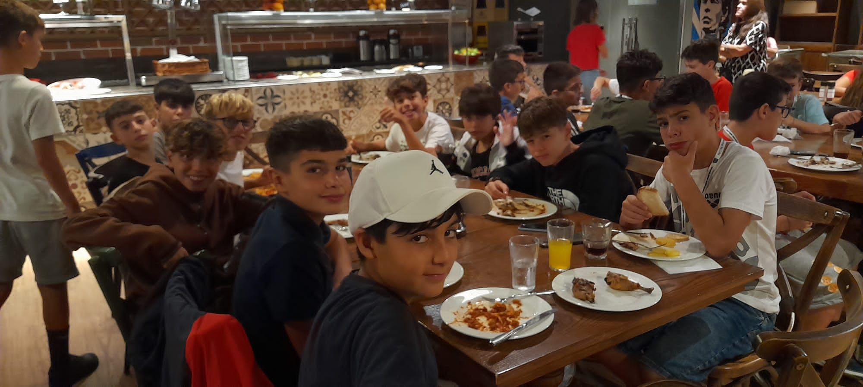
In the evening/night
The first act of the evening was dinner which started at 20:00 with a wide variety of food : burgers, pasta, fruit... After dinner, around 20:30/21:00, you had time until 22:00 to hang out at the hotel, and then go to your room to sleep ready for the next morning.

Slide 9
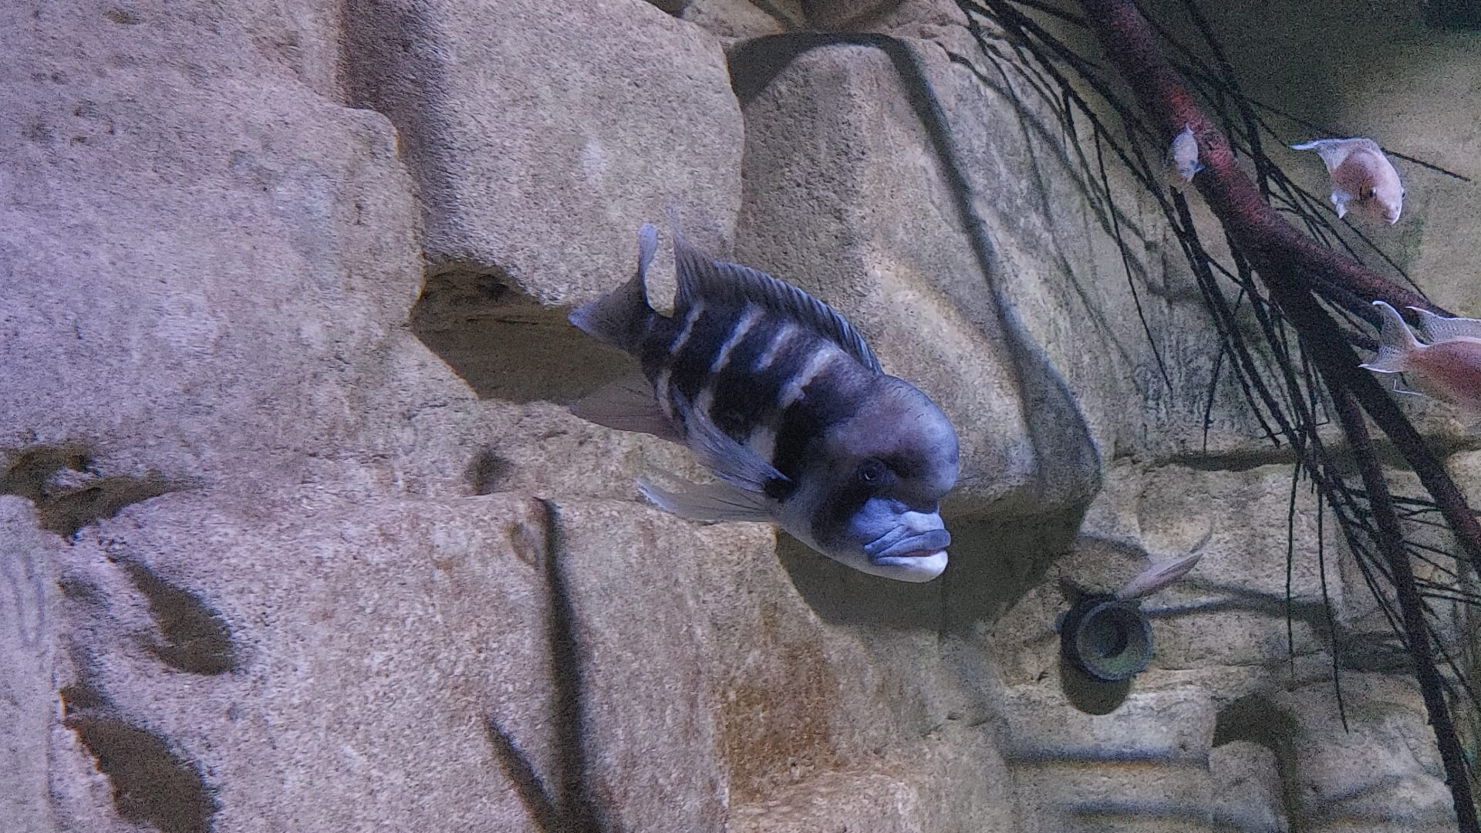
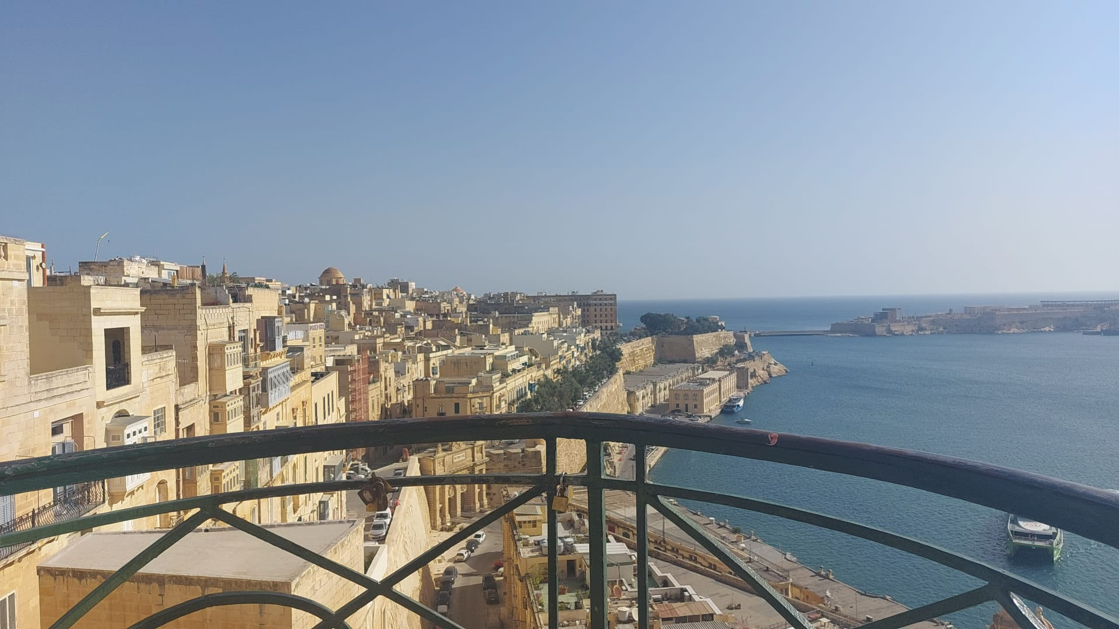
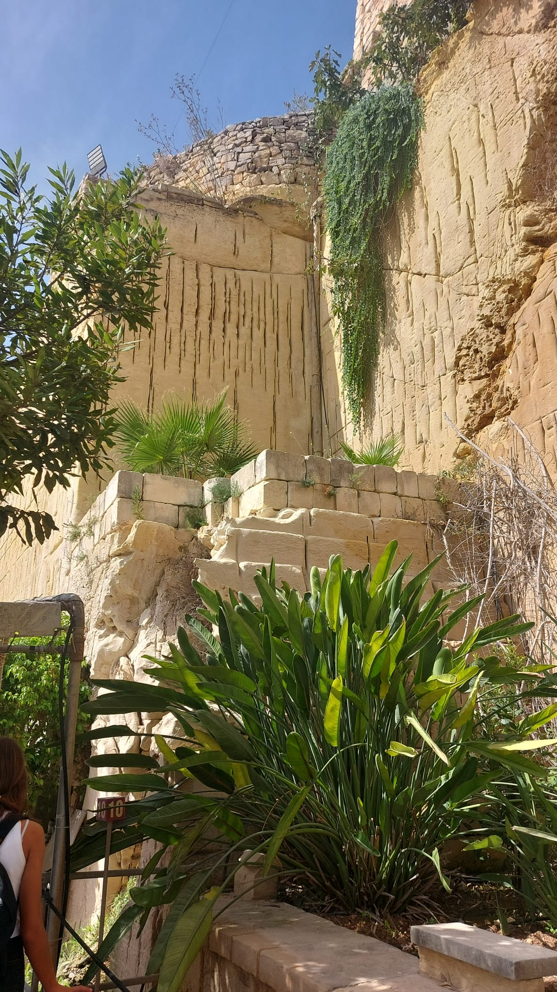
Places to visit

Slide 10
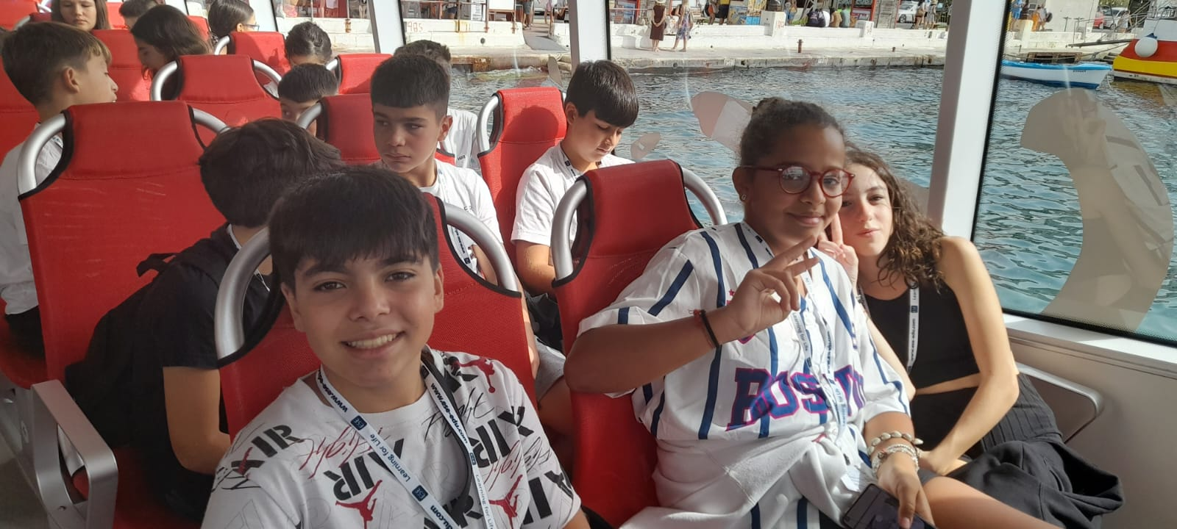
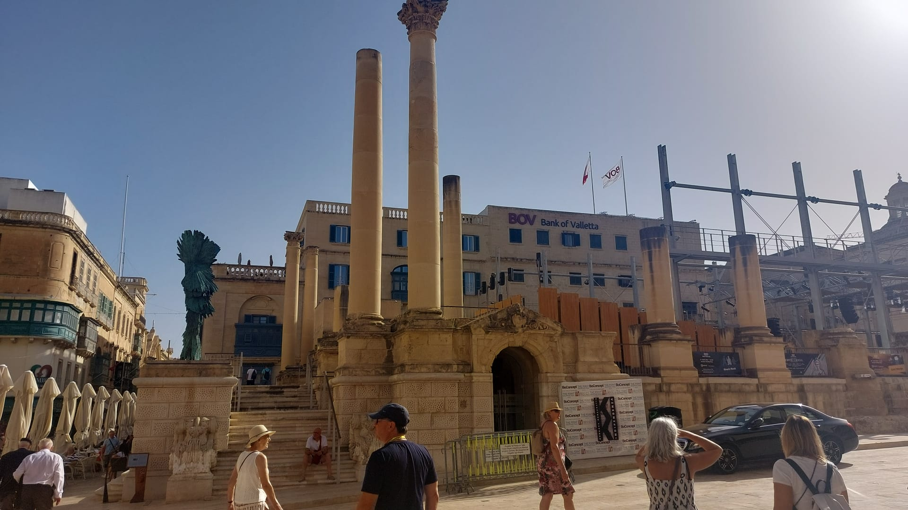
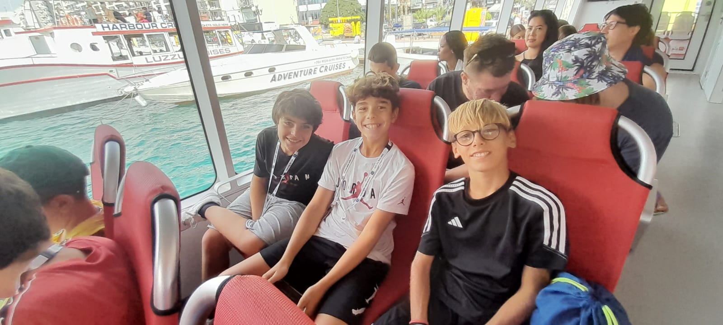
Valletta
La Valletta (capitale di Malta) è una citta molto turistica e con una storia bellissima .
Ricca di palazzi antichissimi e con le sue alte mura , che attirano turisti da tutto il mondo .
Consiglio di visitarla anche con una gita organizzata in barca .

Slide 11
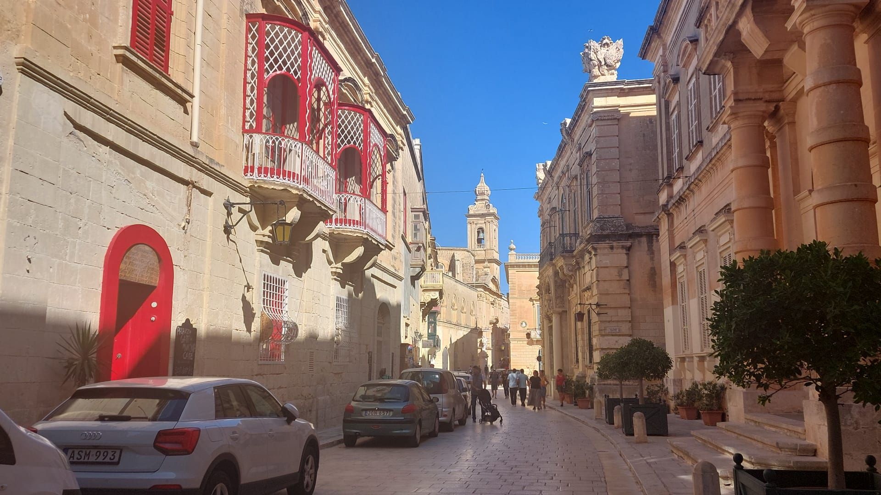
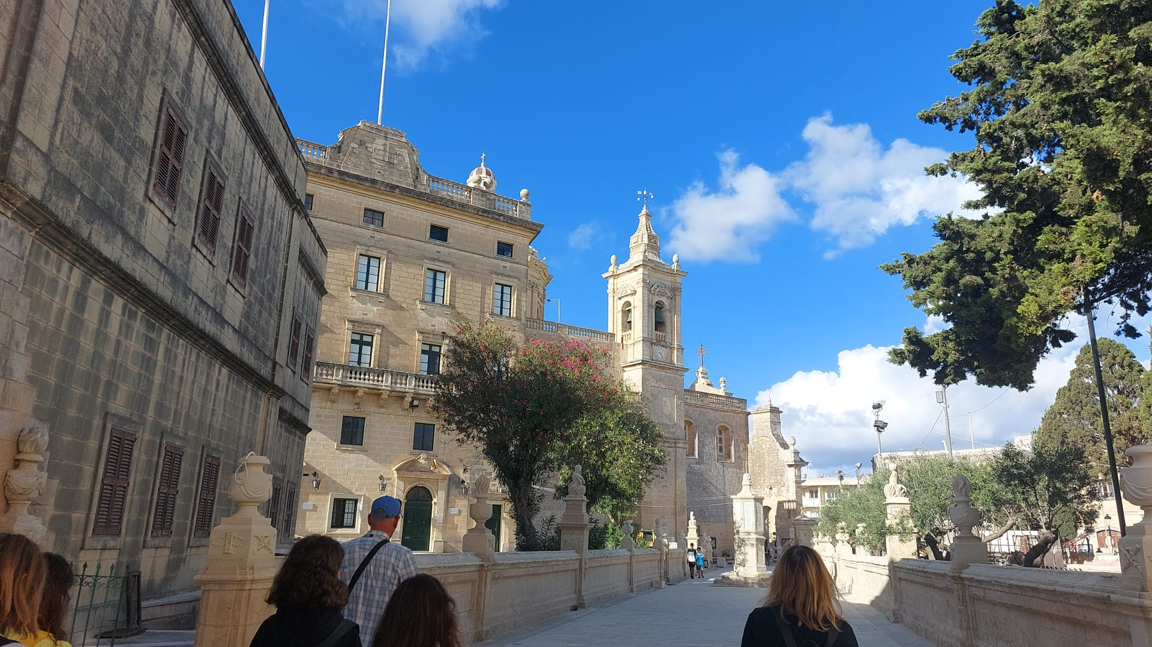
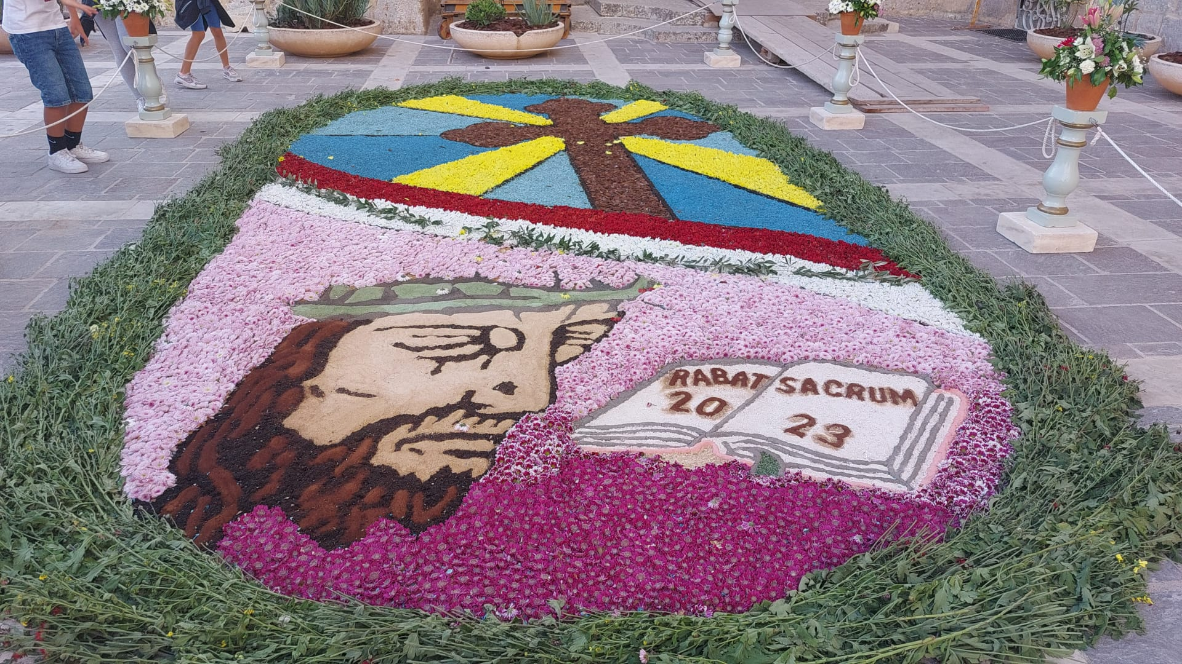
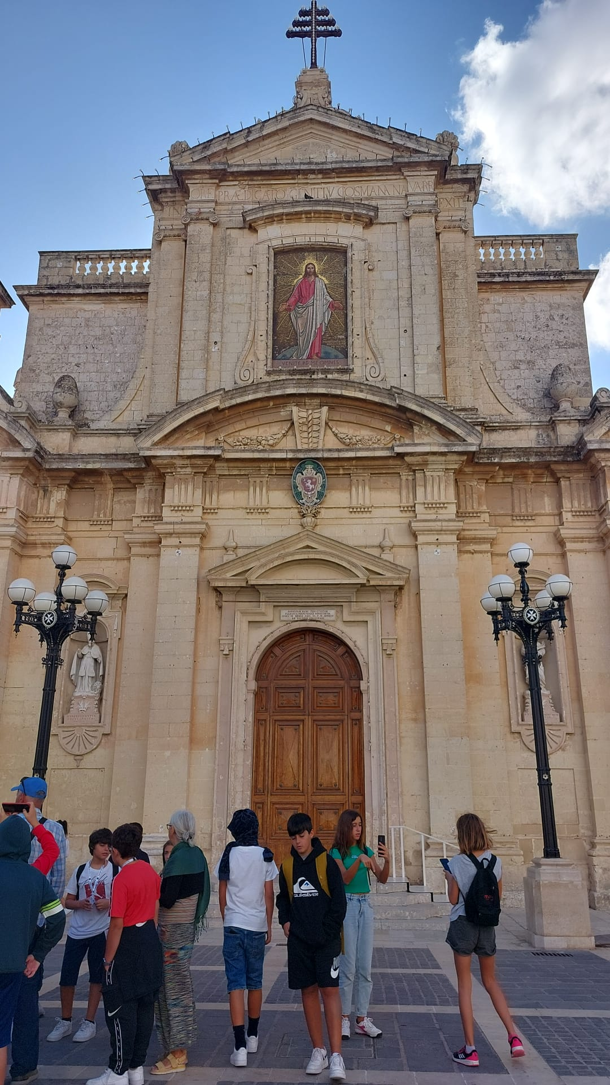
Medina
Anche questa citta è ricca di mura , chiese e castelli , ma soprattutto molto turistica .
Consiglio di visitarla

Slide 12
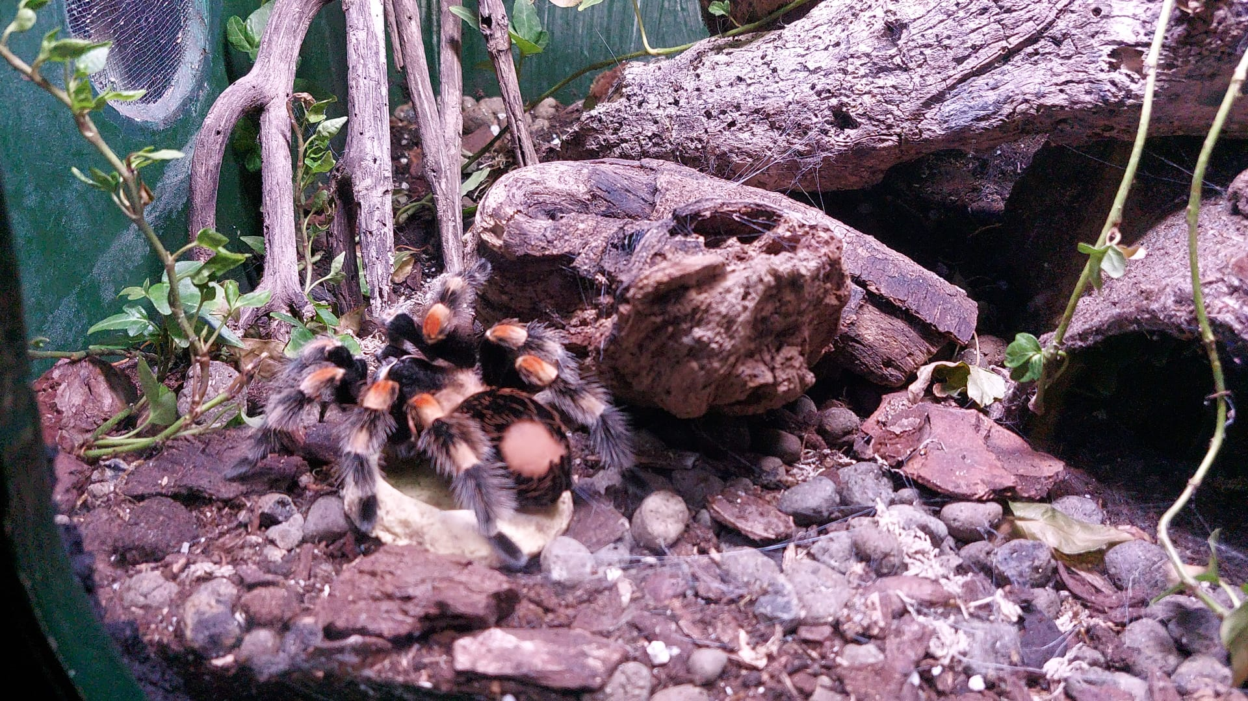
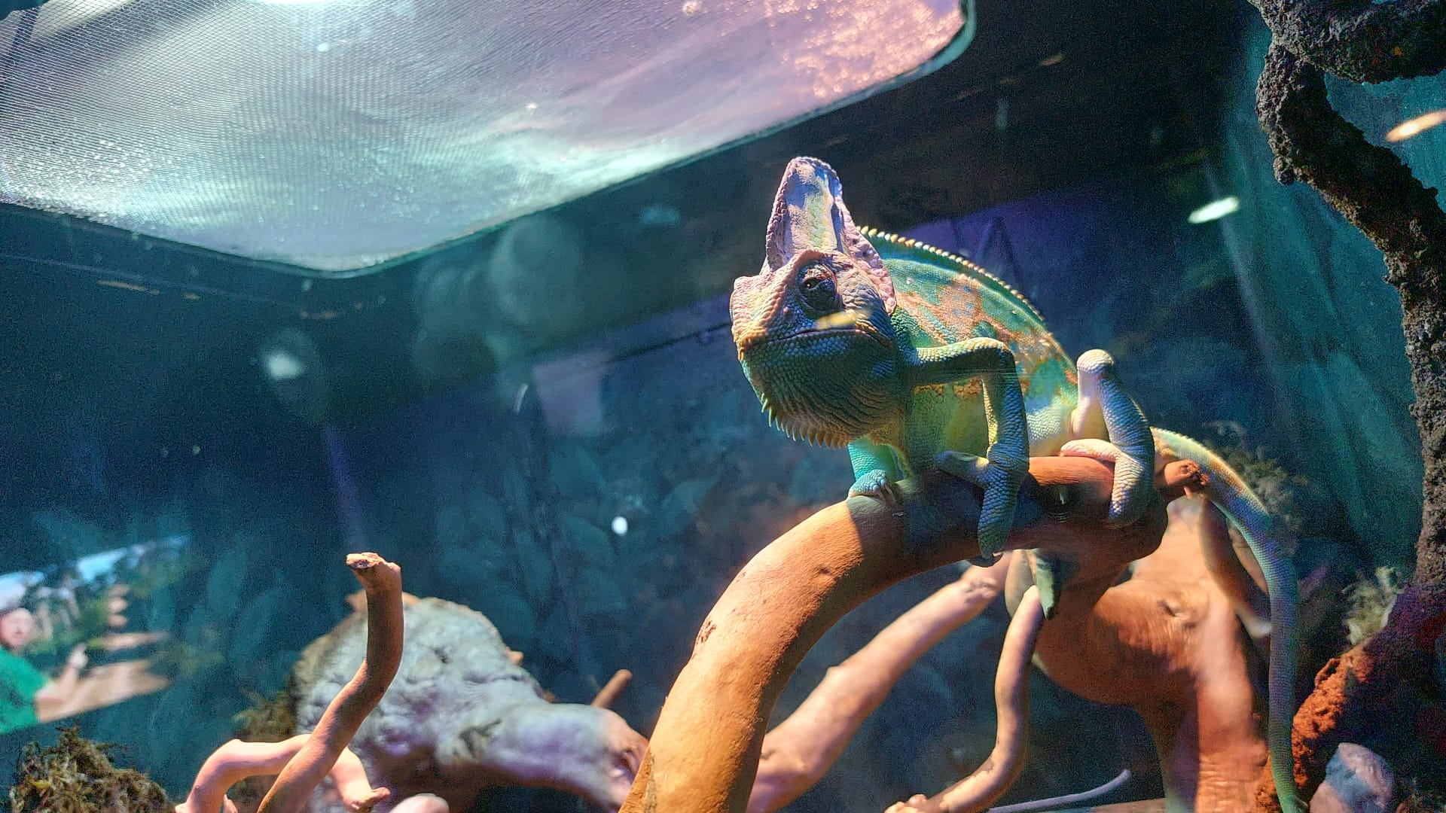
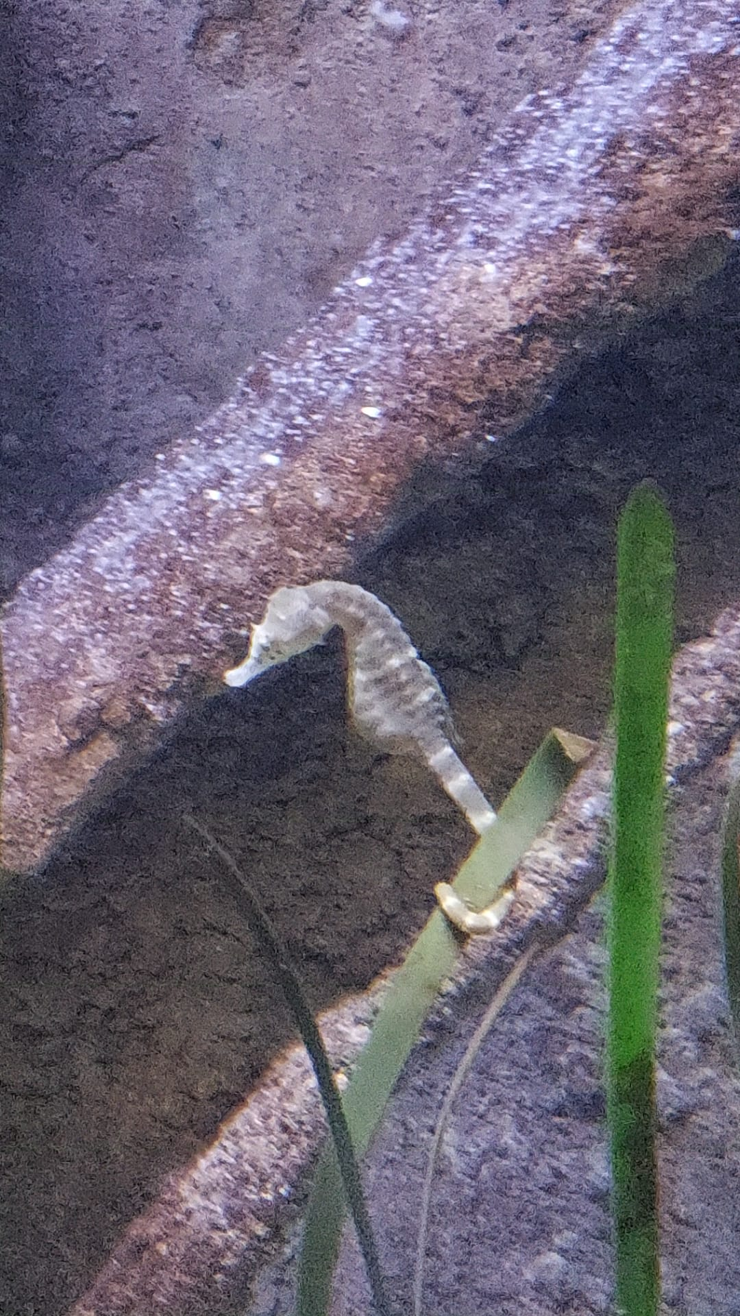
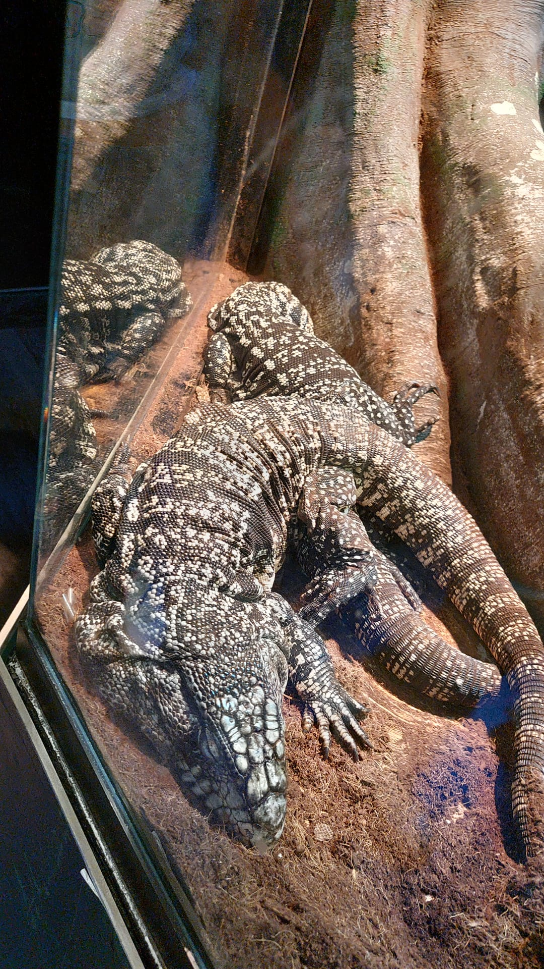
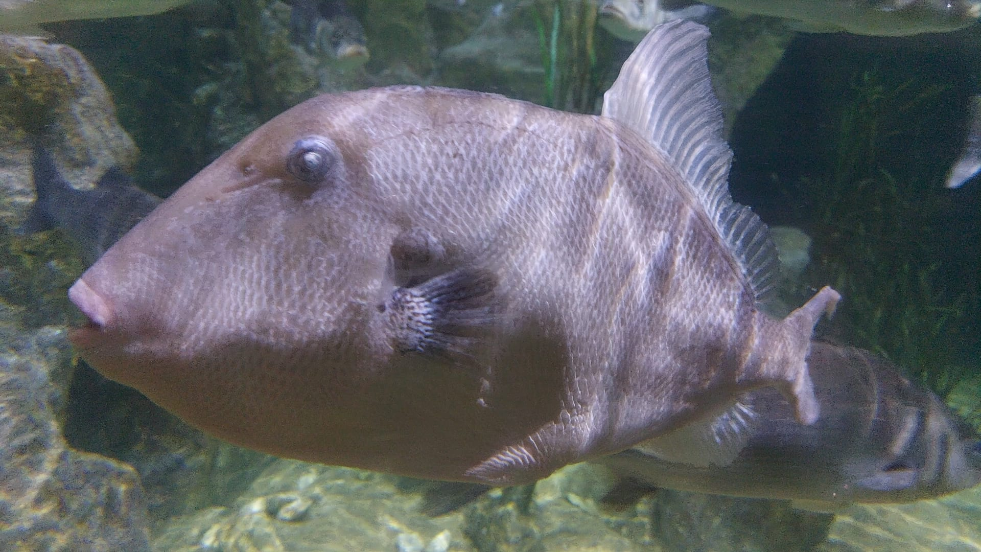
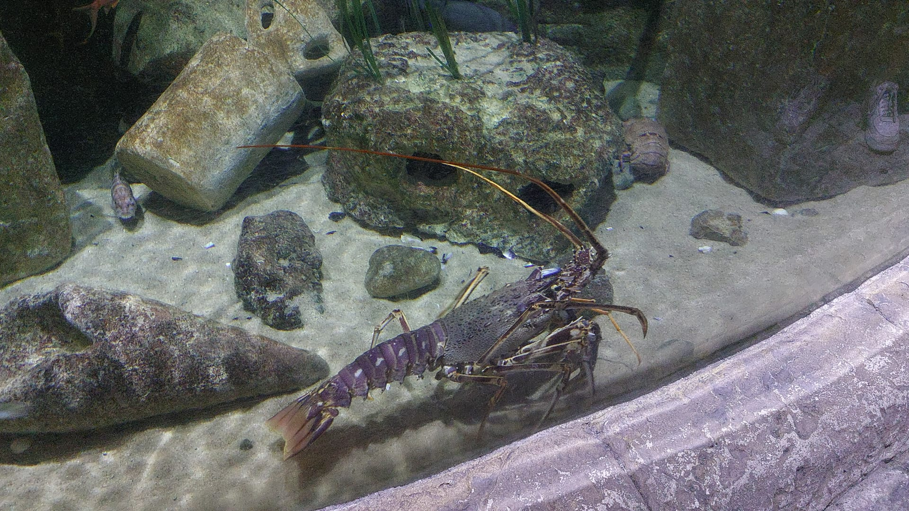
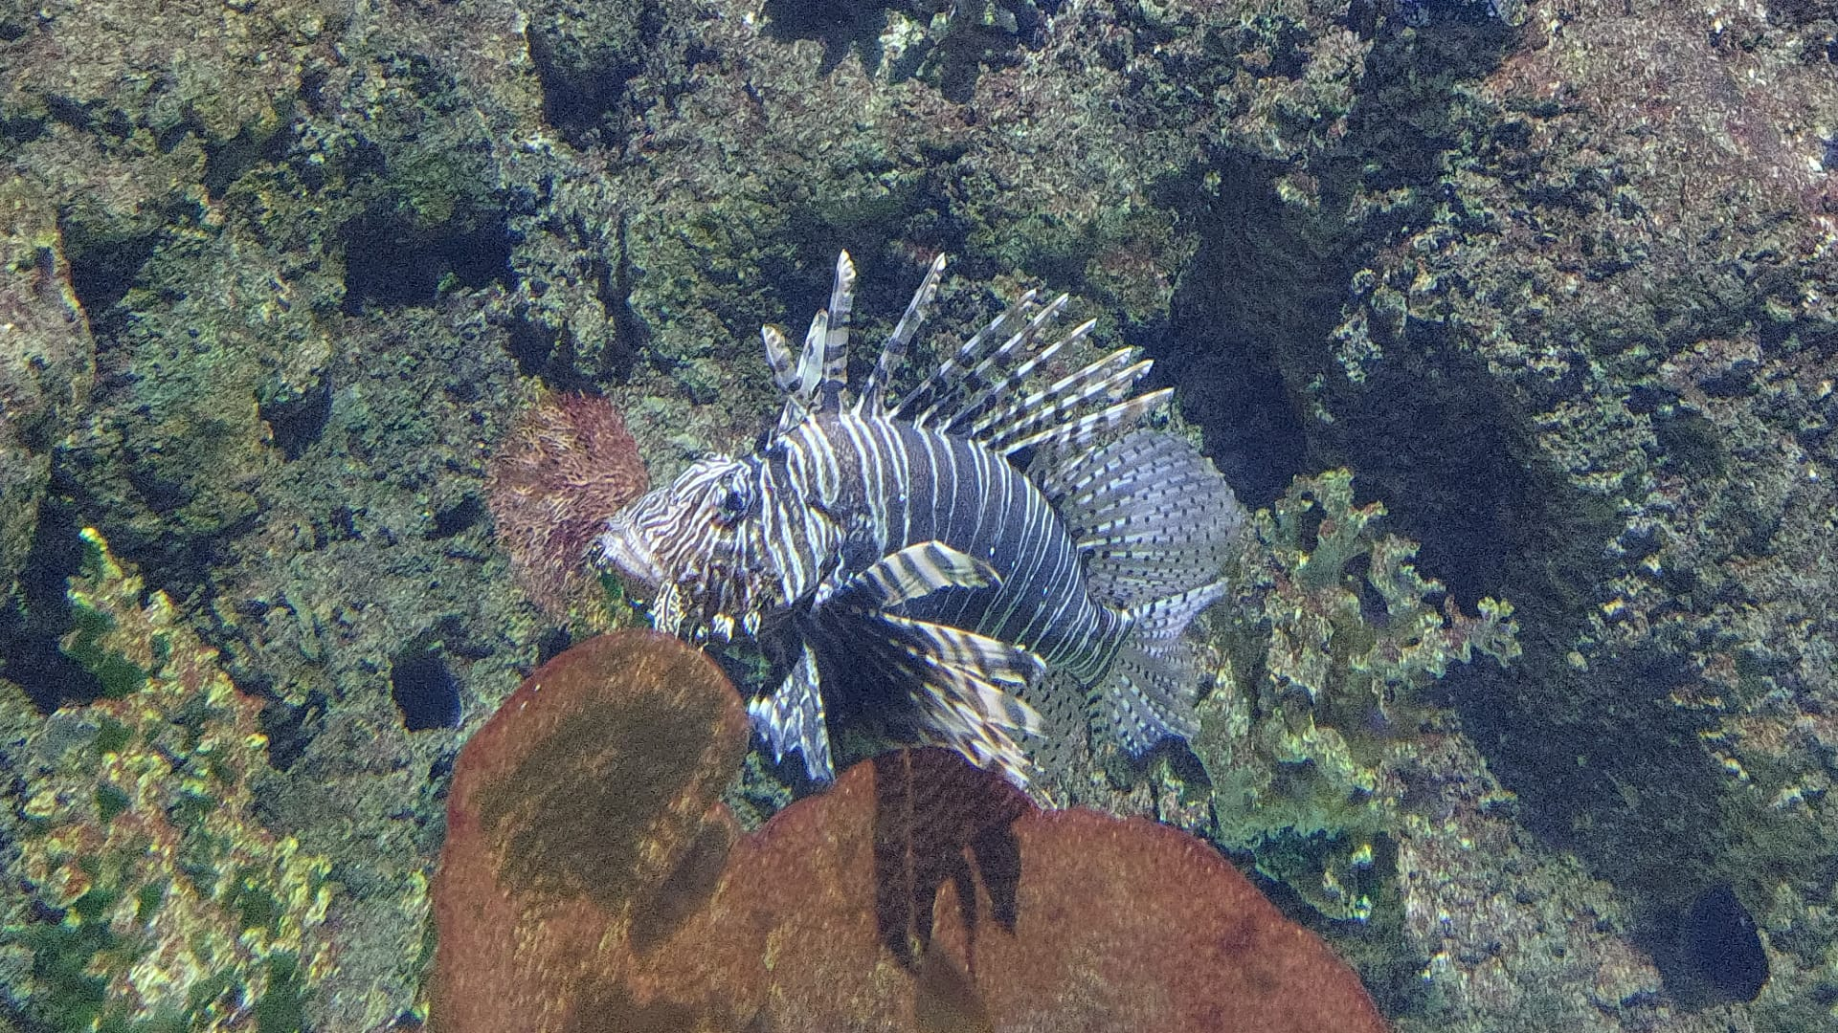
Malta National aquarium
L’acquario Nazionale di Malta mi ha veramente stupito soprattutto la grande quantità di specie marine lasciandoci tutti a bocca aperta .

Slide 13
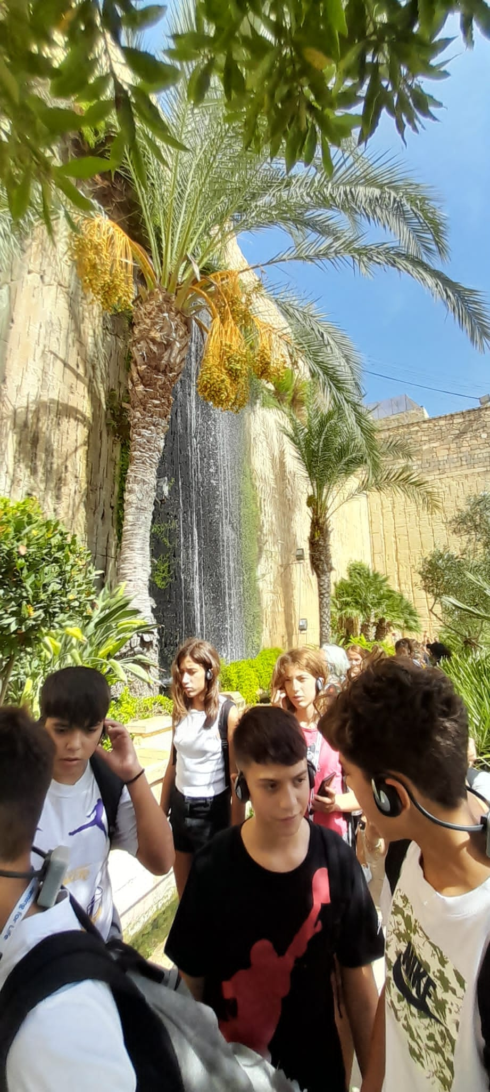
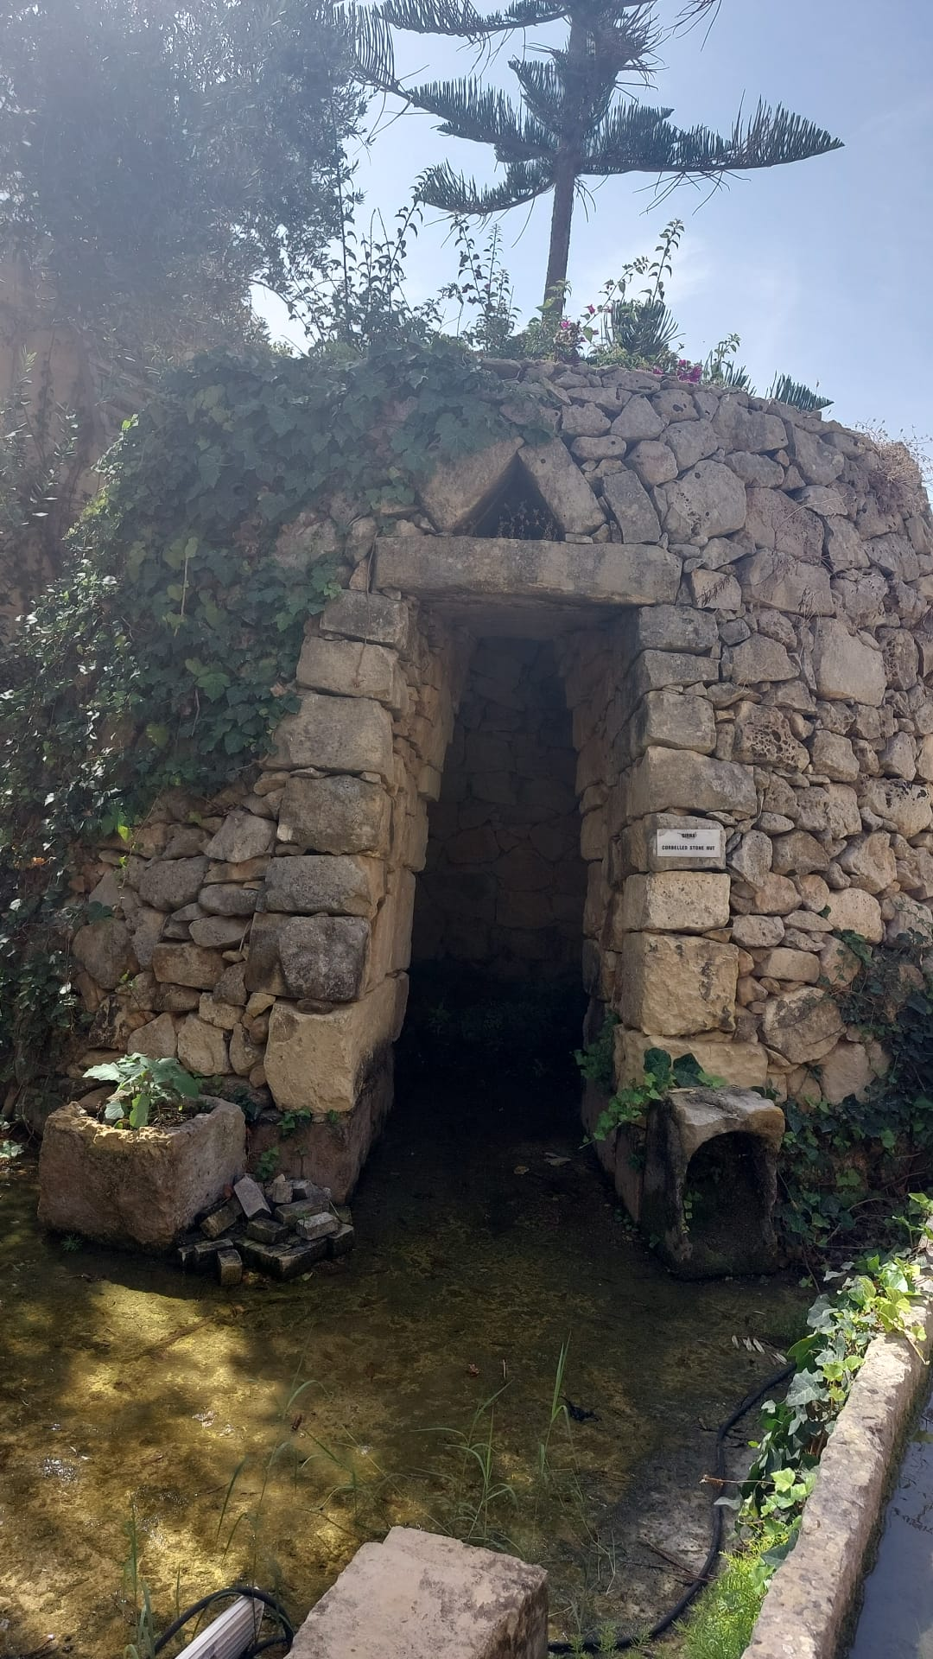
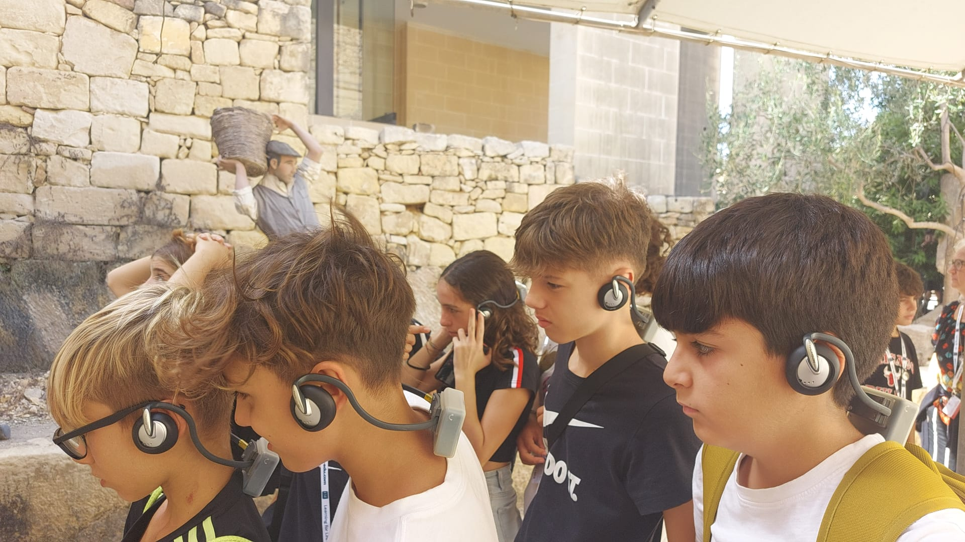
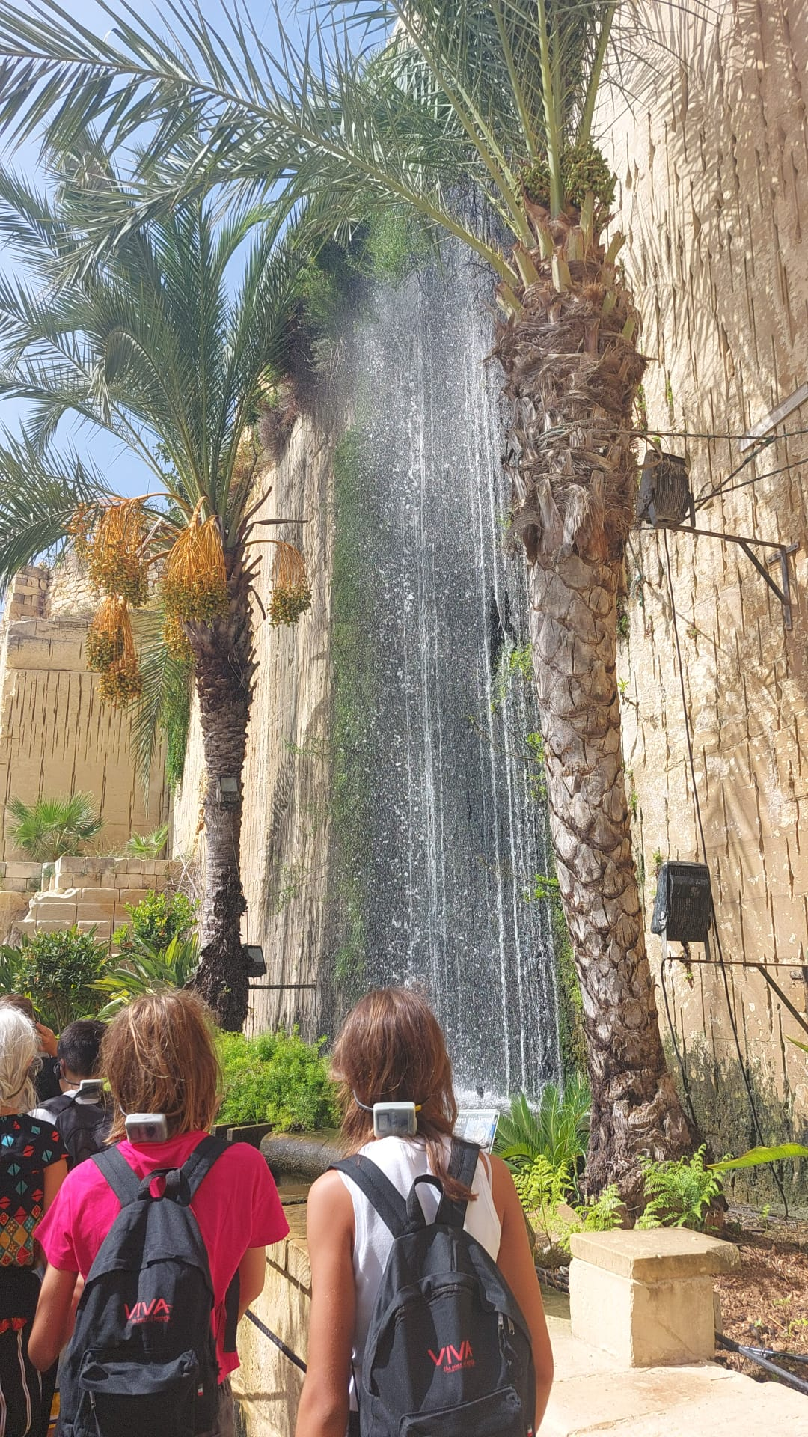
Limestone quarry
Another thing I recommend visiting is the limestone quarry, with an equipped museum inside where its history is well explained.

Slide 14
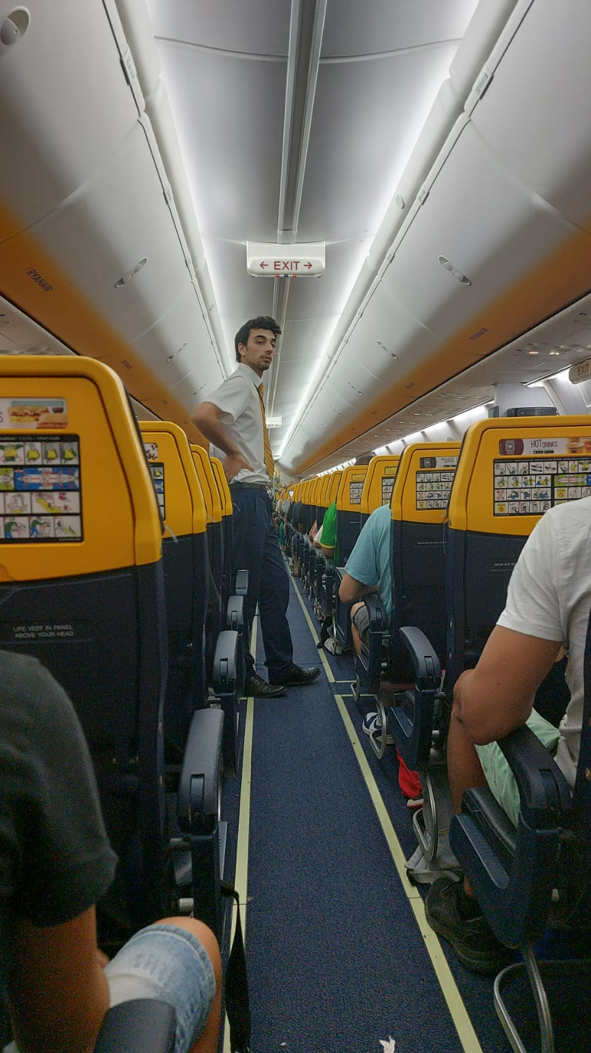
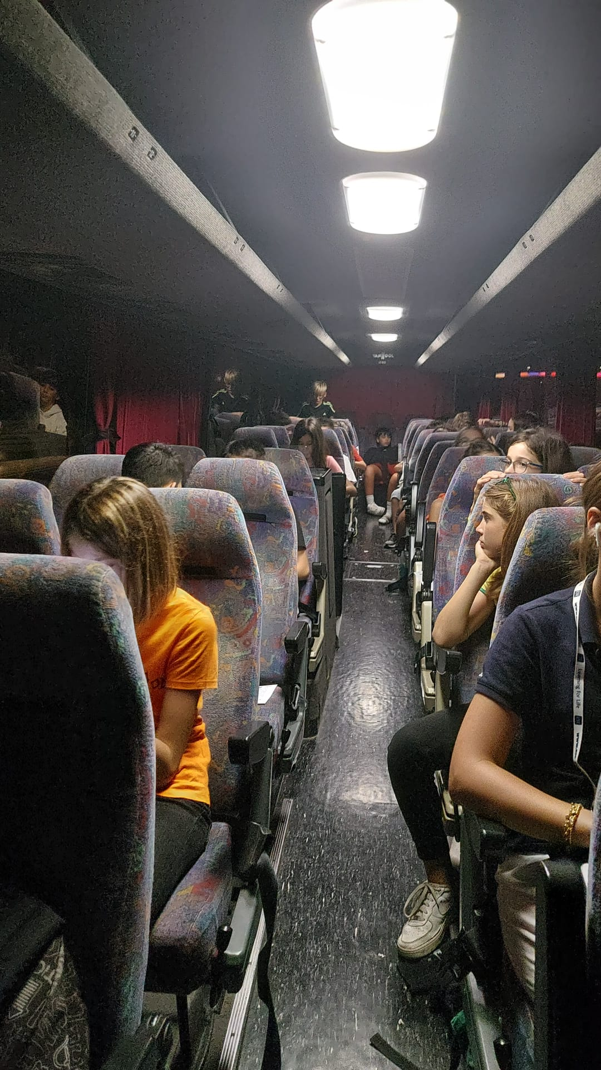
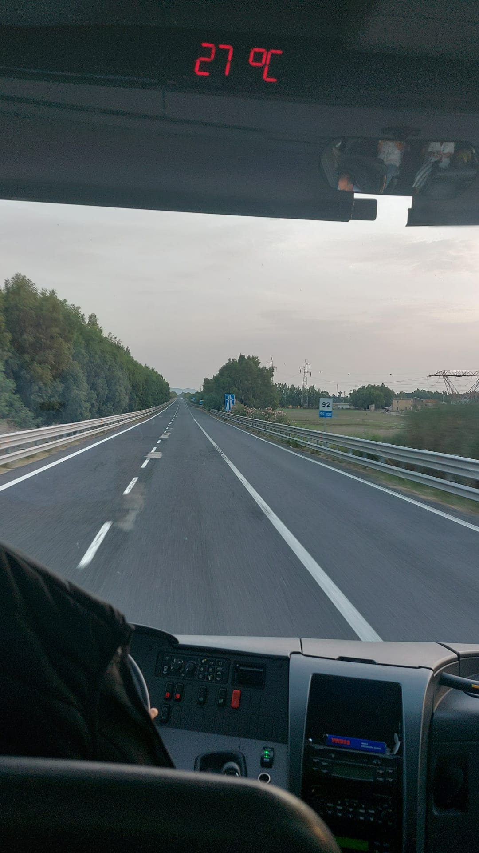
Return day
The day of return starts with breakfast and then check out and then stays at the hotel until the evening waiting for the bus to the airport Once we arrived at the airport we started the boarding of the luggage in the hold and then we headed to the security check with an immense nostalgia ..... After arriving in Cagliari, waiting for our luggage, we thought about how bad it would be to go back to the usual school desks. Arrived in Sassari (2:30) we said goodbye and couldn't wait to go to bed.

