Slide 1
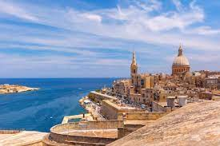
THE MALTA EXPERIENCE 2023!!
Progetto di : Eleonora Rau , Nicolò Rubattu , Lorenzo Carta e Daniele Ricciardi

Slide 2
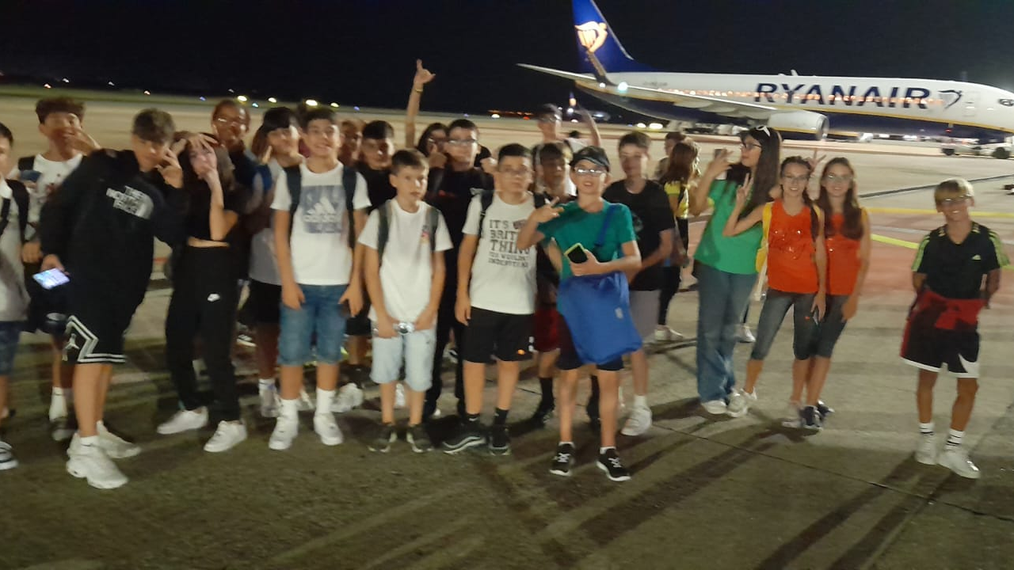
l2023, sept 19th_Let’s go to start!!
We take the plane and go to Malta

Slide 3

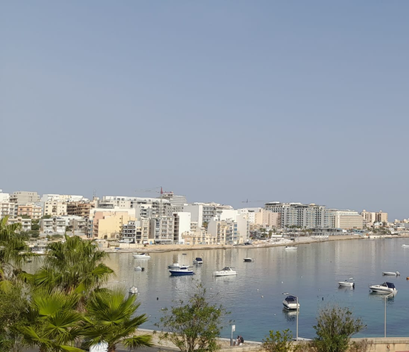
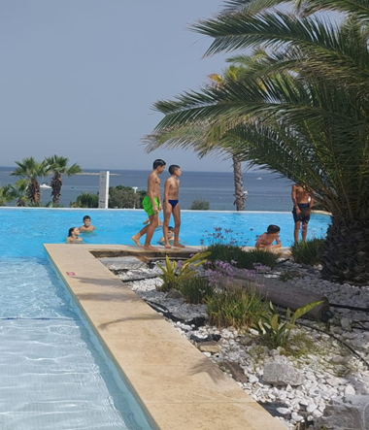
September 20th_The first day in Malta
Let’s explore the hotel and relax by the pool

Slide 4
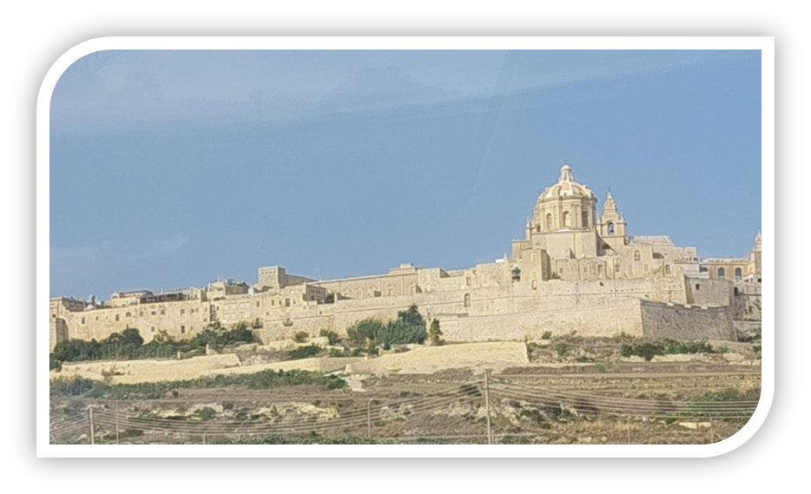
Let’s talk of our first excursion to
La Valletta, the capital city of Malta.

Slide 5
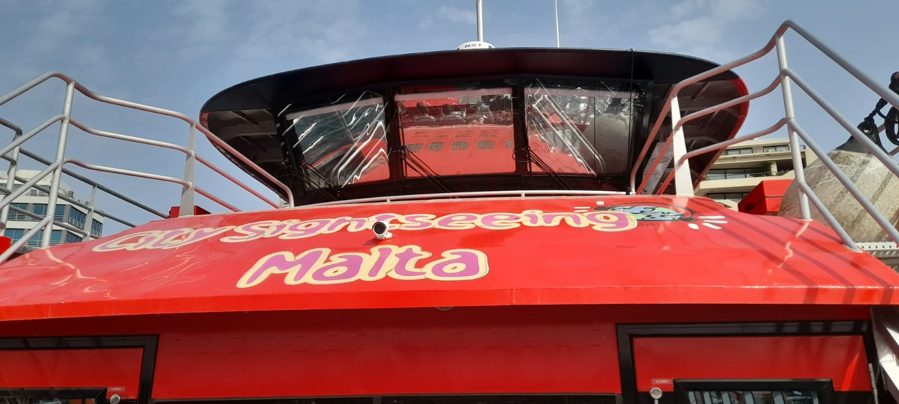
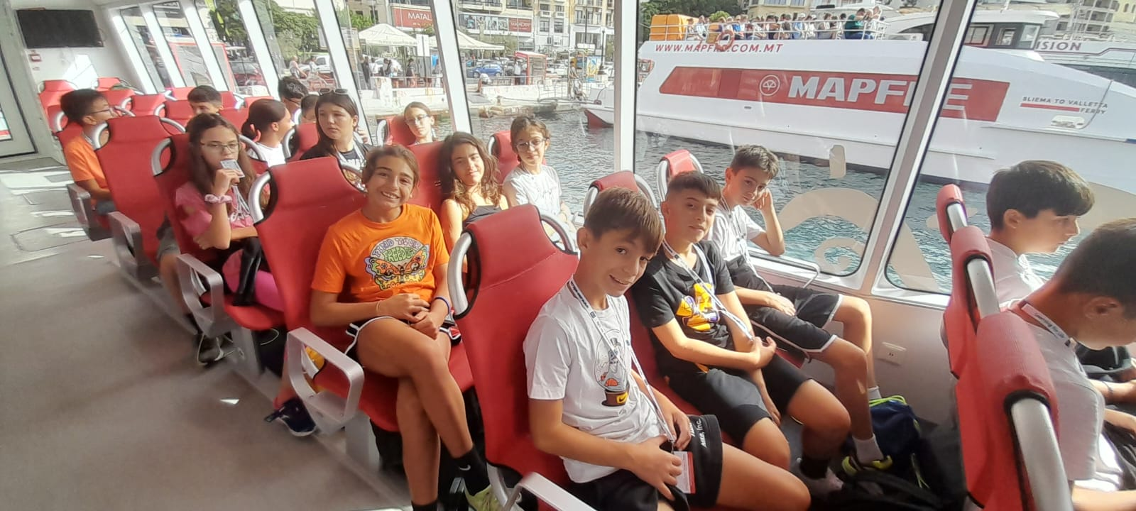
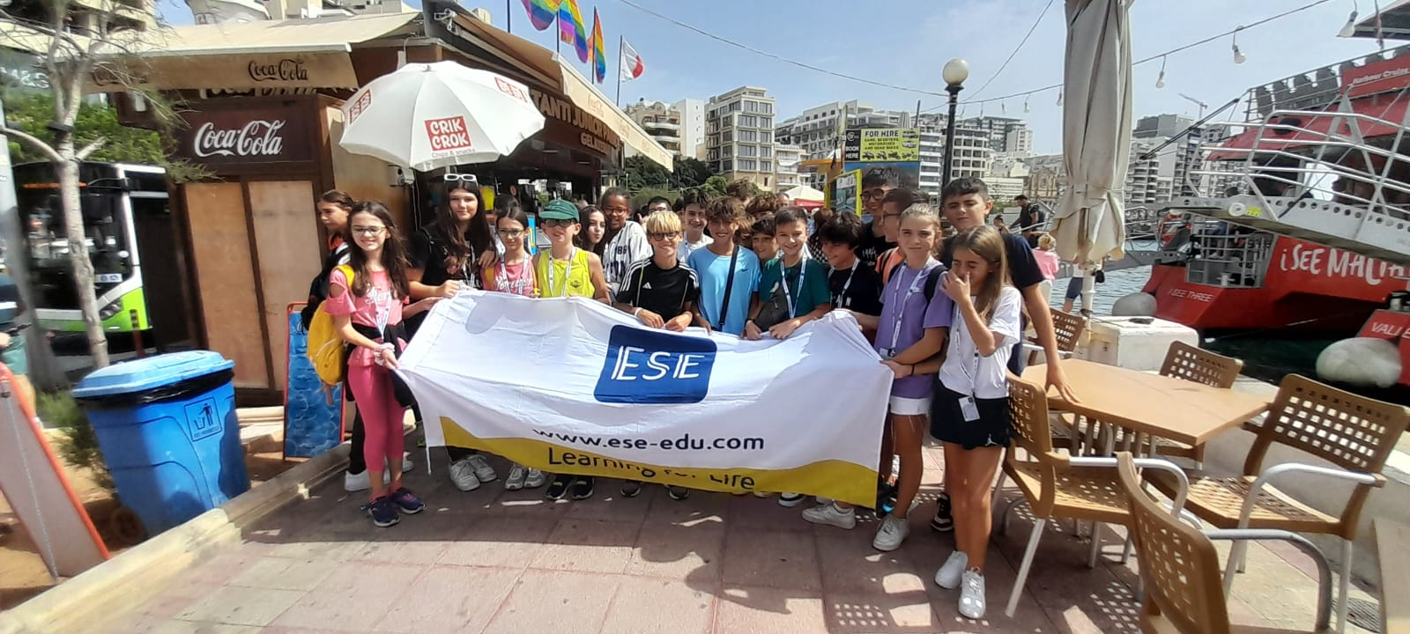
This city is close to the sea. Thus, the first thing we did that day was go on a small boat which showed us some beauties of La Valletta.
For example, we saw that the city is surrounded by ancient walls that were built for defence

Slide 6
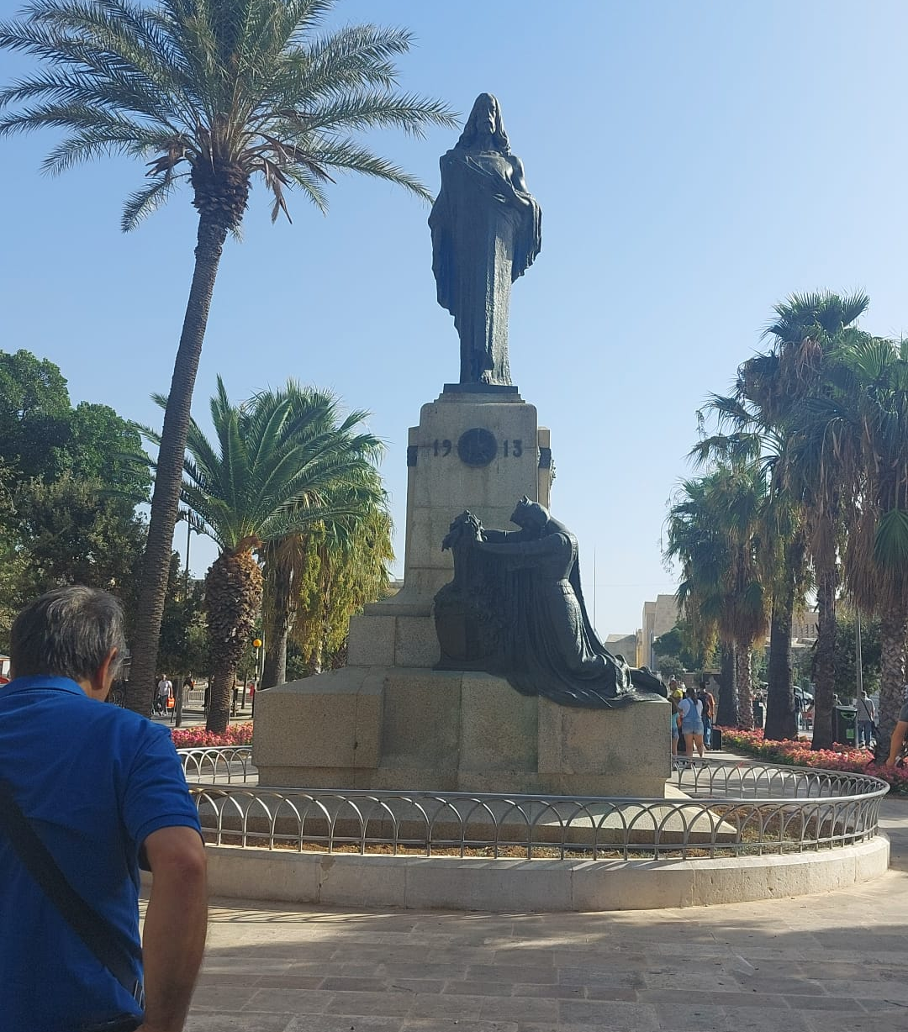
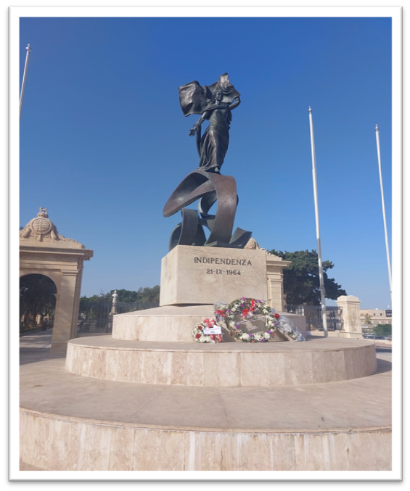
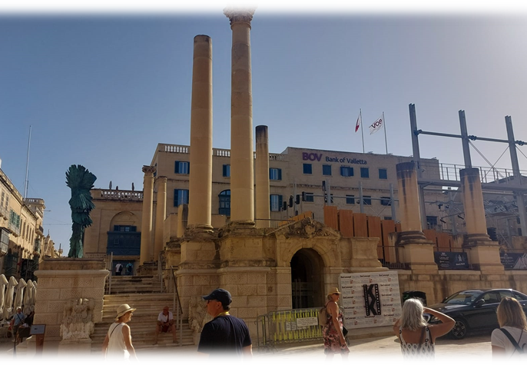
Then we had a walk in the historic center of the city…
We saw some ancient buildings and statues , including the statue of independence...
…some beautiful churches…
…the ruins of the first theatre…
…and squares and fountains…

Slide 7
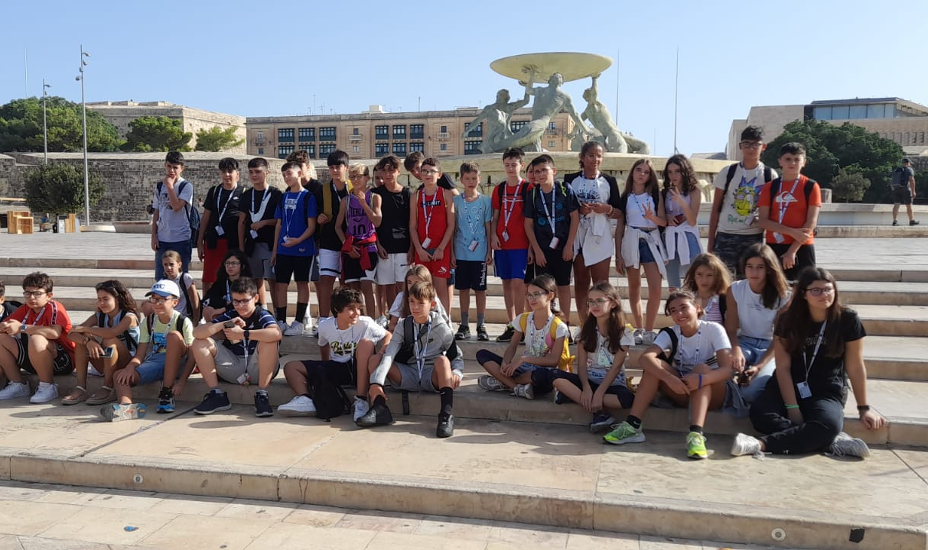

Slide 8
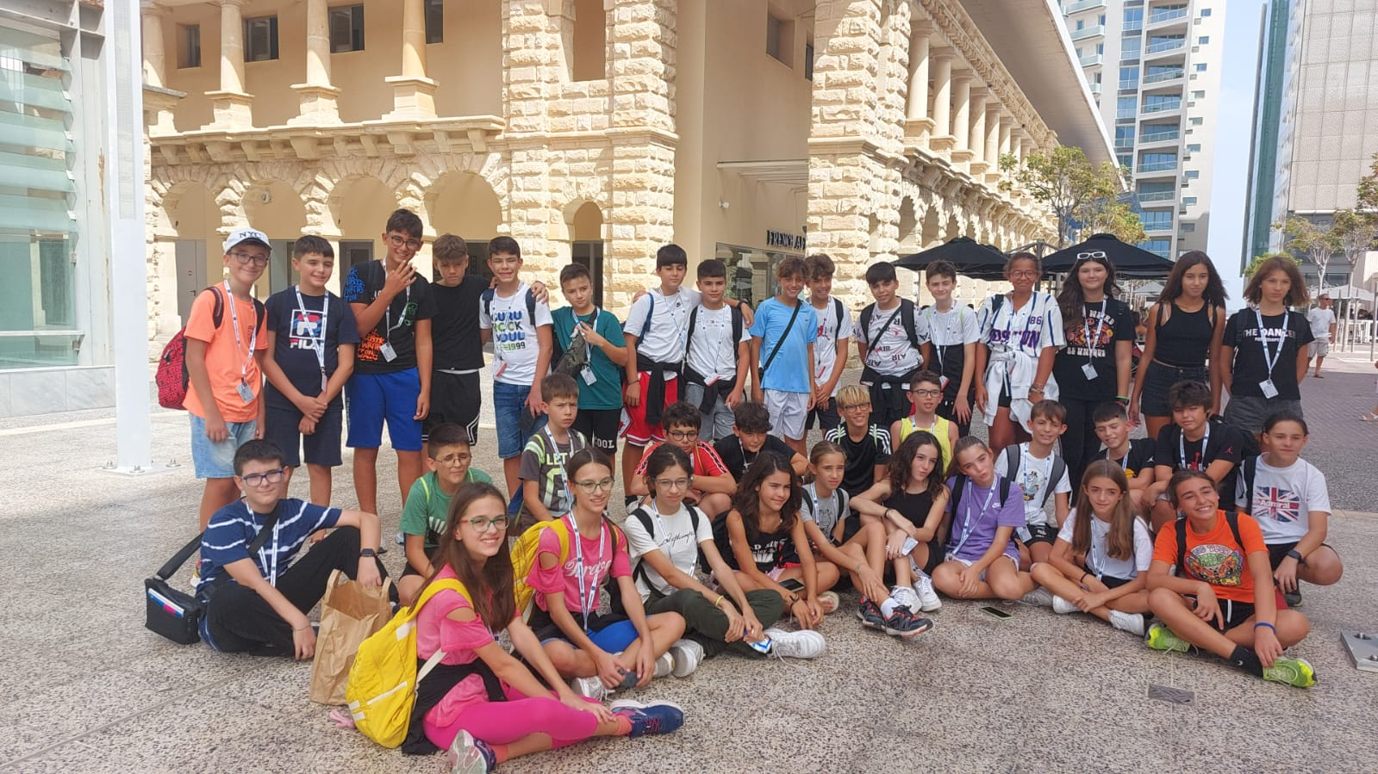
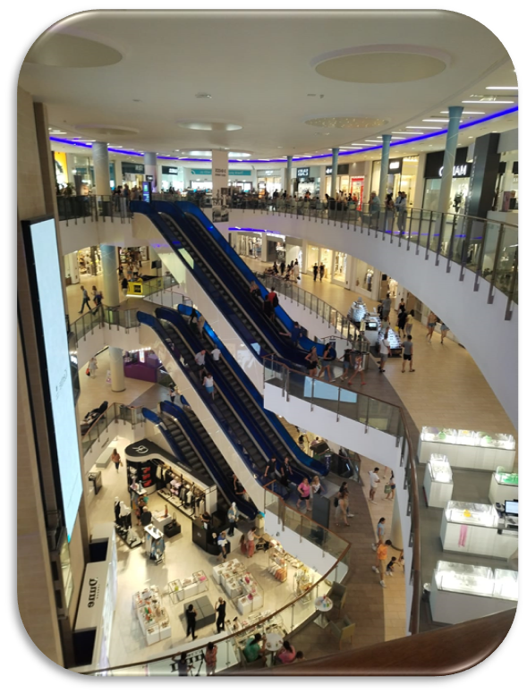
We went to a very large shopping center where we could shop in several shops of very famous brands.
we took many photos together before returning to the hotel.

Slide 9
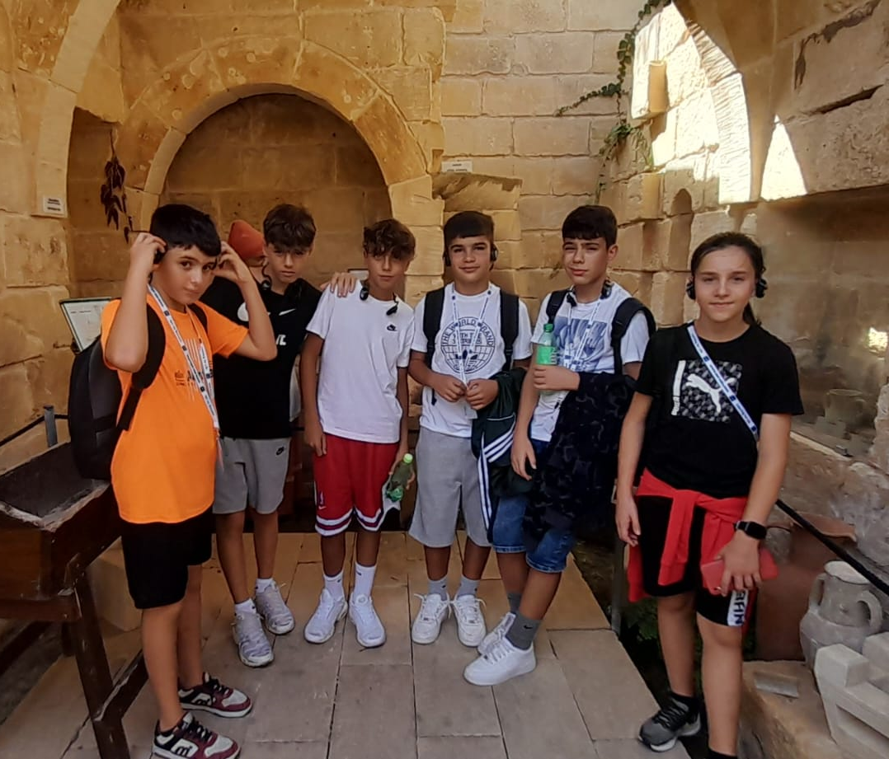
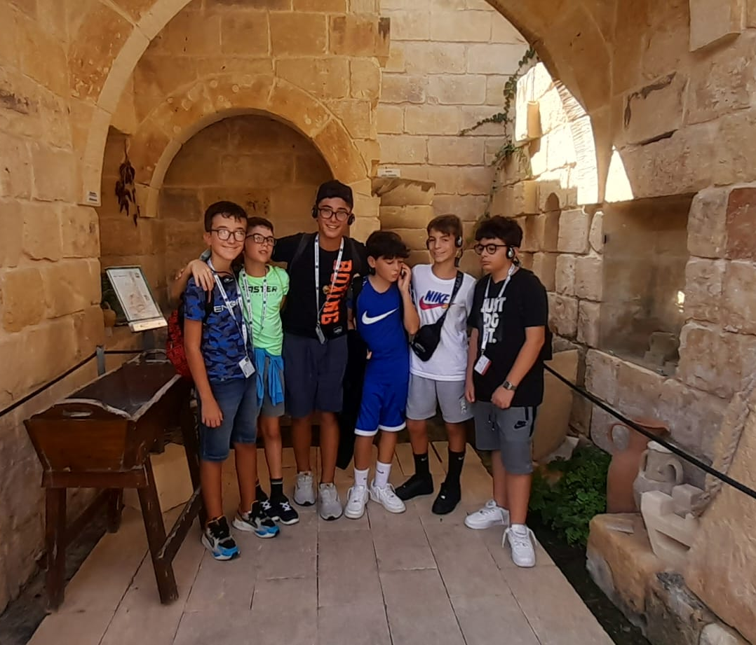
Gozo

Slide 10
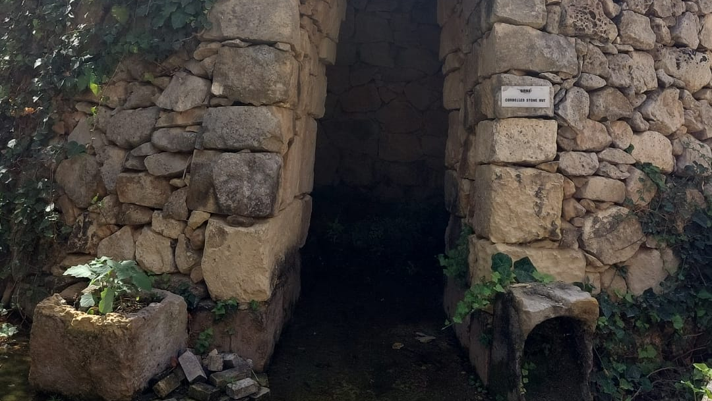
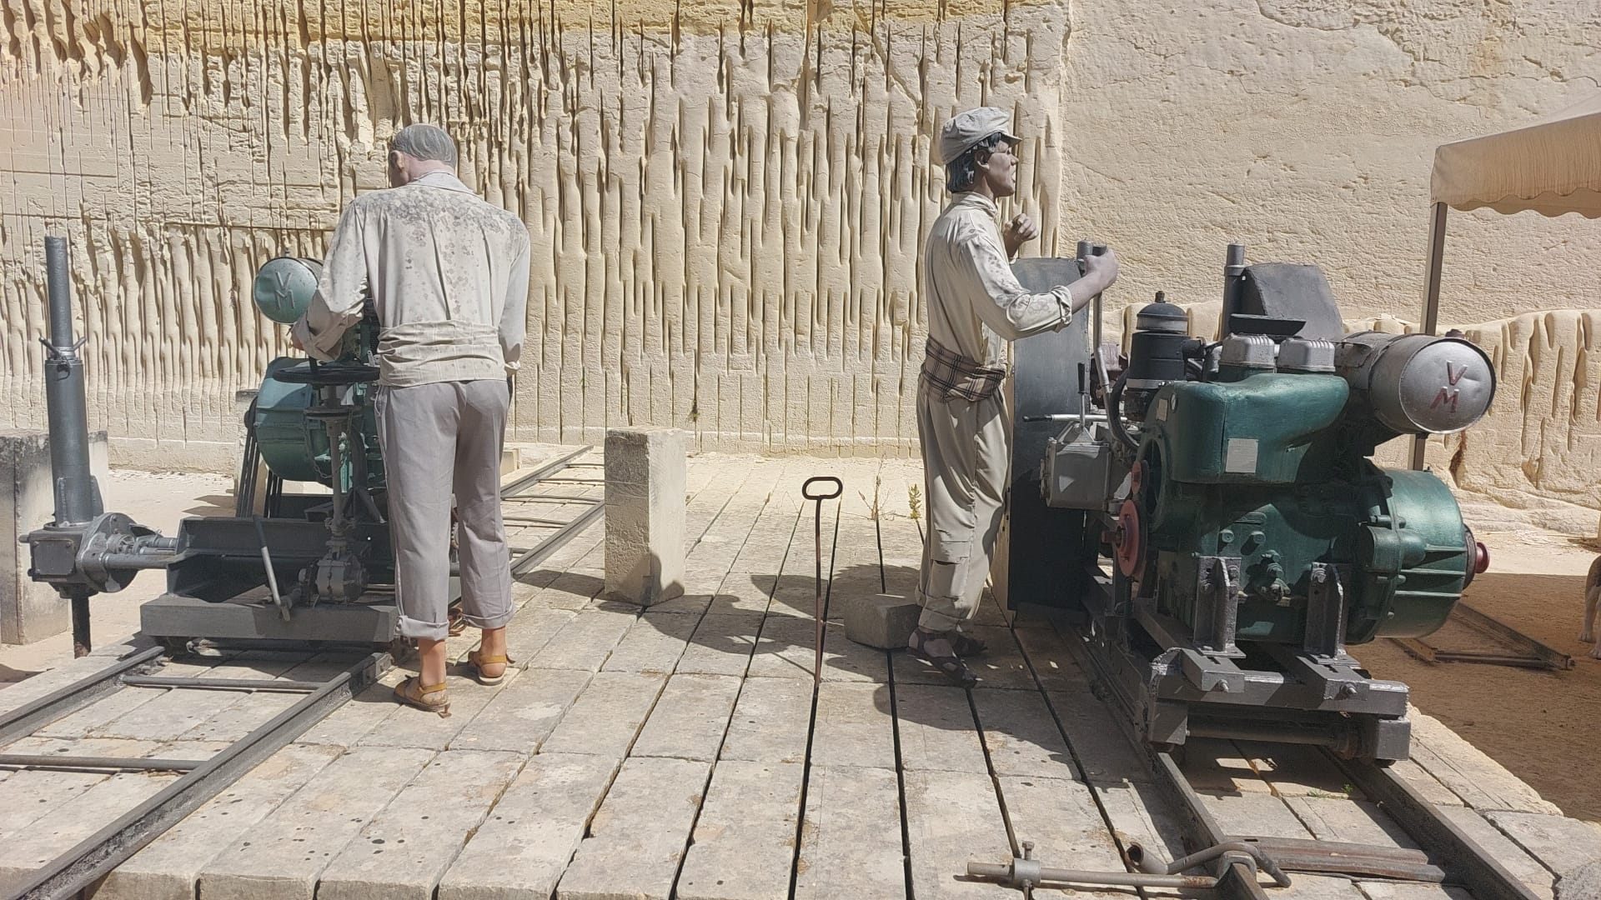
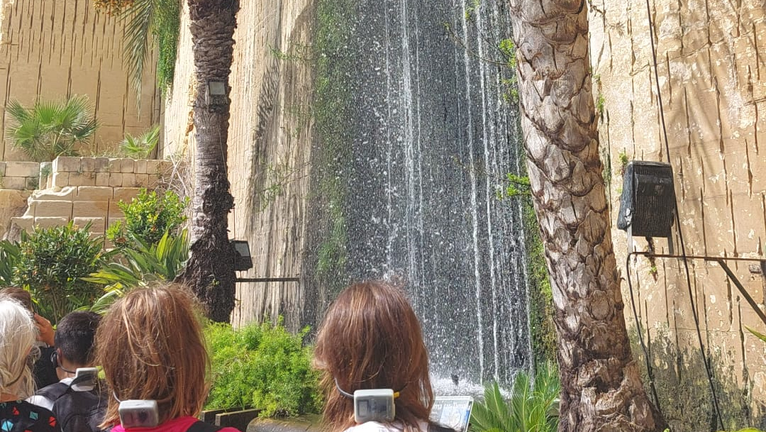
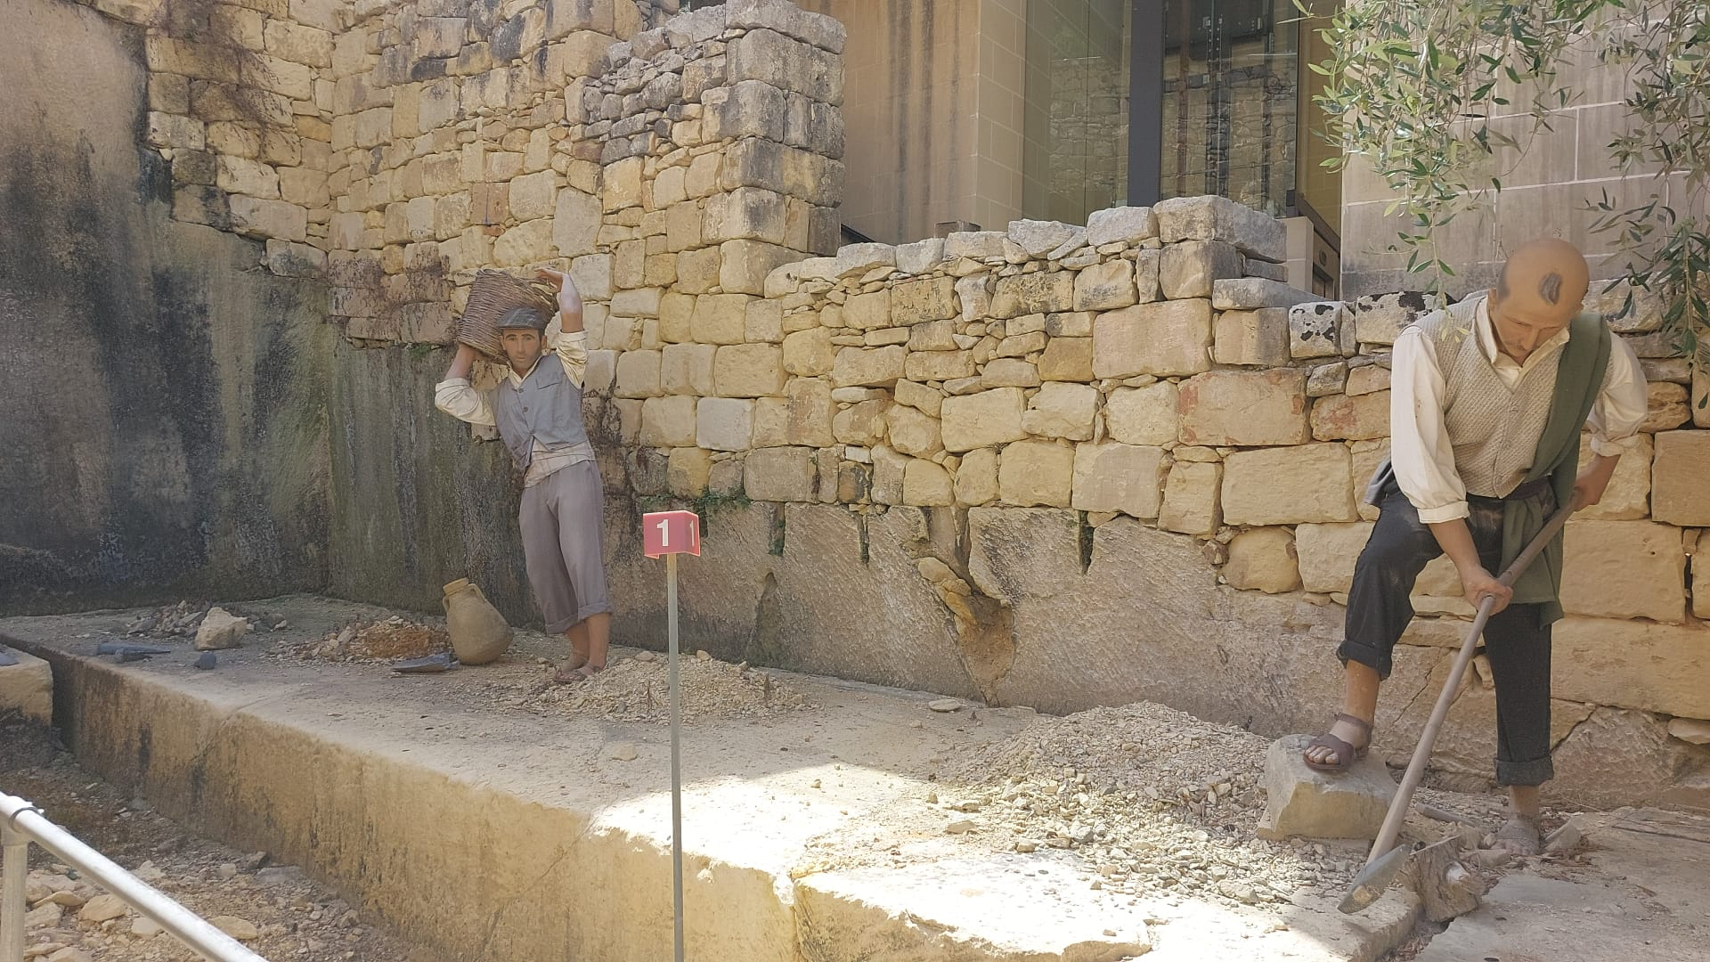
we saw many things(Gozo)

Slide 11
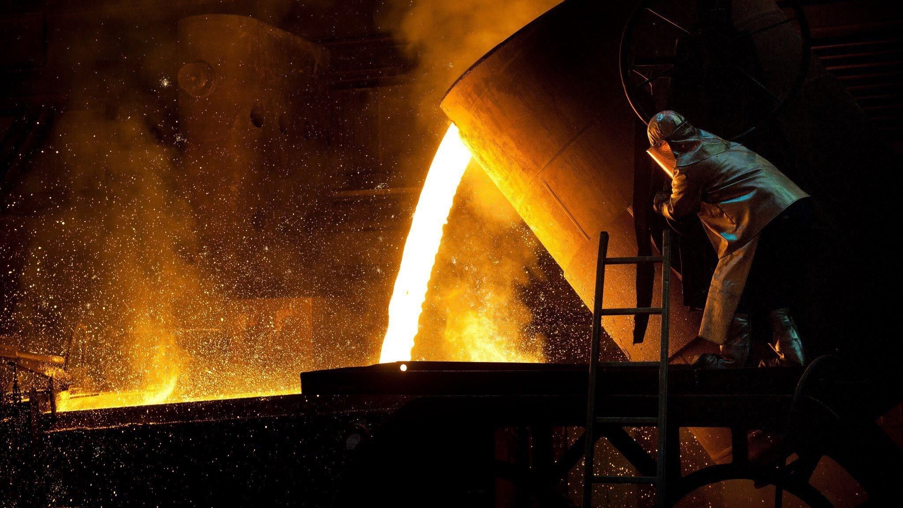
Glass blowing in Malta

Slide 12
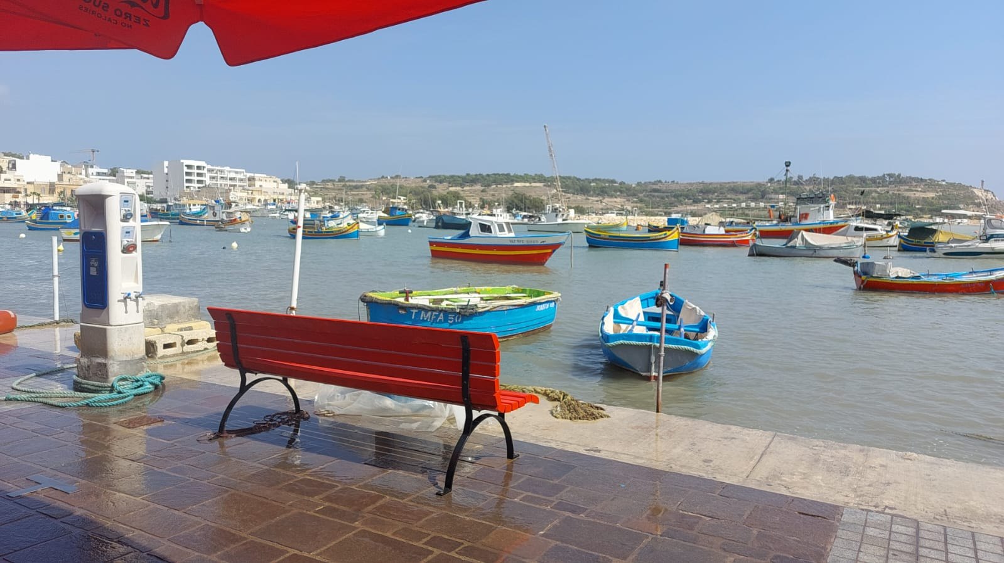
One of the many trips we took in Malta was to go to a colored glass refinery

Slide 13
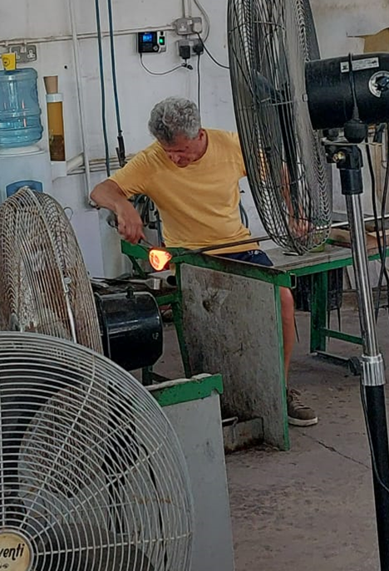
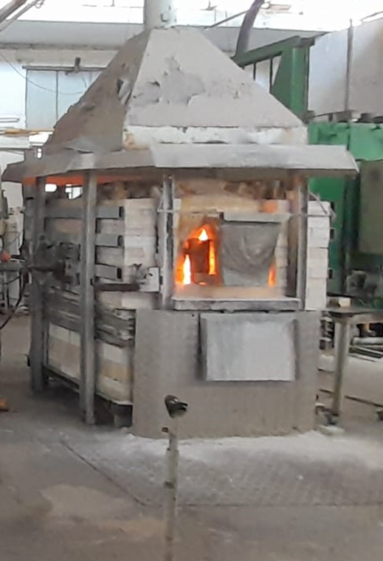
As soon as we entered we were surrounded by thousands of colored glass figurines.Immediately afterwards we were taken to the centerpiece of the shop; the refinery where we watched as a man created beautiful glass figurines

Slide 14
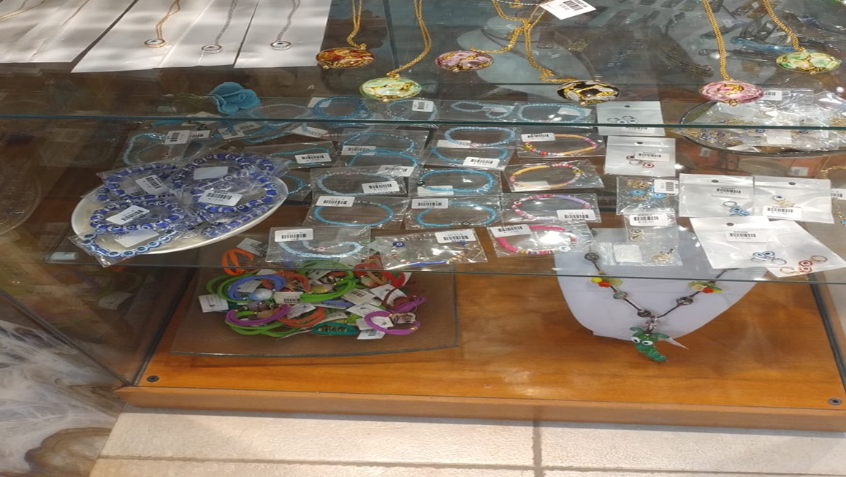
Finally, in order to remember that wonderful experience, we purchased a glass souvenir that we choose among: animals, earrings, necklaces and much more

Slide 15
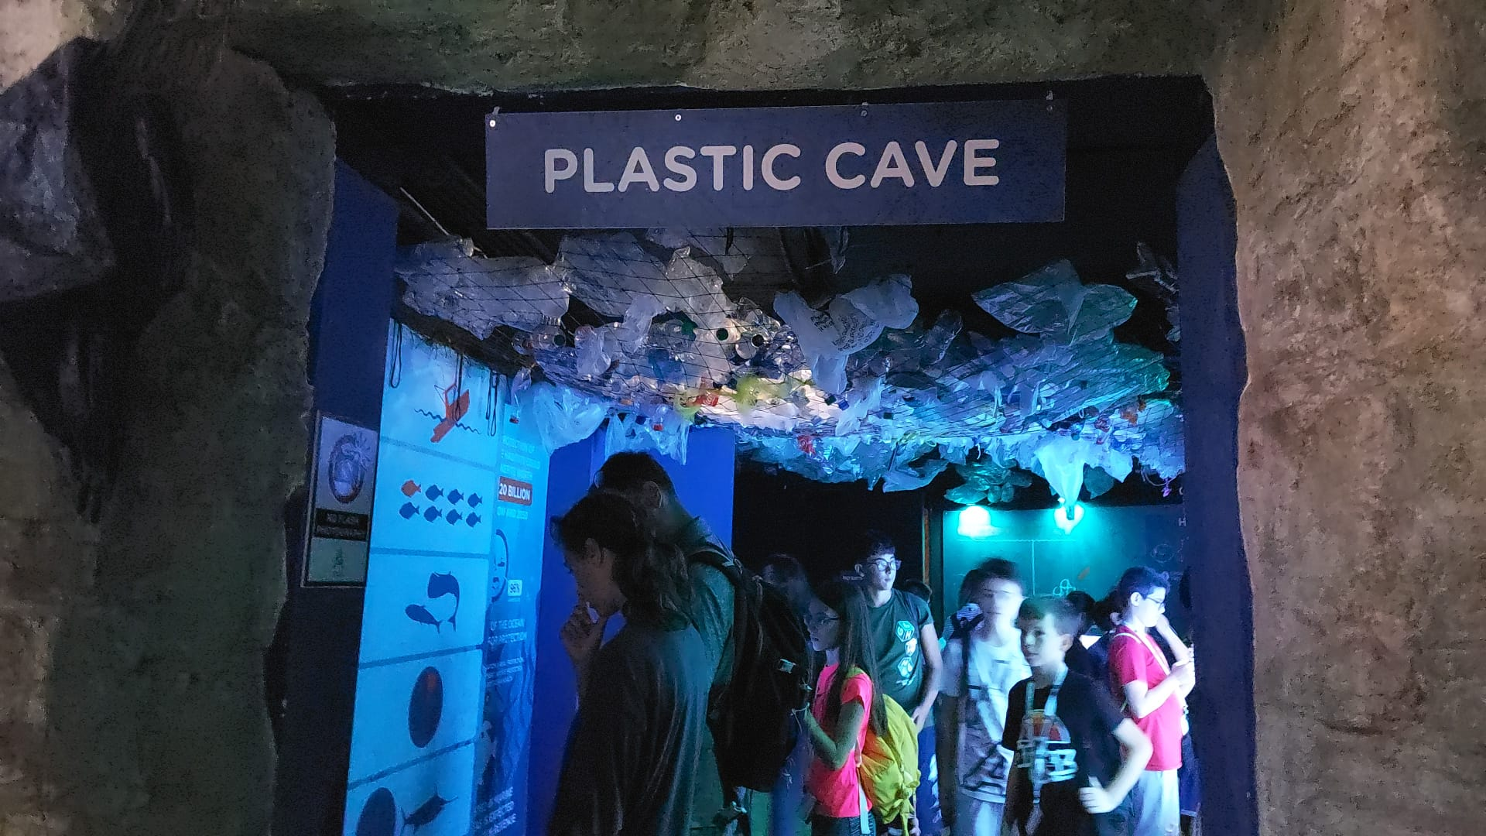
In malta we saw the aquarium

Slide 16
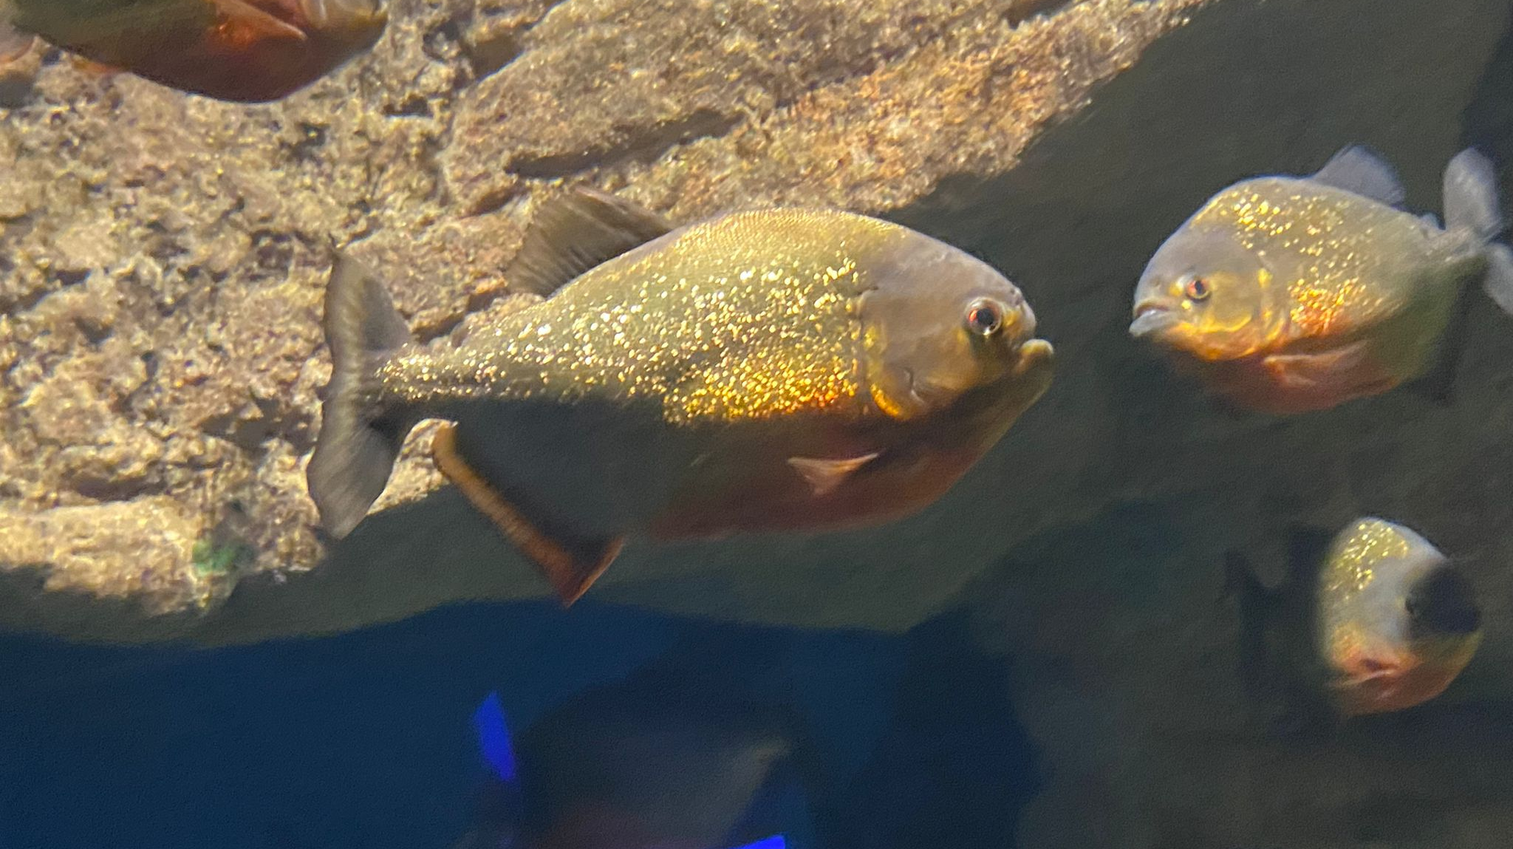
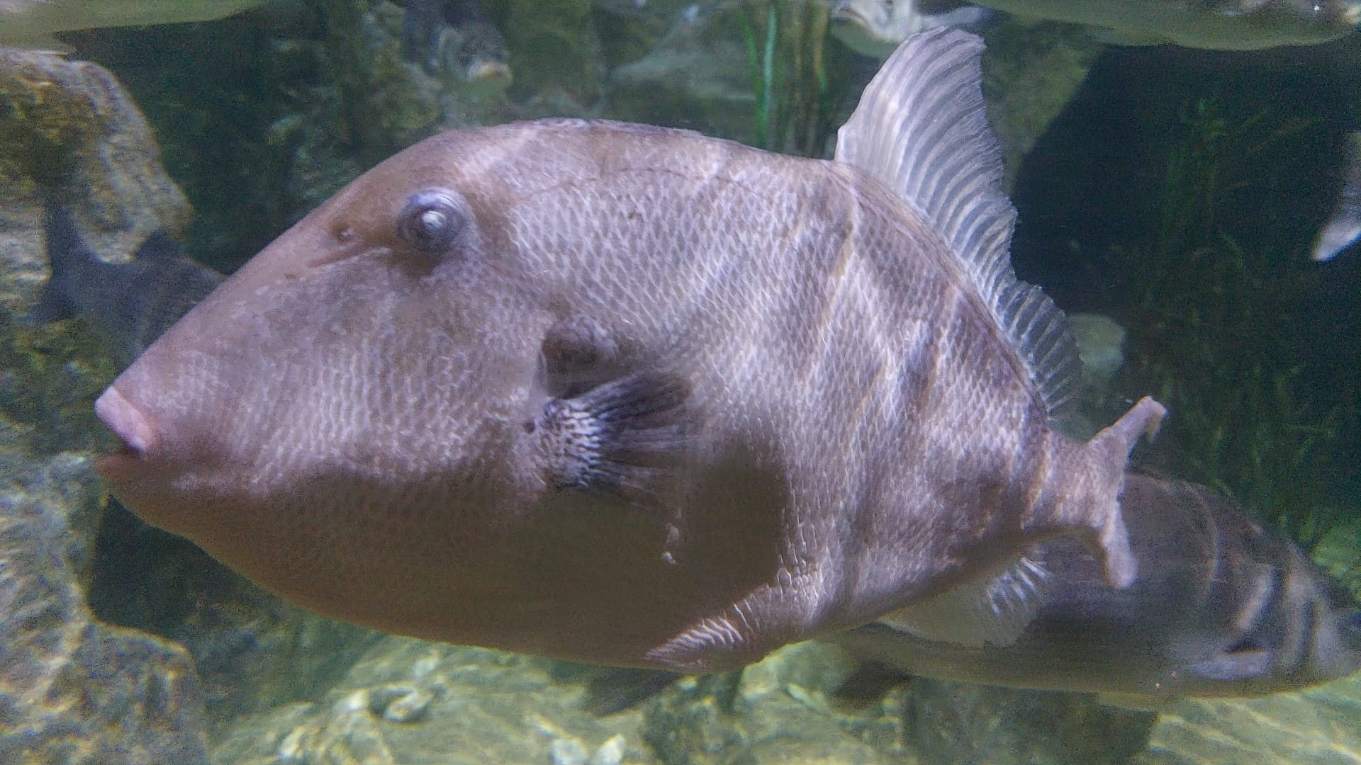
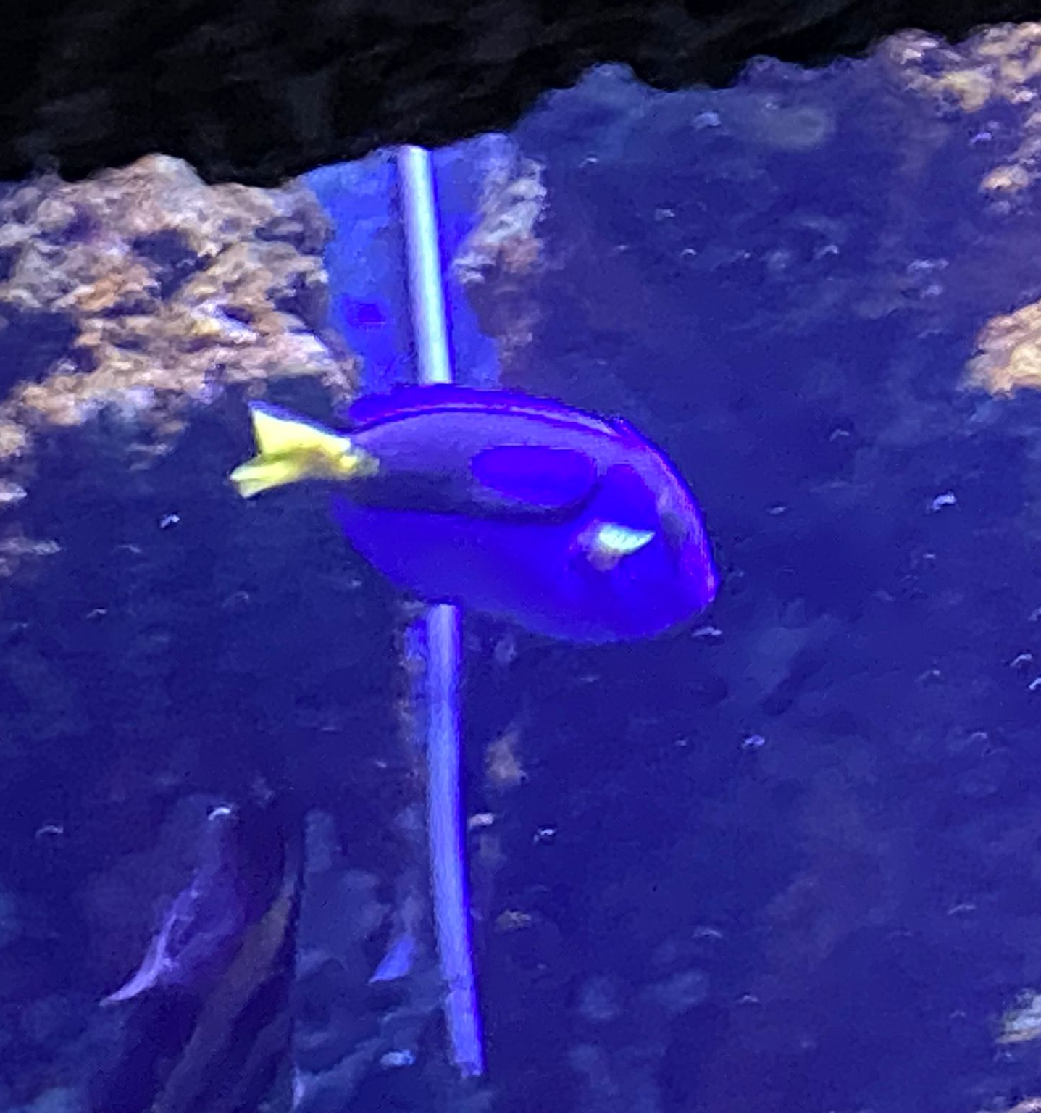
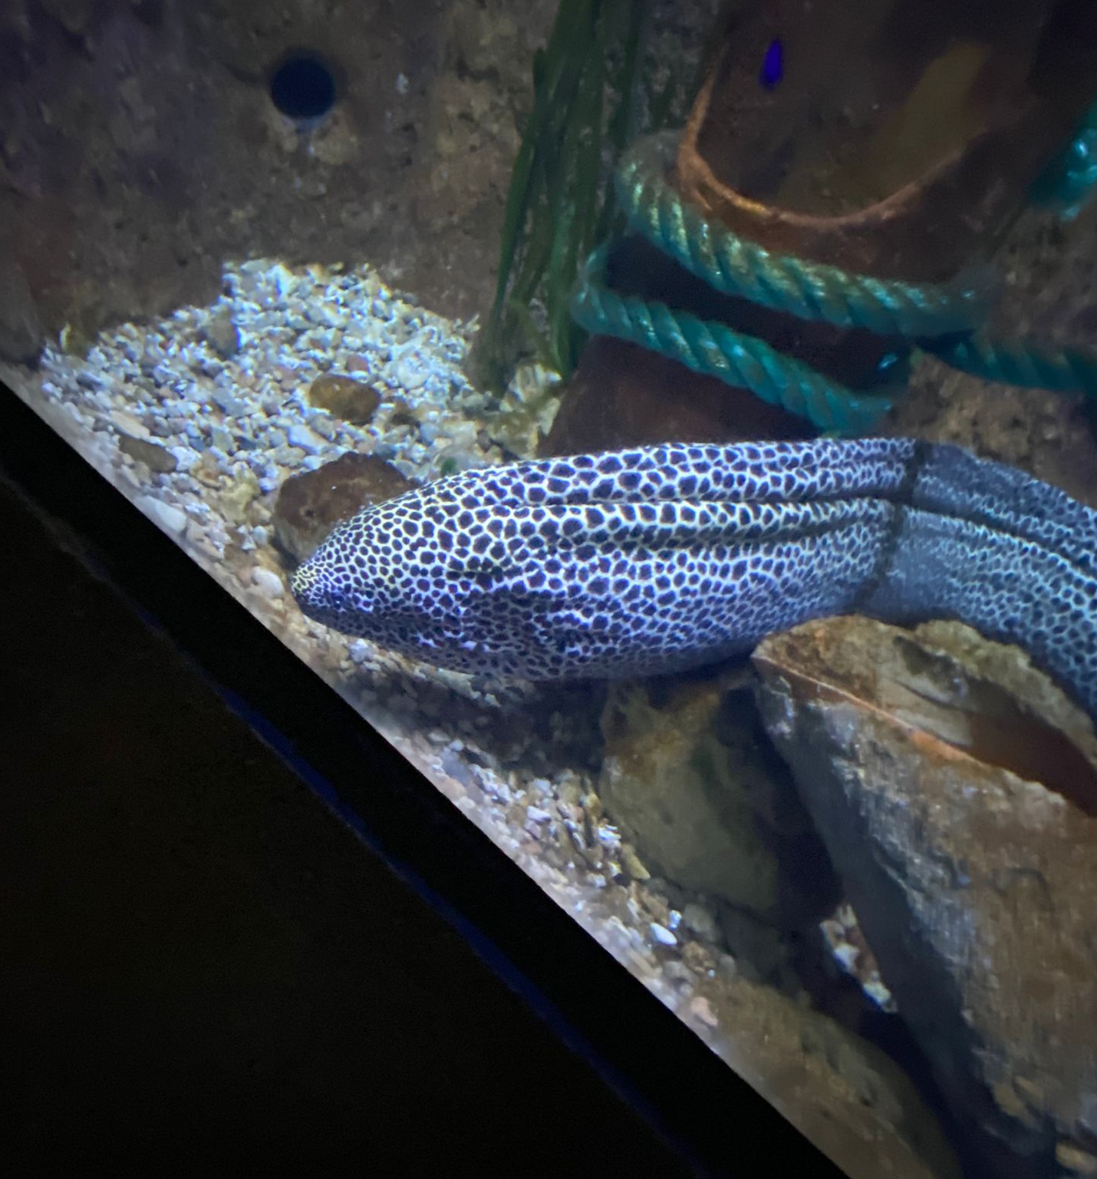
We saw a lot of fish

Slide 17
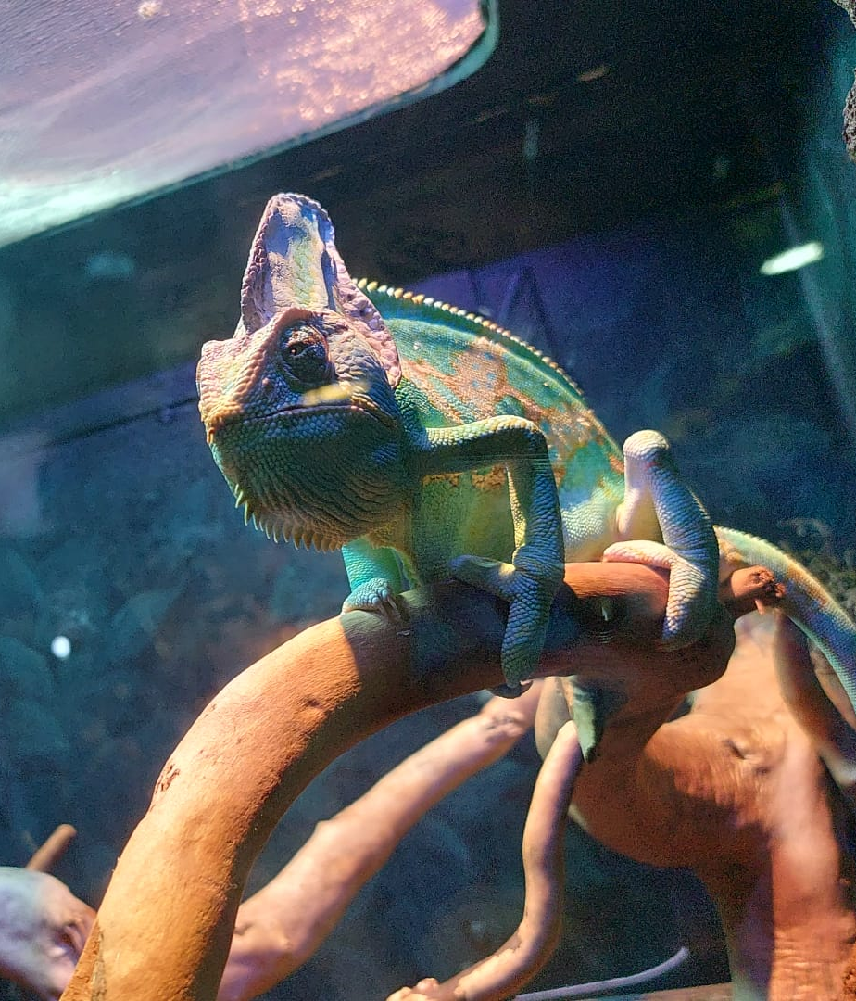
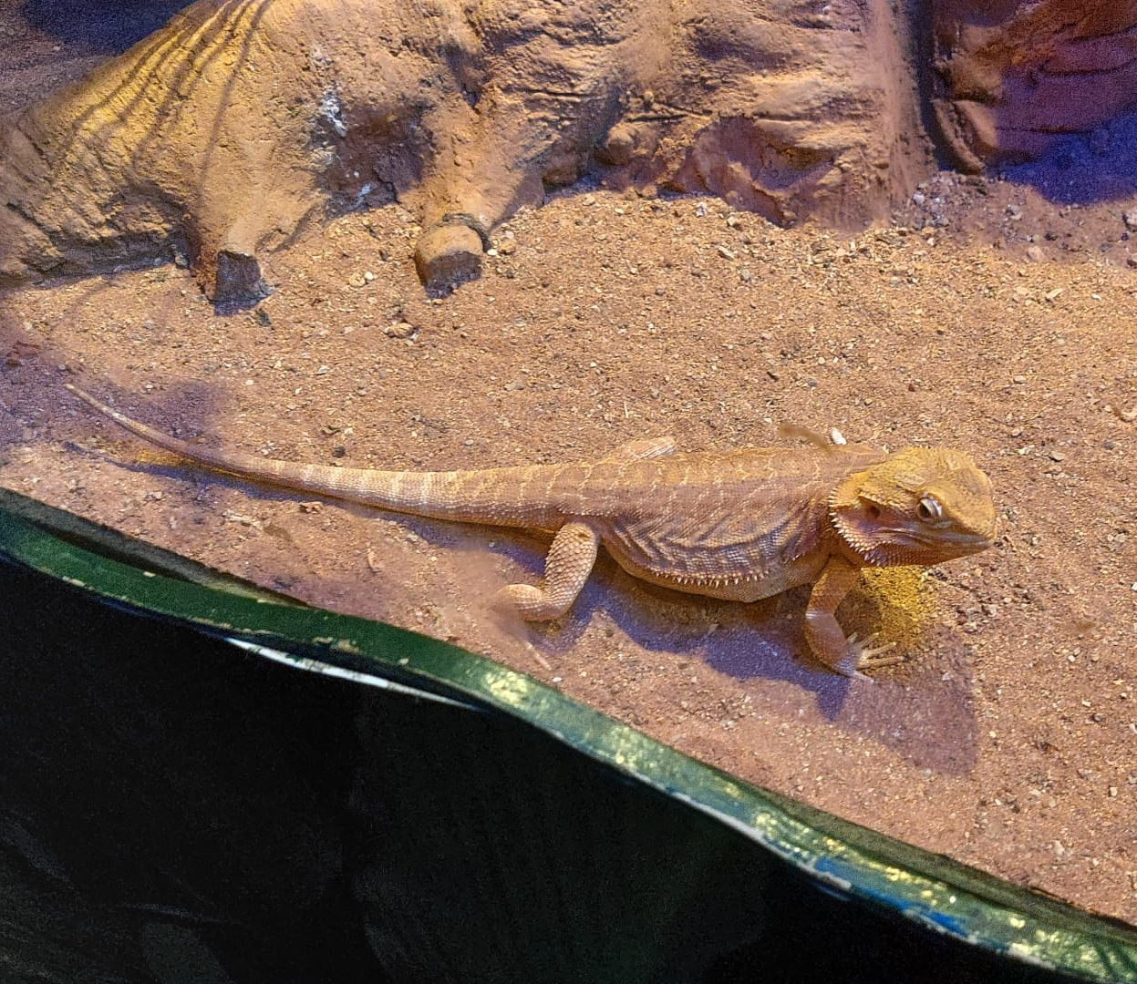
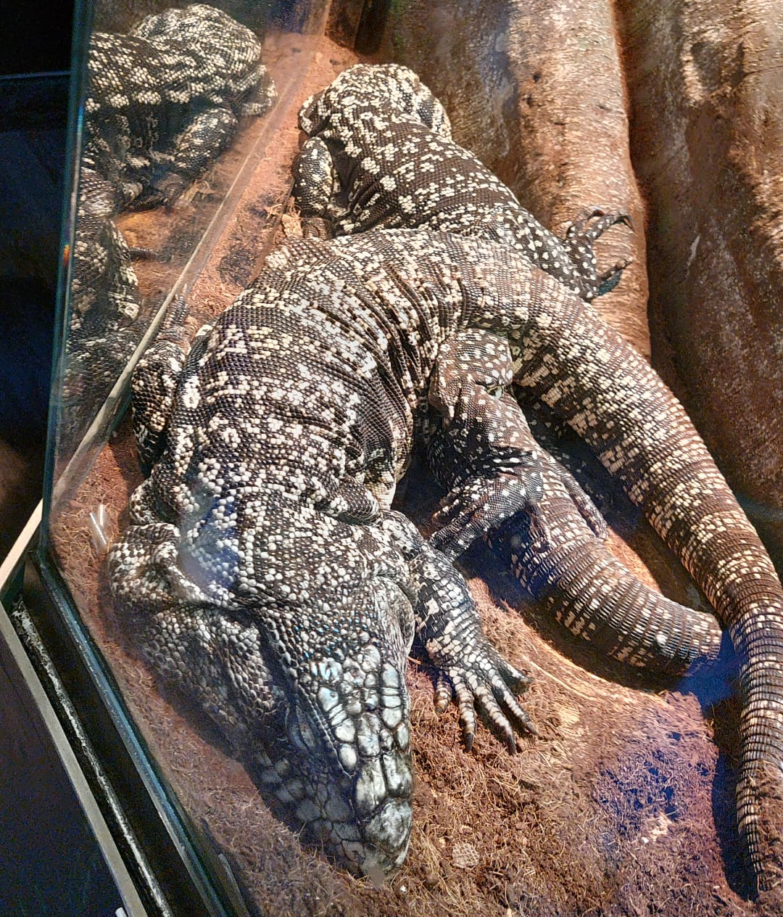
There are many species of reptiles

Slide 18
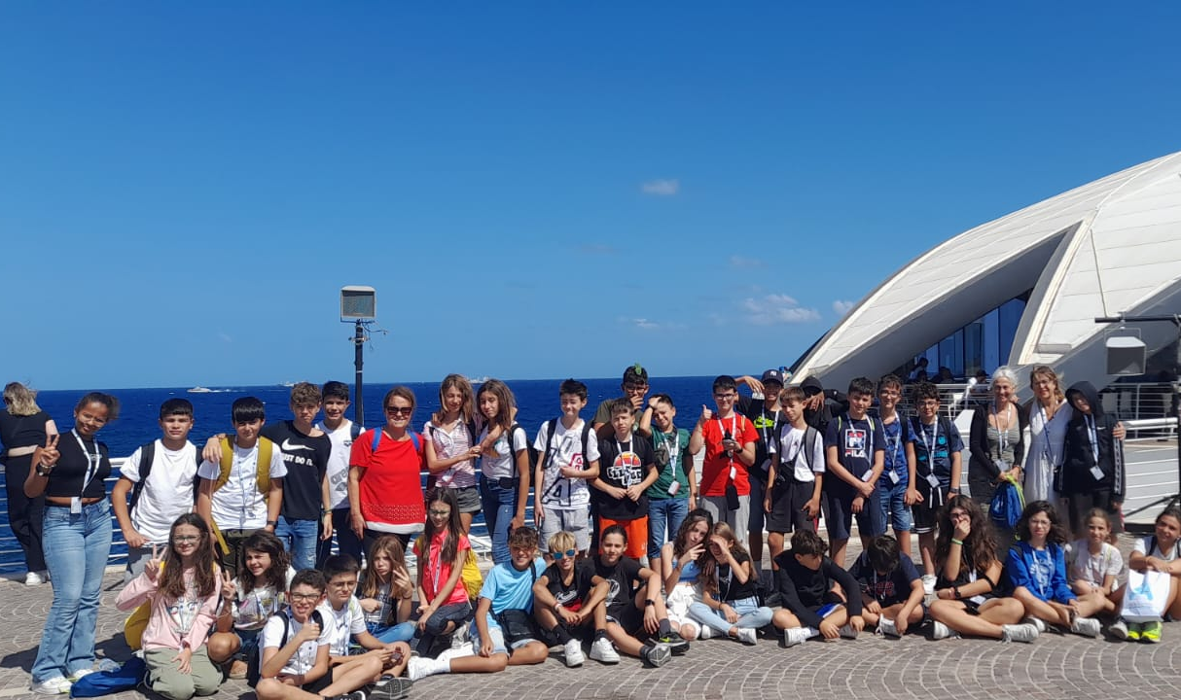

Slide 19
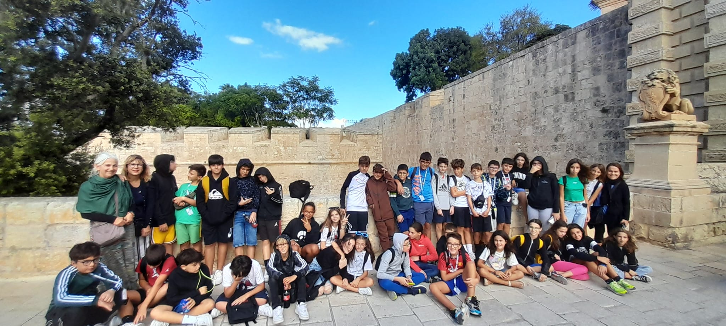
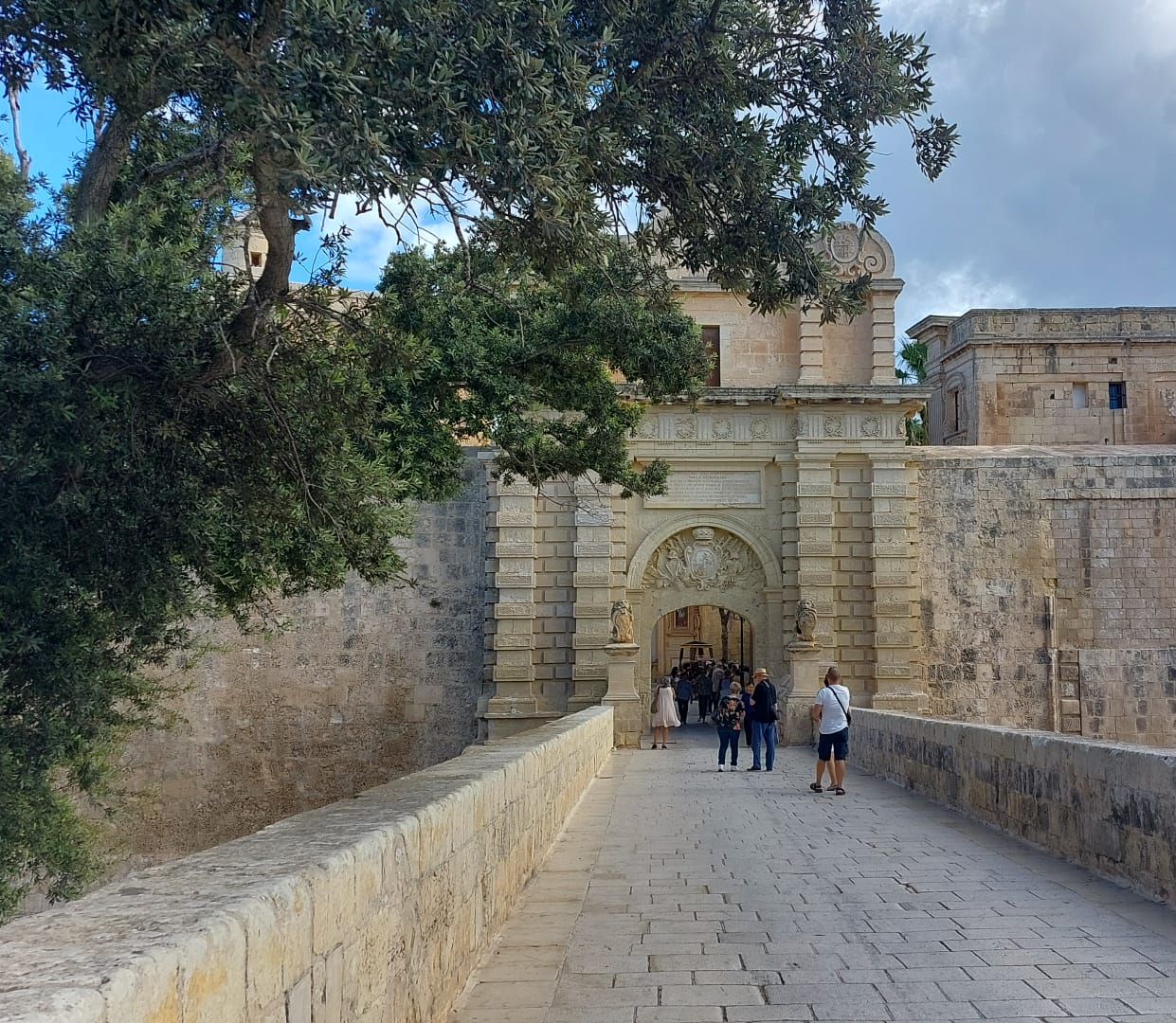
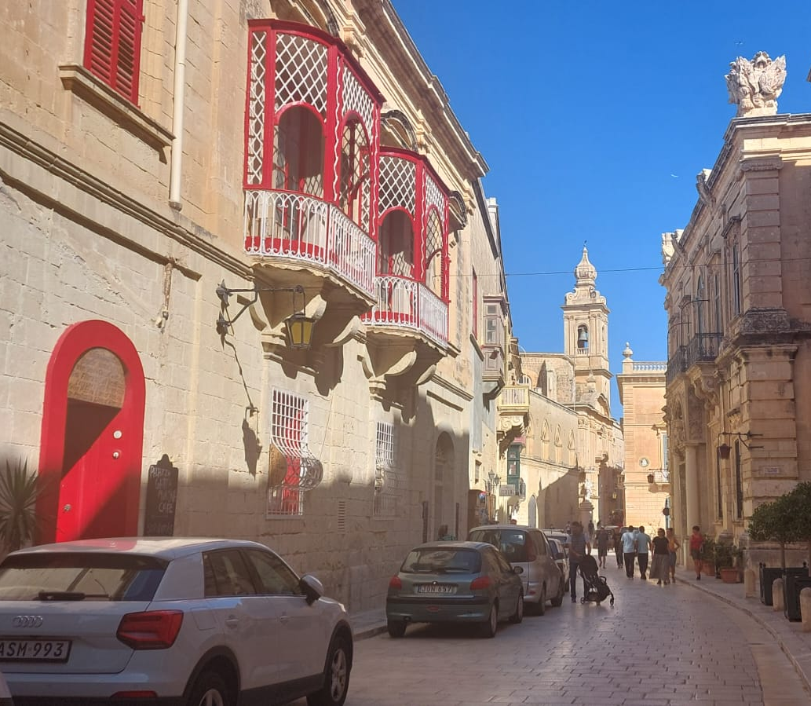
Rabat, the city of silence

Slide 20
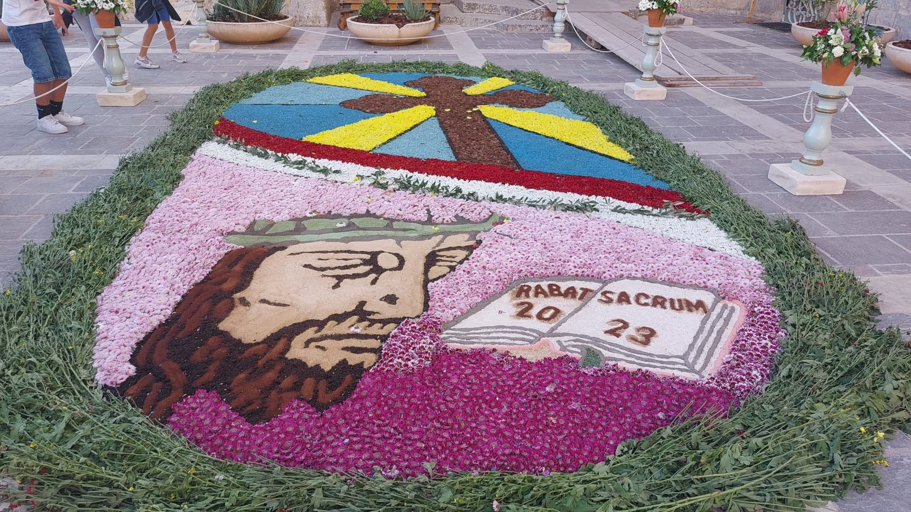
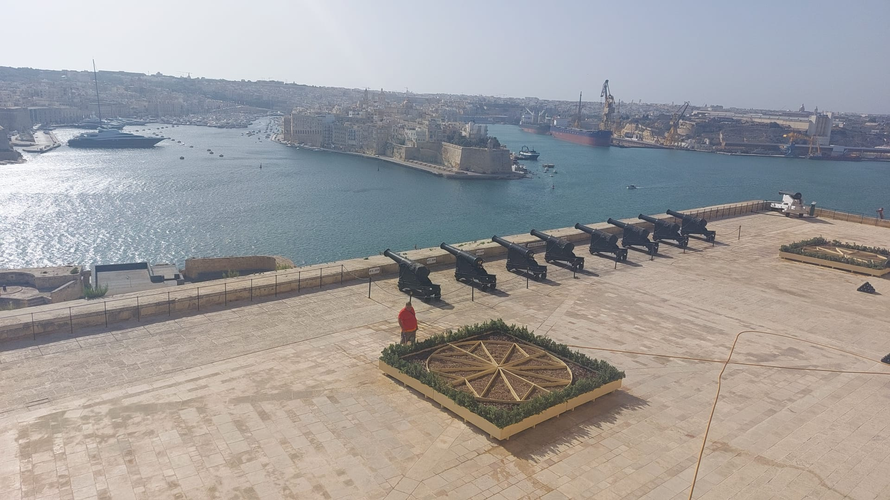

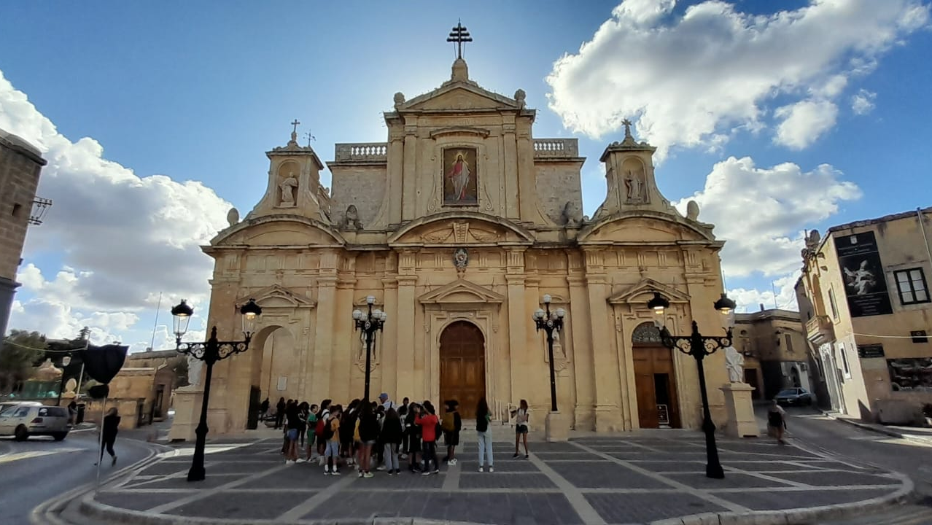
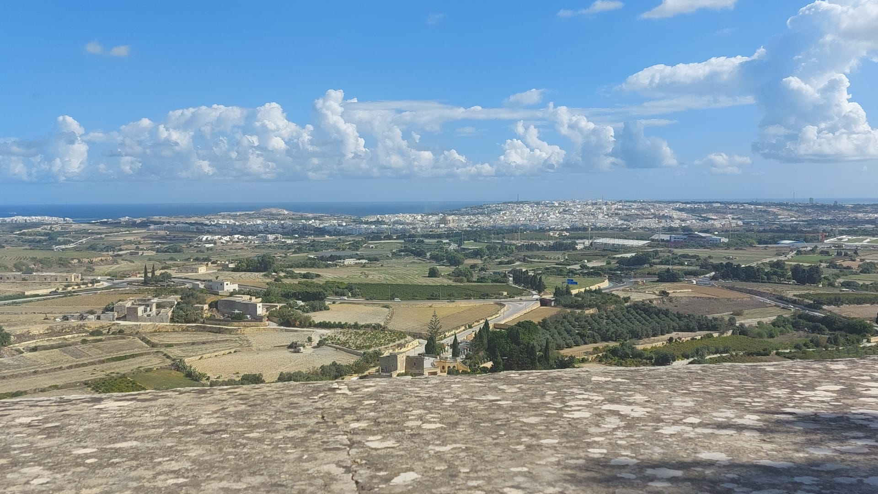


Slide 21
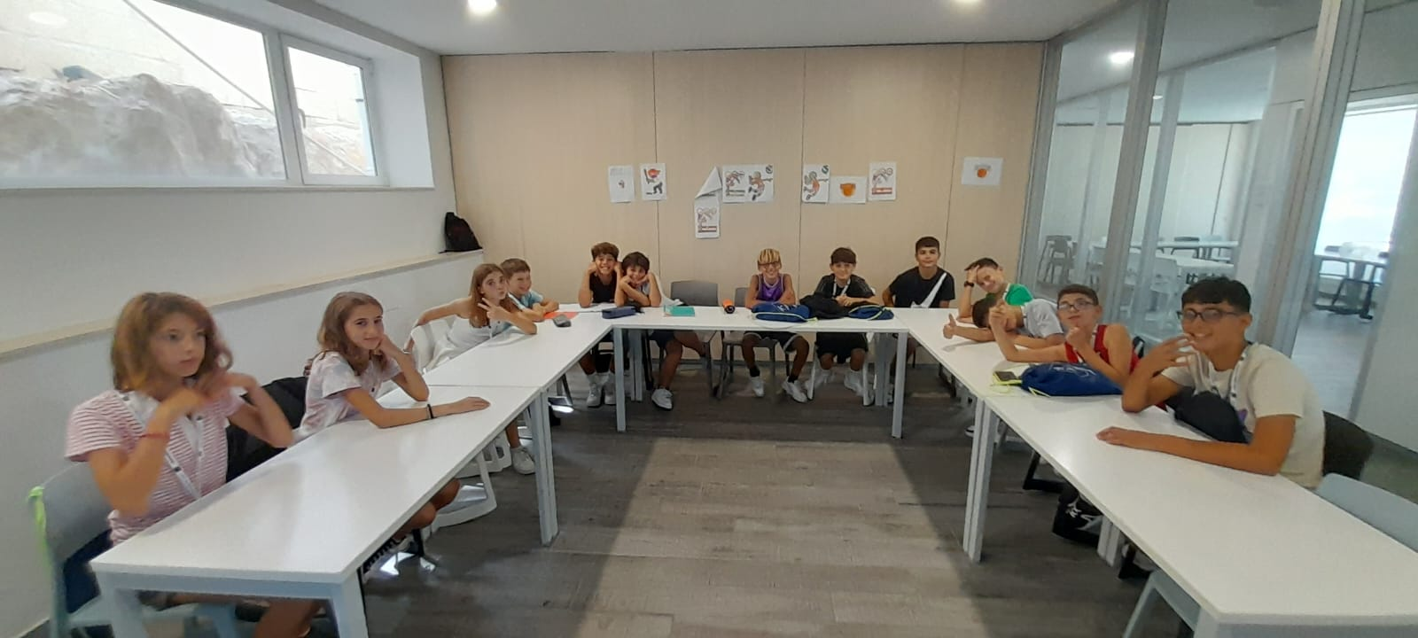
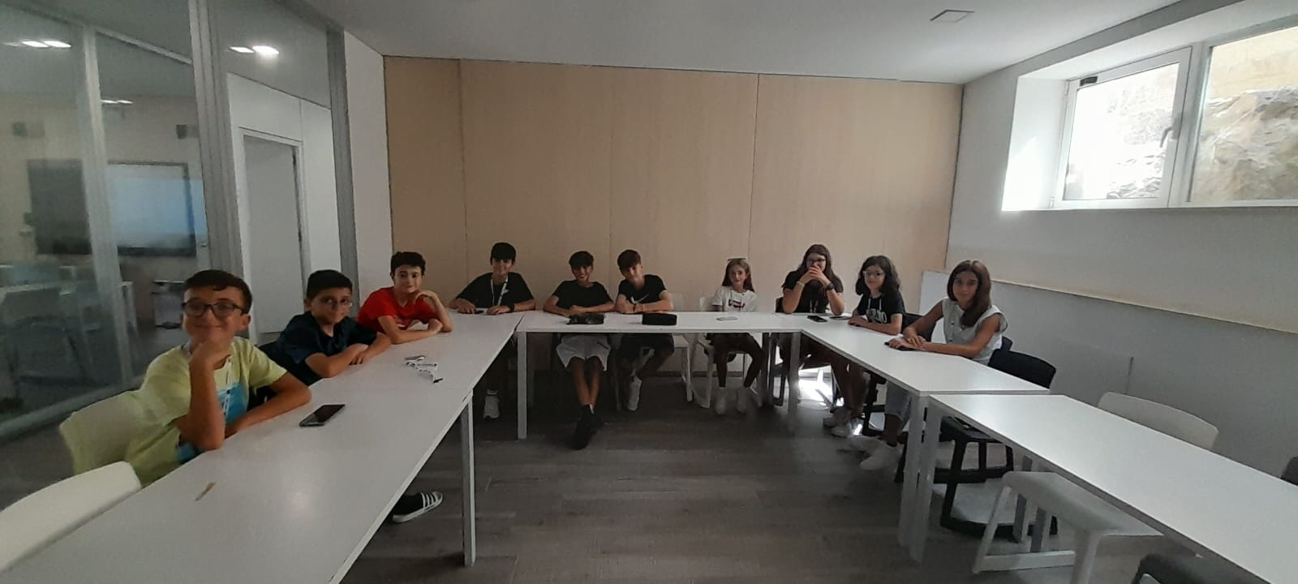
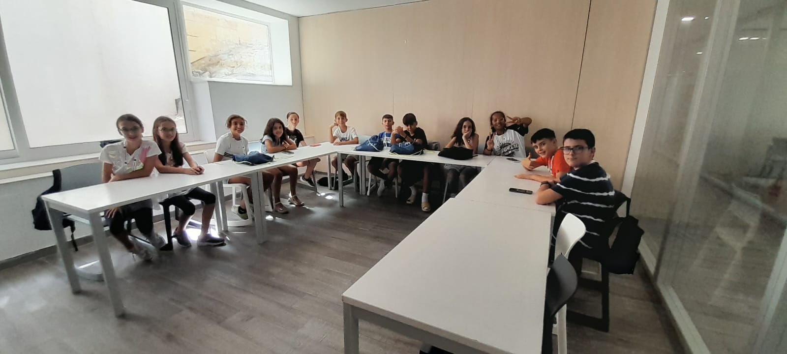
We were divided into three classes. Every morning we had class.

Slide 22
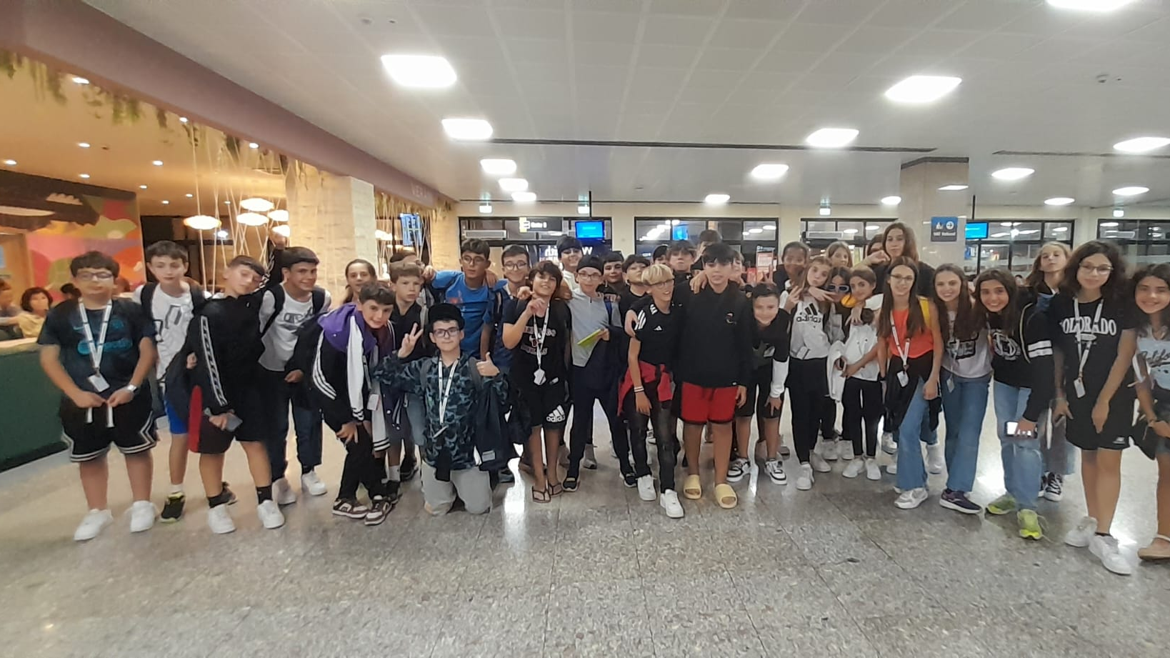
with much sadness, but satisfaction we return home

Slide 23

Thanks for everything. Malta
Progetto di : Eleonora Rau , Nicolò Rubattu , Lorenzo Carta e Daniele Ricciardi

