Slide 1

Our trip to Malta
Marco Carboni e Tommaso Nurra
2^F

Slide 2
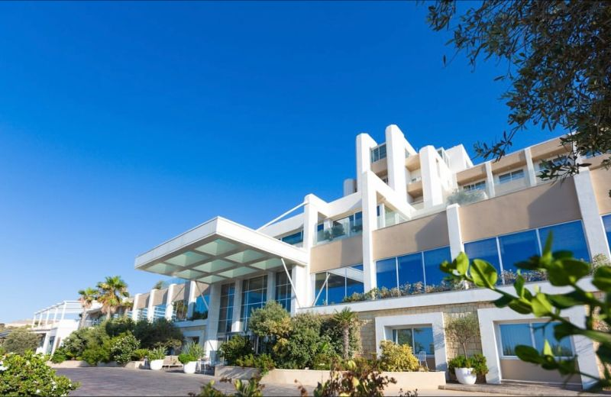
First day
On Tuesday night we arrived at Malta with a plane from Cagliari. As soon as we arrived we got to the Salini Resort, were we stayed for all the nights.

Slide 3
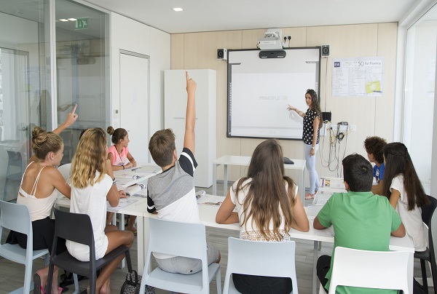
Second day
On Wednesday we got a bit of rest and then, in the afternoon, we went to the lesson. It lasted four hours and fifteen minutes with two recreations.

Slide 4
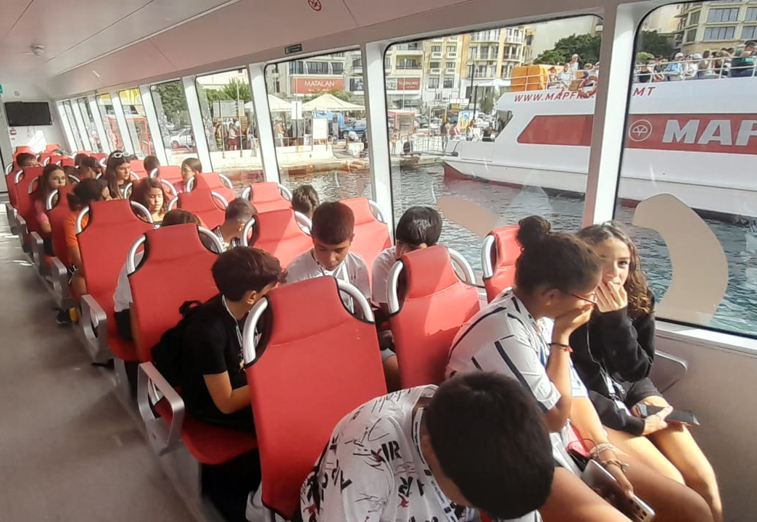
Third day
On Thursday we went on a boat trip, from 9:00 to 11:45, to visit the coasts of La Valletta, the capital of Malta. We also went in a mall where we had lunch and had a break until 13:45, when the bus got us back to the hotel , where we spent the rest of the day.

Slide 5
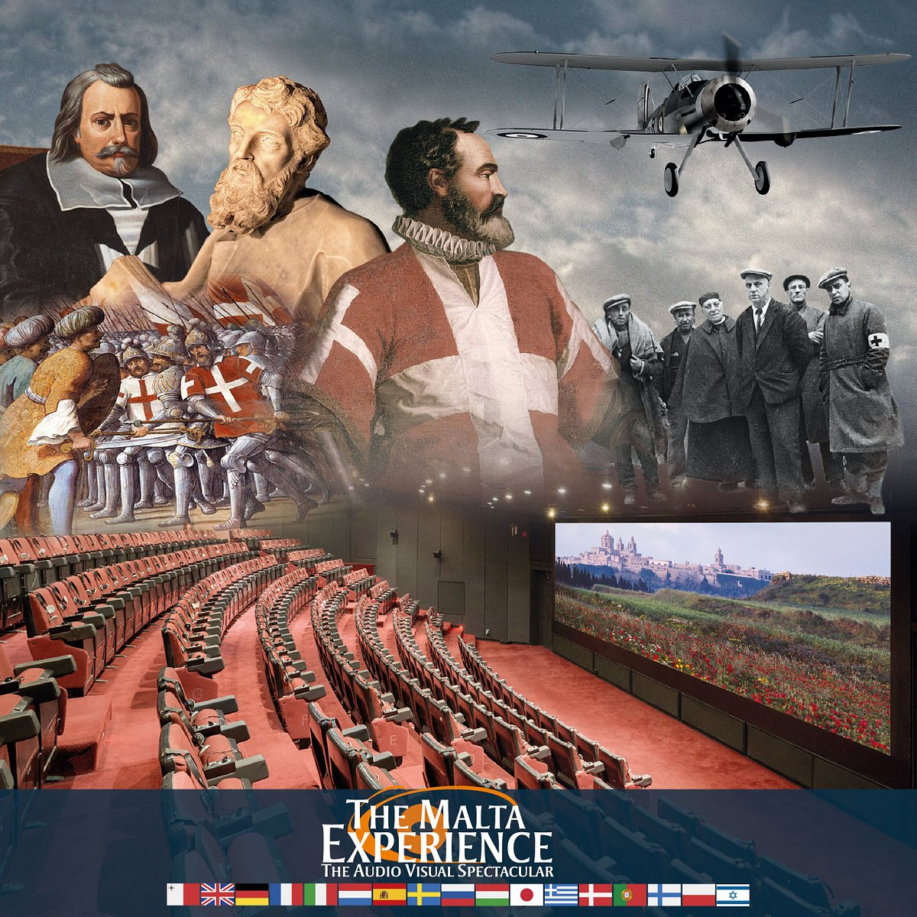
Fourth day
On Friday morning we went to the cinema to watch a mini-film about the origins of Malta and its conquers. It was colled «The Malta Experience». Then we had lunch and got back at the hotel to go to English lesson.

Slide 6
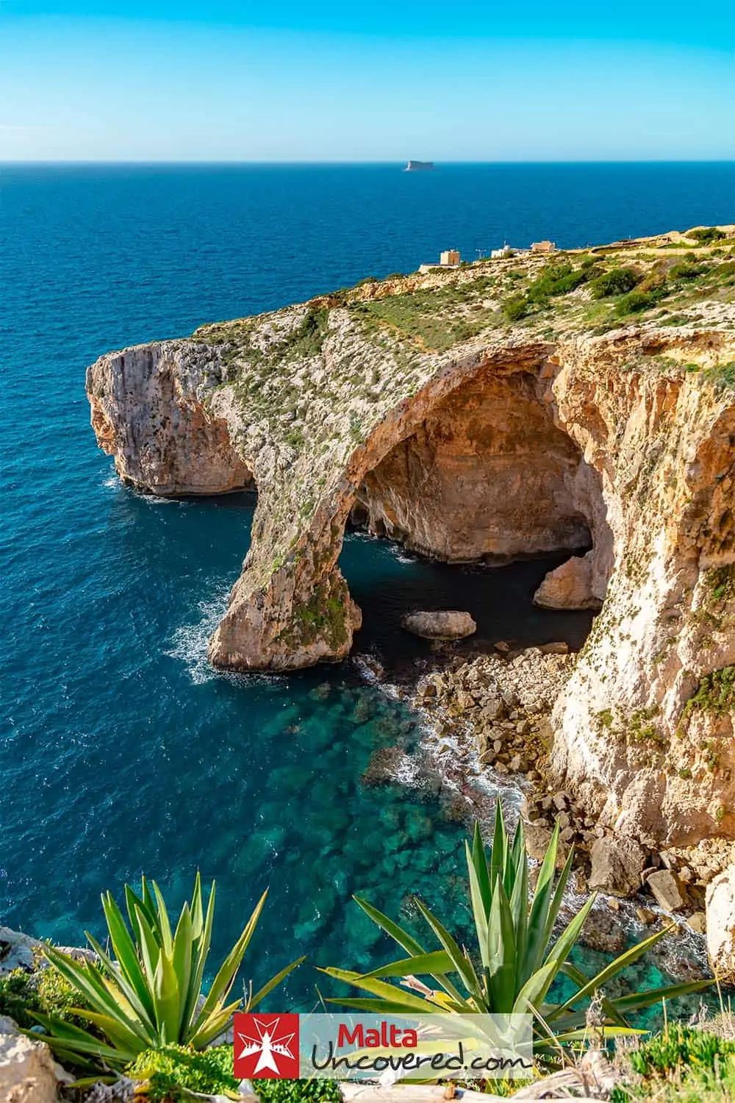
Fifth day
On Saturday at 9:00 we went to the Craft Village, there they explained to us the tecniques to make sculptures and various glass objects. After that we went shopping, and then we went to the famous Blue Lagoon Caves, even if the sea was not the best they were fantastic. That evening we went to the karaoke, and we had so much fun.

Slide 7
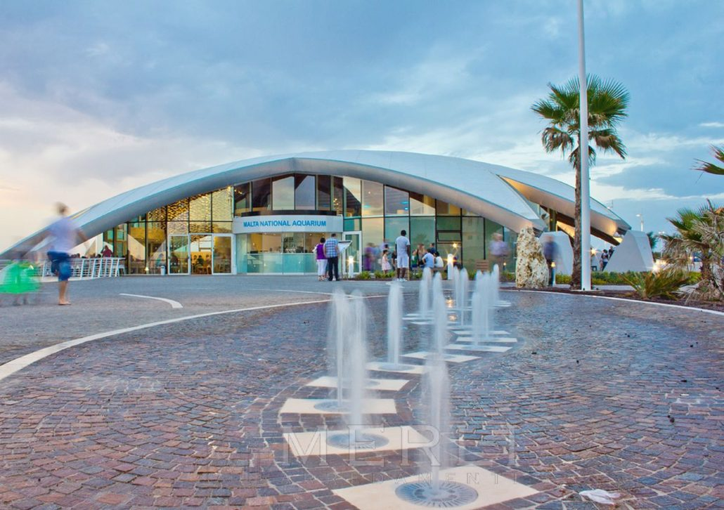
Sixth day
On Sunday we went to the acquarium and we saw every type of fish, then we had a walk in the city and we had lunch in a square. We got back at the hotel were we had free time and dinner. Than the bus took us to the bowling were we had great fun. Then we got at the hotel to sleep.

Slide 8
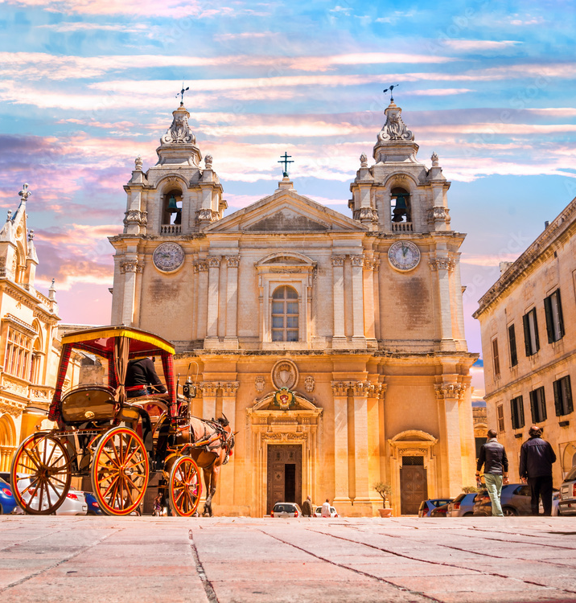
Seventh day
On Monday morning at 8:30 we went to Rabat with our guide and we saw Vilhena Palace and Cathedral Square, were we saw a bridge with a marvellous wiew. We also went to the Xara Palace and the Falson Palace. After that we came back at the hotel to go to lesson and then sleep.

Slide 9
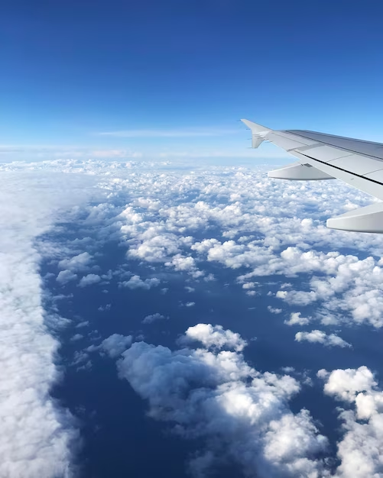
Eighth day
On Tuesday morning we got up, made our lugagge, had breakfast and then we did the checkout. We took a bus to the airport and then got the plane to go to Cagliari. Once there we took another bus to arrive at Sassari, it was late in the night.

Slide 10
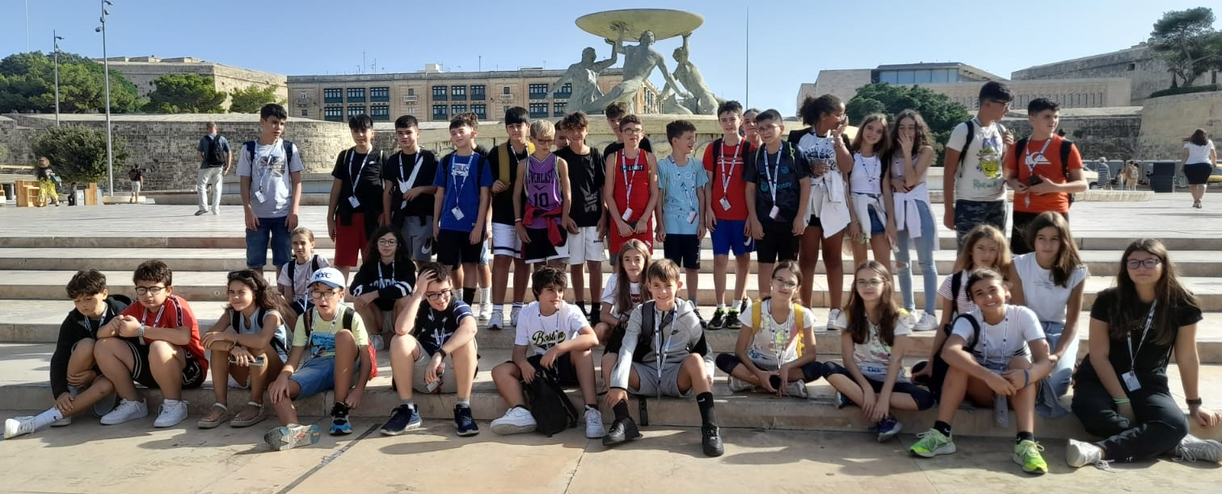
It was a fantastic experience, we got so much fun and we enjoyed it so much. We’re so happy that we had this opportunity.

